Slide 1
Global, Human,
and Ethical Impacts
Introduction to Engineering Design
© 2012 Project Lead The Way, Inc.

Slide 2
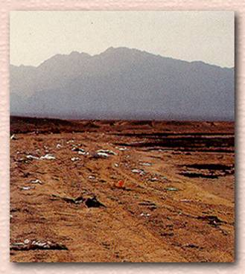
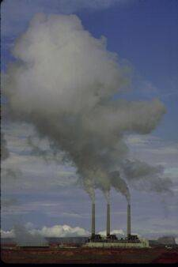
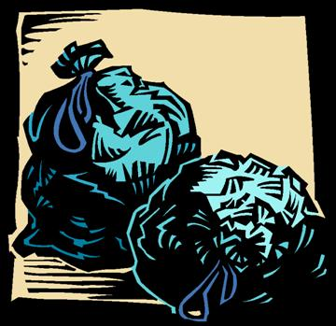
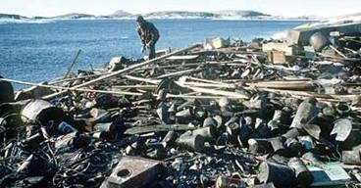
Global, Human, and Ethical Impacts
Notes:
Student Questions: 1) What do you see in each of the following pictures? Answer: Upper left is a land fill buried and leveled out. Center is a factory. Lower center is a barge that is full of waste. 2) What, if anything, can be done to prevent or limit some of this waste and pollution? Answer: Better recycling practices and alternative energy.

Slide 3
Impacts
Human
Throughout time, humanity has used natural resources, animals, plants, and inanimate materials for its survival, consumption, and enjoyment
It is often taken for granted that current resources will always be available
Many times short-term monetary gain is considered a priority
Notes:
Talk about change: How our society has grown over the years; the increase in wants and needs; results in more pollution, waste, etc.

Slide 4
Impacts
Global
Population:
  - Growing at an exponential rate
  - Shows a continual change in human needs and wants
Energy: Non-renewable resources are becoming more and more scarce

Slide 5
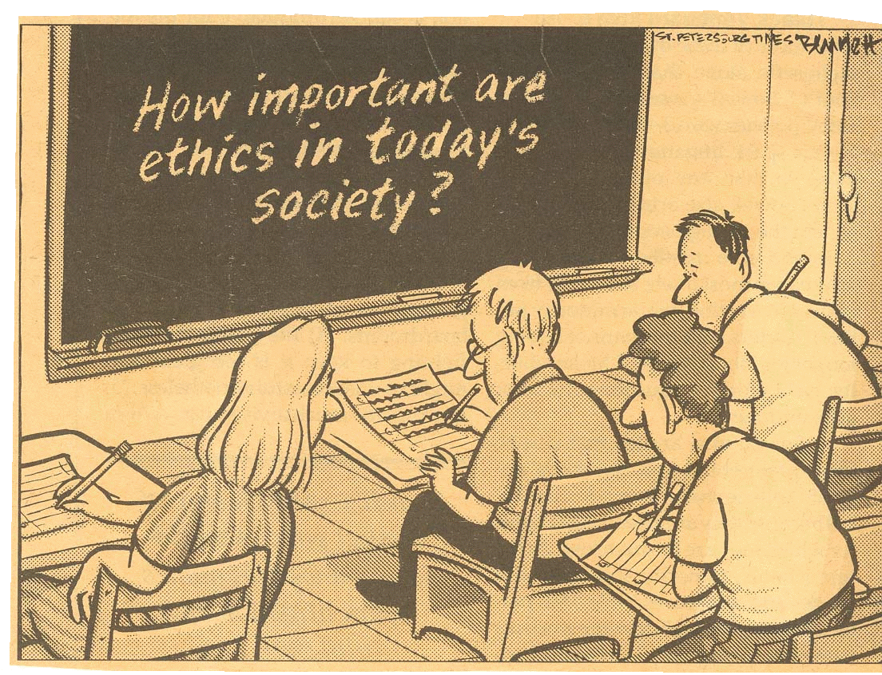
Ethics
A set of moral principles or values; a theory or system of moral values
The discipline dealing with what is good and bad and with moral duty and obligation
Notes:
Teacher: Ask the question on the chalk board. Have students answer with yes or no and defend their answers.

Slide 6
Ethical Design Dilemmas
Situations in which decisions you make are in conflict with what may or may not be morally correct
Sometimes this is obvious right away, and other times it is not
Solutions to open-ended design problems provide dilemmas that designers face when creating the product
Let’s look at some pictures of products and discuss the ethics involved

Slide 7

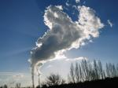

Inventions
What are the ethical consequences suggested in these pictures?
Notes:
Dialogue with the students concerning some possible dilemmas in the following slides. Mention the global and human impacts these have made. How is the sun affecting our decisions? Etc.

Slide 8
Steps in Resolving Ethical Design Decisions
Moral Clarity - Identify the relevant moral values
Conceptual Clarity - Clarify key concepts
Just the Facts - Obtain all relevant information
Informed about Options - Consider all genuine options and alternative solutions
Well-Reasoned - Make a reasonable decision

Slide 9
Design Analogy
Engineering design as a metaphor or model for thinking about moral decision making in general, not just within engineering
Like design, moral choice often involves alternative permissible solutions to dilemmas

Slide 10
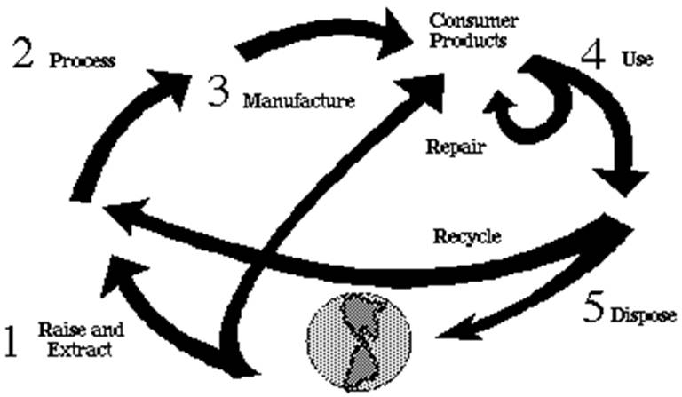
Product Lifecycle
Definition
Five Steps
Notes:
Definition: The total process of creating, using, and disposing of consumer products made from the earth's resources.

Slide 11
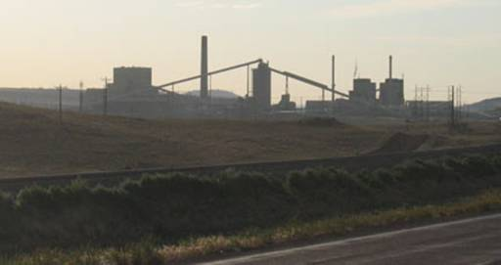
Raise and Extract
All consumer products begin their lifecycle with
a dependence on the natural environment
Some form of energy is always required to extract the natural resources from the earth or its atmosphere
Notes:
Use examples: Coal, wood, etc.

Slide 12
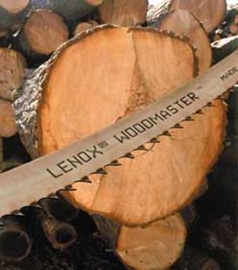
Process
Raw materials are processed or refined
Energy is required for the processing and refining

Slide 13
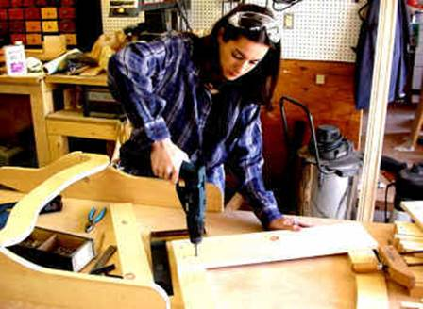
Manufacture
Additional energy is required as the processed or refined materials move through the manufacturing and assembly process
Notes:
All products have different manufacturing processes.

Slide 14

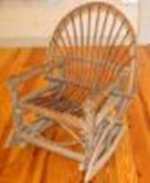
Use
Consumer products are transported to stores (consuming additional energy) and are ready for purchase
Products remain at this stage as long as they are usable or repairable
Notes:
Mention to students examples of products that have long useable rates and some with short useable rates.
Appliances have long useable rates when compared to a disposable razor, etc.

Slide 15



Dispose
When the product is no longer of use to us, we “get rid” of it
Notes:
It is important to reinforce to students that environmental impact is considered when choosing materials for products design.
A possible discussion topic: What is the impact of computers and electronics on landfills due to their short life cycle. What can be done to recycle these items?

Slide 16

EPA Guidelines
EPA: Environmental Protection Agency. This organization’s mission is to protect human health and the environment

Slide 17

EPA Guidelines
The EPA works to develop and enforce regulations that implement environmental laws enacted by Congress

Slide 18
EPA Guidelines
The EPA is responsible for researching and setting national standards for a variety of environmental programs
The EPA delegates to states and tribes the responsibility for issuing permits and monitoring and enforcing compliance

Slide 19
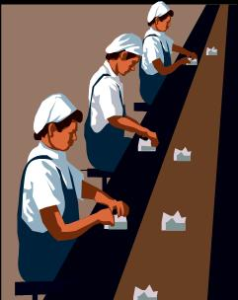
OSHA Guidelines
OSHA (Occupational Safety and Health Administration)
OSHA's mission is to assure the safety and health of America's workers by setting and enforcing standards; providing training, outreach, and education; establishing partnerships; and encouraging continual improvement in workplace safety and health

Slide 20

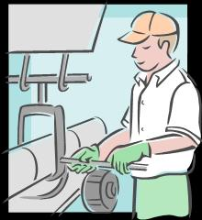
OSHA Guidelines
To establish and maintain safe workplace environments, OSHA enforces standards and reaches out to employers and employees through technical assistance and consultation programs

Slide 21
Recycle

Slide 22
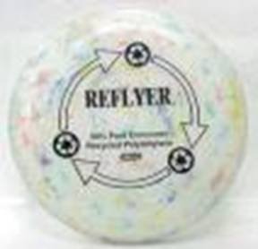


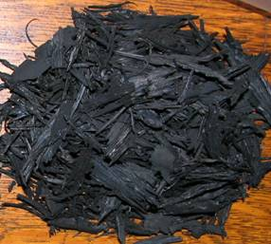
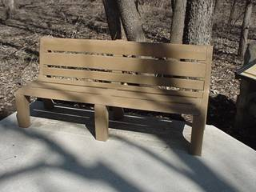
Products Made from Recycled Material
Notes:
Products made from recycled material include Frisbee from plastic benches, walkways from composites, and even the newspaper that we read daily.

Slide 23
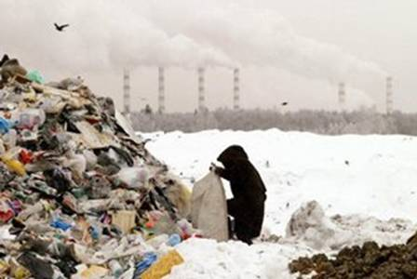



Why Recycle?
Notes:
Landfills are filling at an alarming rate. The raw material for some products is becoming scarce. Decomposition requires a long time, etc. Heath issues arriving in and around waste sites are becoming more common. Help keep our earth clean for us and those after us.

Slide 24
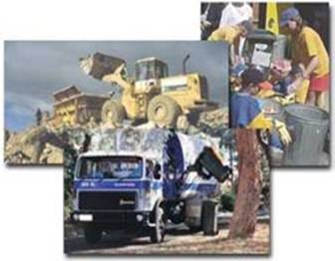
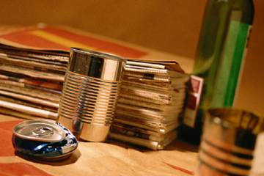
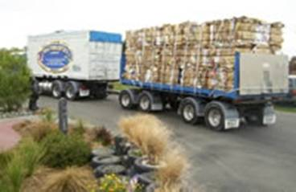
The Process
Products to be recycled
Consumer’s role
Collector’s role
Remanufacturing process
Finished product
Notes:
Usually products have signs on them indicating whether they can be recycled. If not, you can call your local recycling plant for verification.
Mention to students how important consumers are in the recycling process.
The process is dependent on the material. Discuss newspaper recycling. The collectors of these products have to collect and sell it to a paper dealer. The paper dealer then sells to the user. This is where the actual recycling (manufacturing one product into a new product) takes place. The user, usually a paper mill, separates the ink from the newspaper fibers through a chemical washing process. A slusher turns the material into pulp which is strengthened by wood chip pulp and then fed through steam heated rollers to flatten for use as paper again.

Slide 25
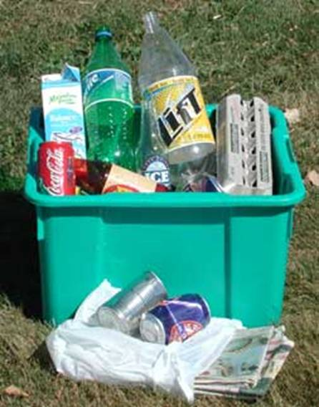





The Key to Recycling is the Consumer!
Notes:
Without the help of people like you and me, the process of recycling would not occur.

Slide 26
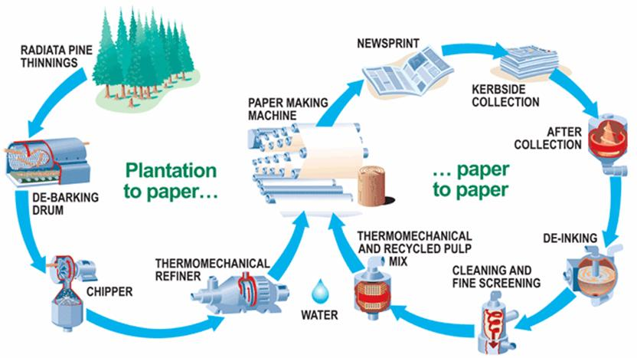
Plantation to Paper & Paper to Paper
http://www.pneb.com.au/recycling.html
Notes:
http://www.pneb.com.au/recycling.html
The Publishers National Environment Bureau (PNEB) is the association of Australia's leading newspaper and magazine publishers, working since 1990 to promote the sustainable recovery of old newspapers and magazines.

Slide 27

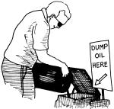
Non-Recyclable Items
What can we do?
How do we dispose of them properly?
Notes:
Topic for discussion:
What can we do with items that are not easily recycled? What can we do with old tires, for example? Some companies are grinding up tires to use in roads. Some non-recyclable types of plastics are being ground and used to make composite materials. (sometimes used to make park benches). How about used cooking oil as an automobile fuel?

