Slide 1
Activity 4.2.8a Satellite Flight
Satellite Robot Construction Guide
Aerospace Engineering
© 2011 Project Lead The Way, Inc.

Slide 2
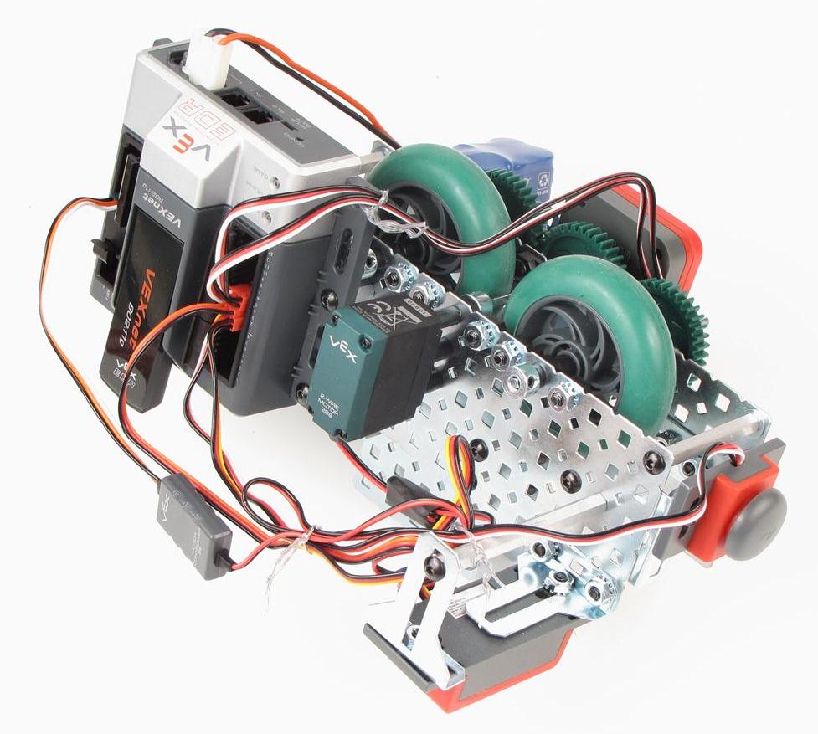
Equipment
AE VEX Kit

Slide 3
Step 1: Construct Side Plates
1 in. Standoffs x 3
Bearing Plate x3
Front Side Plate #1
Back Side Plate #1
Front Side Plate #2
Back Side Plate #2
1/2 in. Standoffs x 2

Slide 4
Step 2: Attach Side Plates
2 in. Standoffs x 2
More washers may need to be added later if vehicle drags
Plate #1
Plate #2

Slide 5
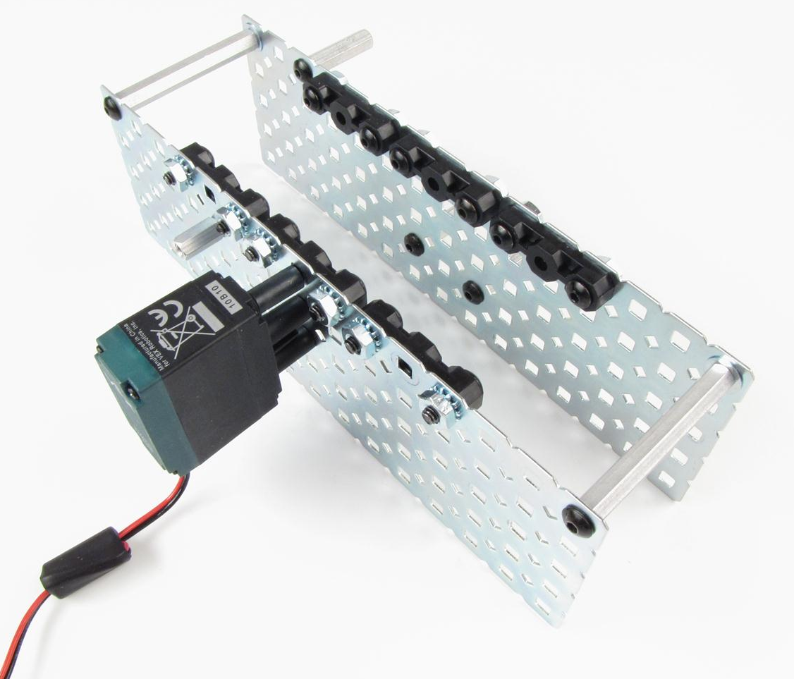
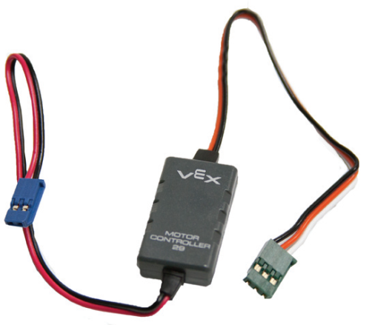
Step 3: Install Motor and Speed Controller
269 Motor

Slide 6
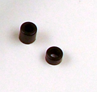
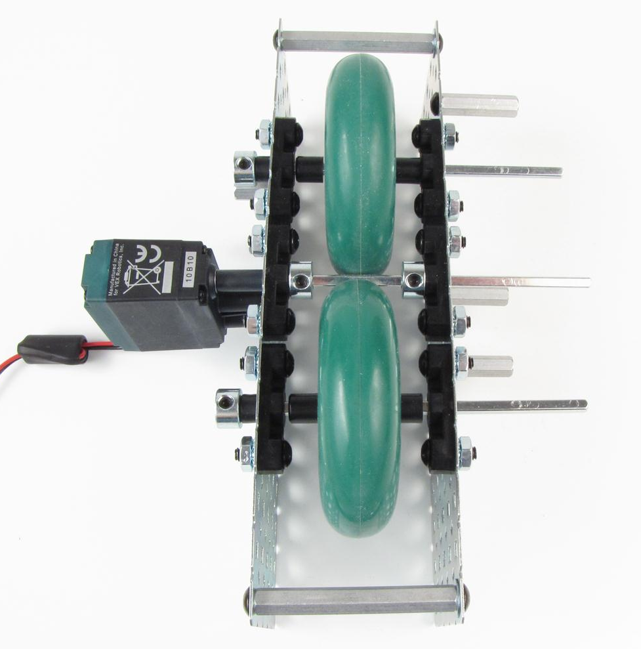
Step 4: Install Wheels and Motor Shaft
x4
x2
Small gap
Small gap
4 in. shafts x3

Slide 7
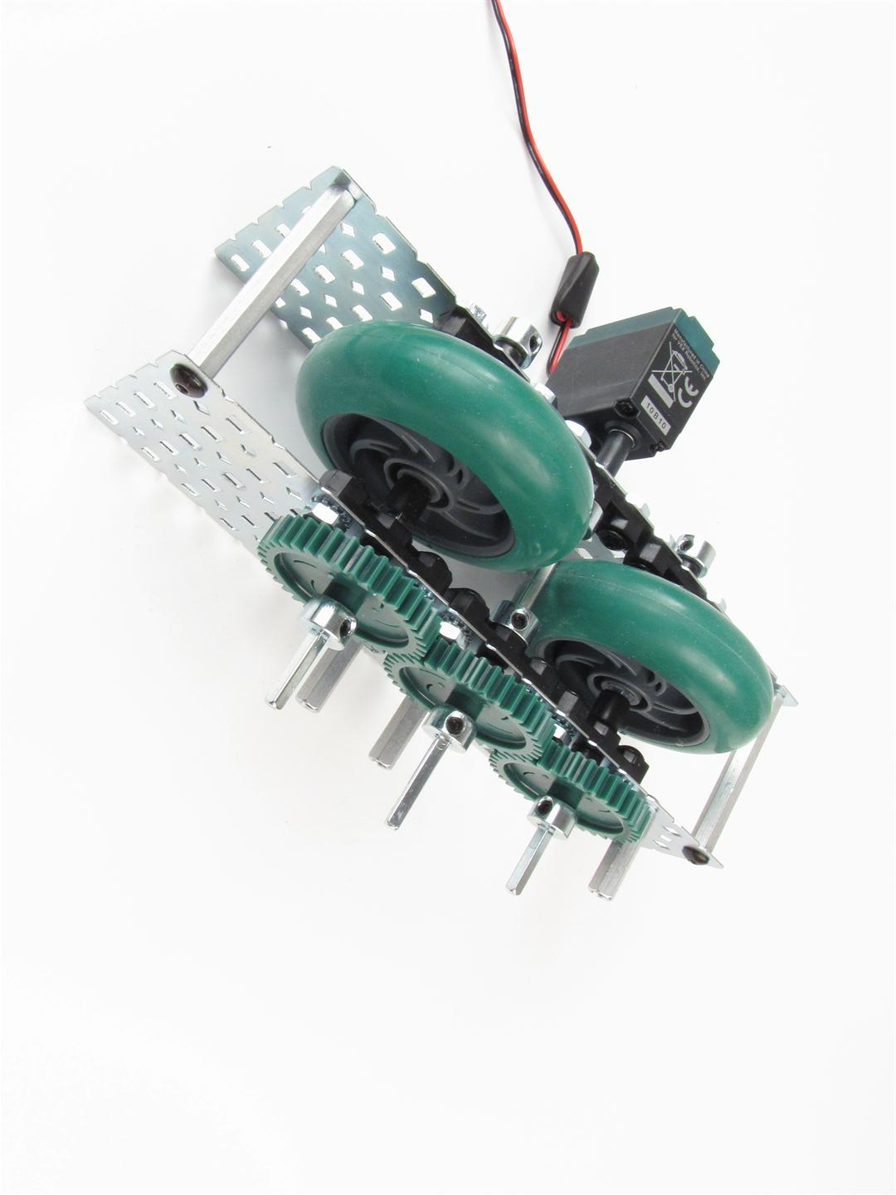
Step 5: Install Gears
x3
Small gap x3
32 tooth gears x3

Slide 8
Step 6: Build Two Guide Plates
½ in. Spacers x 6
Two sides of two identical plates shown

Slide 9
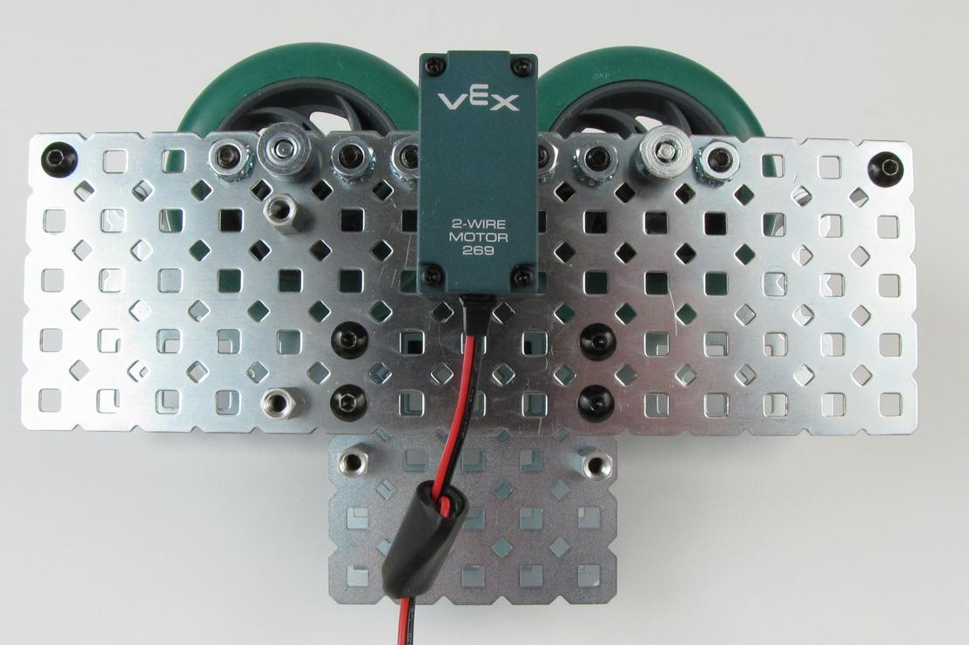
Step 7a: Install Guide Plate on Side #1

Slide 10
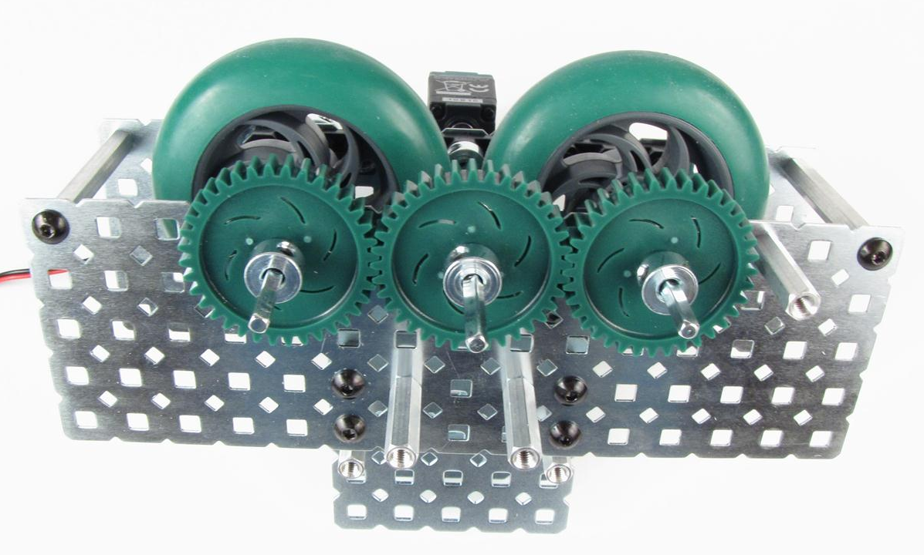
Step 7b: Install Guide Plate on Side #2

Slide 11
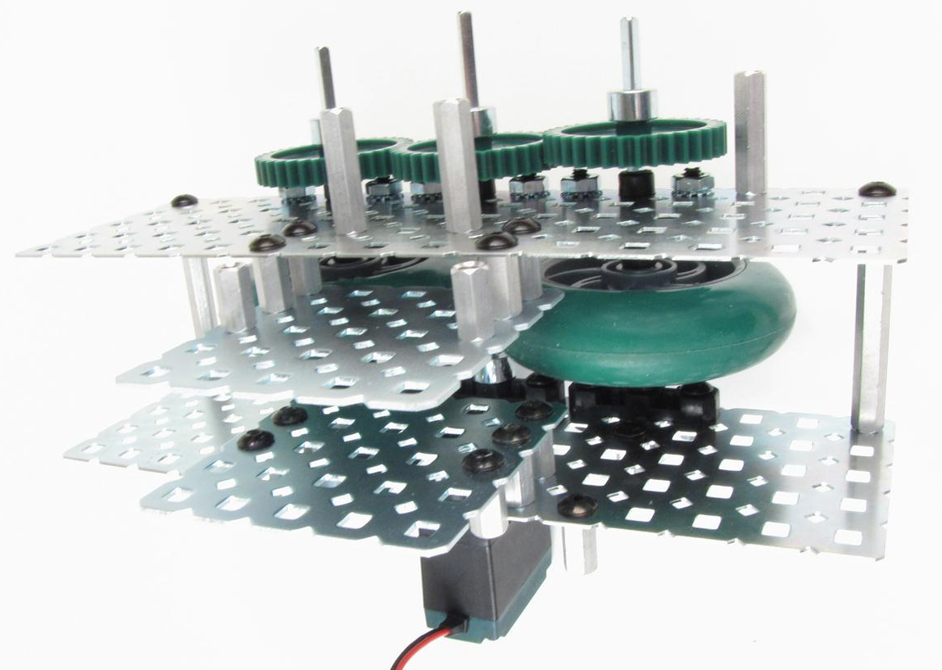
Step 7c: Confirm Guide Plates Installed Correctly
Guide Plate #2
Guide Plate #1

Slide 12
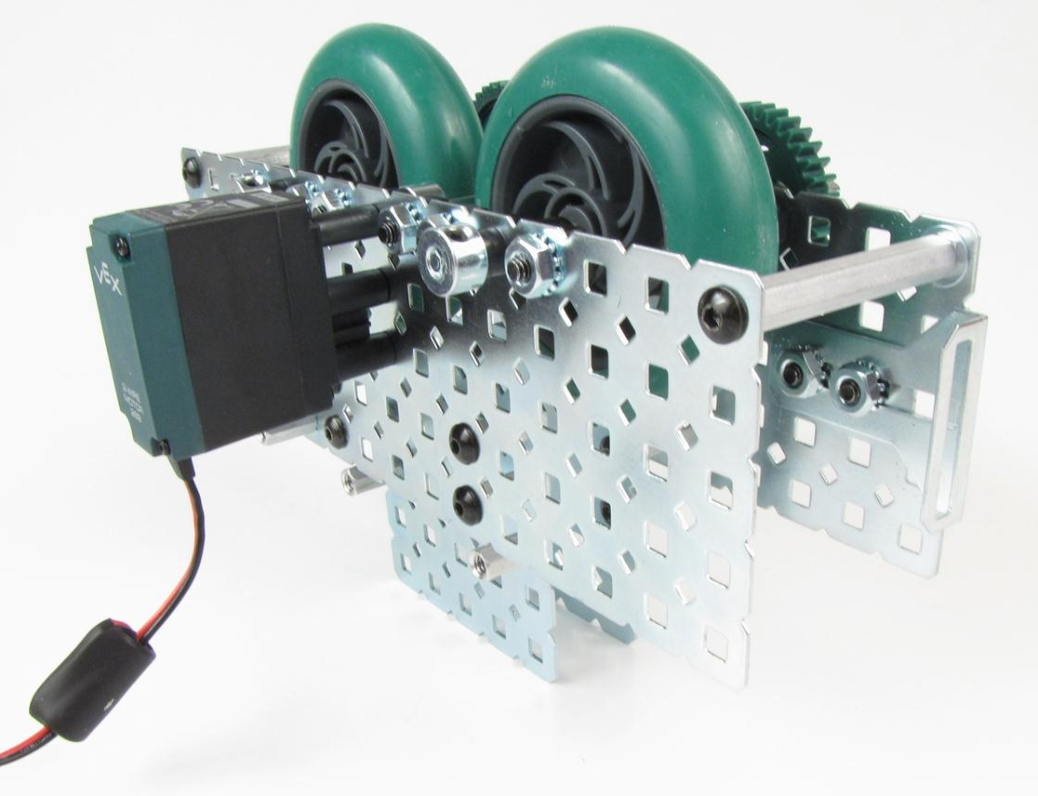
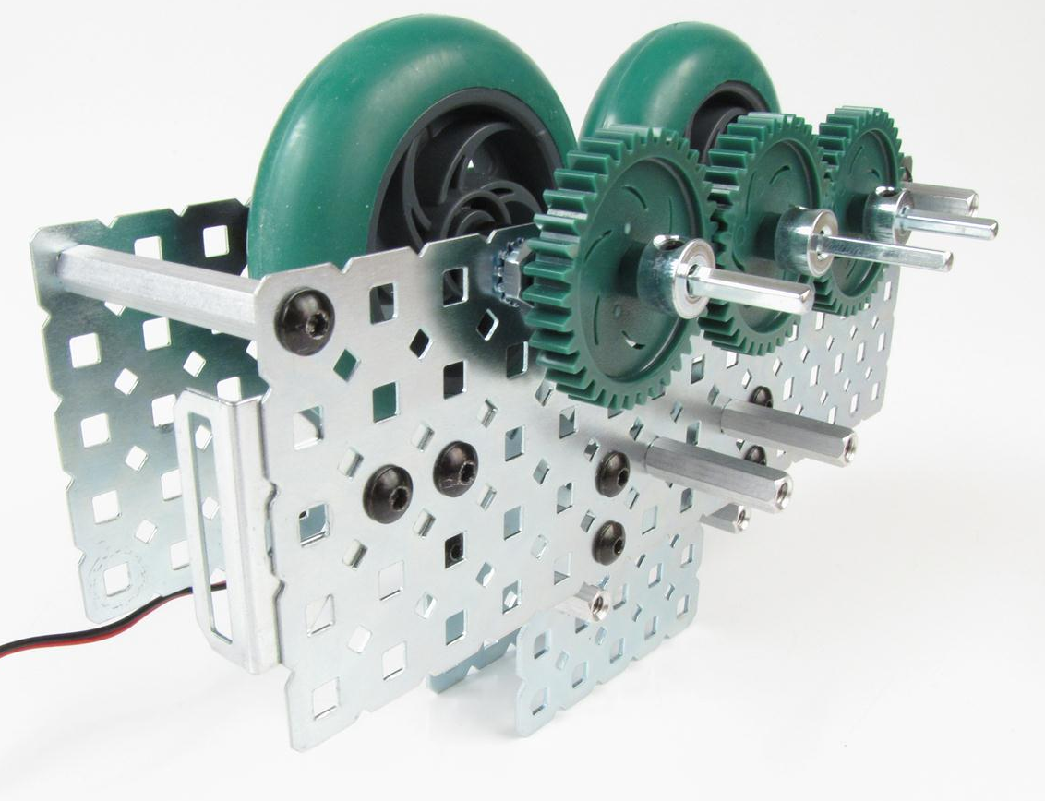
Step 8a: Install Bump Switch Bracket on Plate #1

Slide 13
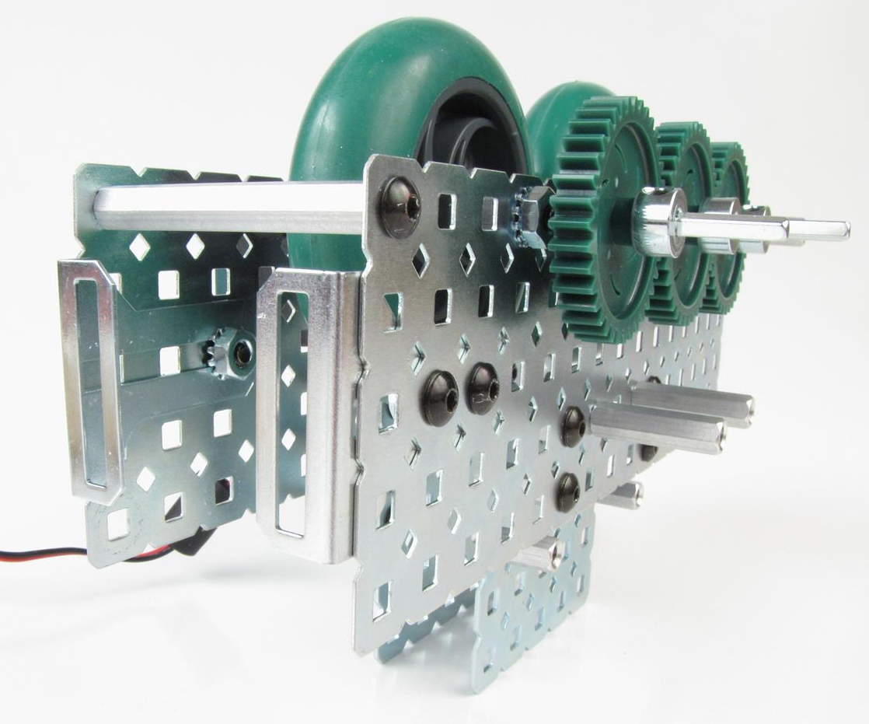
Step 8b: Install Bump Switch Bracket on Plate #2
1 screw

Slide 14
Step 9: Install Sonar Support
3 in.
standoff
x2

Slide 15
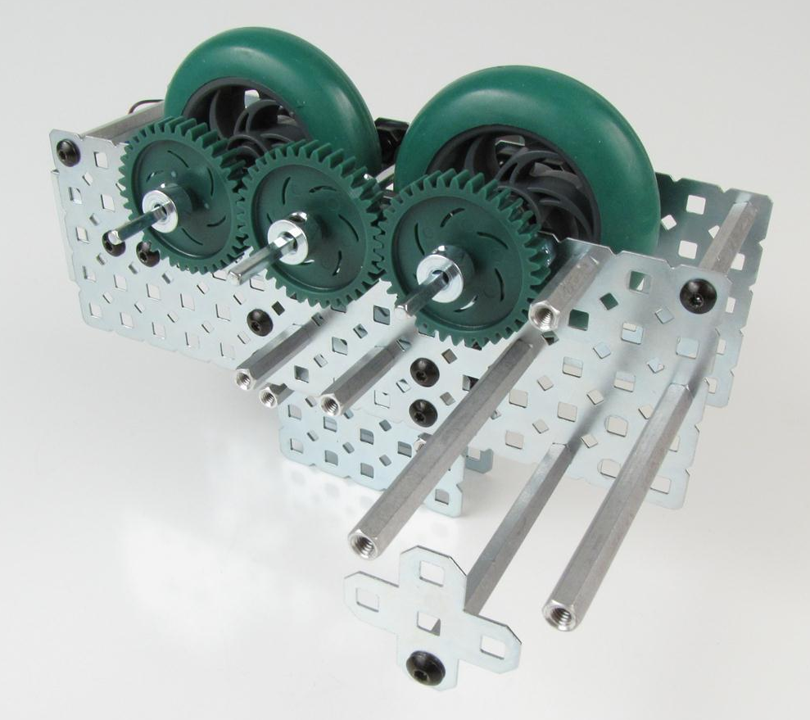
Step 10: Install Battery Holder
3 in. standoffs x 3

Slide 16
Step 11: Install Bump Switch
Align top side plates

Slide 17
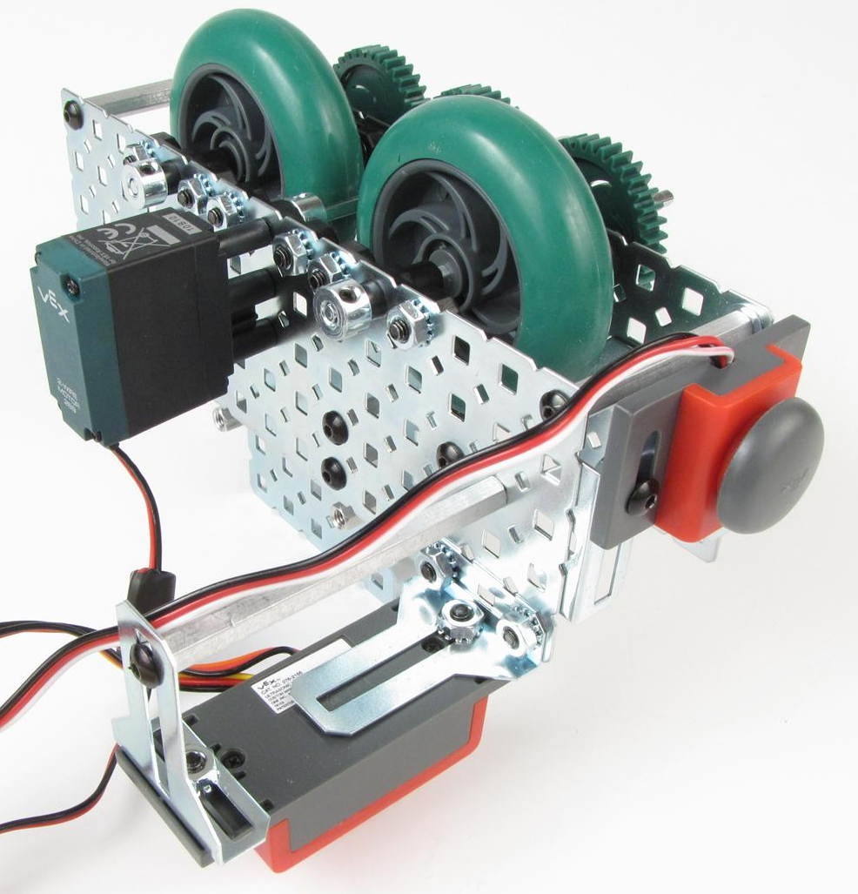
Step 12: Install Sonar
Sonar

Slide 18
Step 13: Install Wheel Encoder
Encoder (top wire)
Encoder (bottom wire)

Slide 19
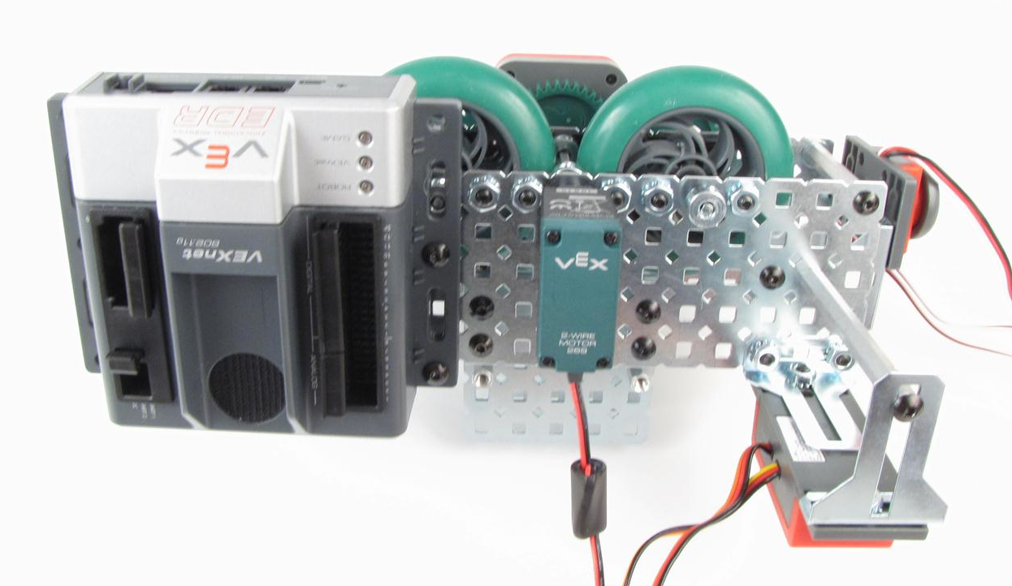
Step 14: Install Cortex
Cortex

Slide 20
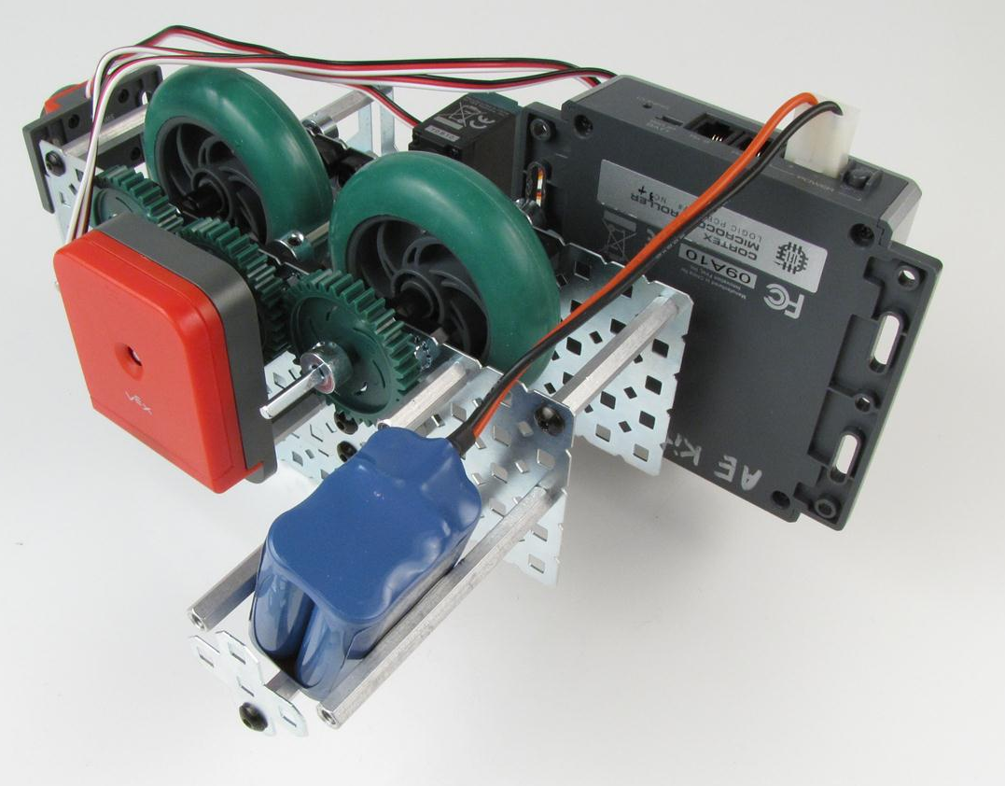
Step 15: Install Battery
Battery

Slide 21
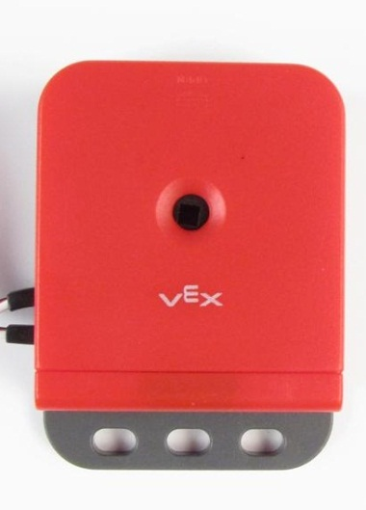
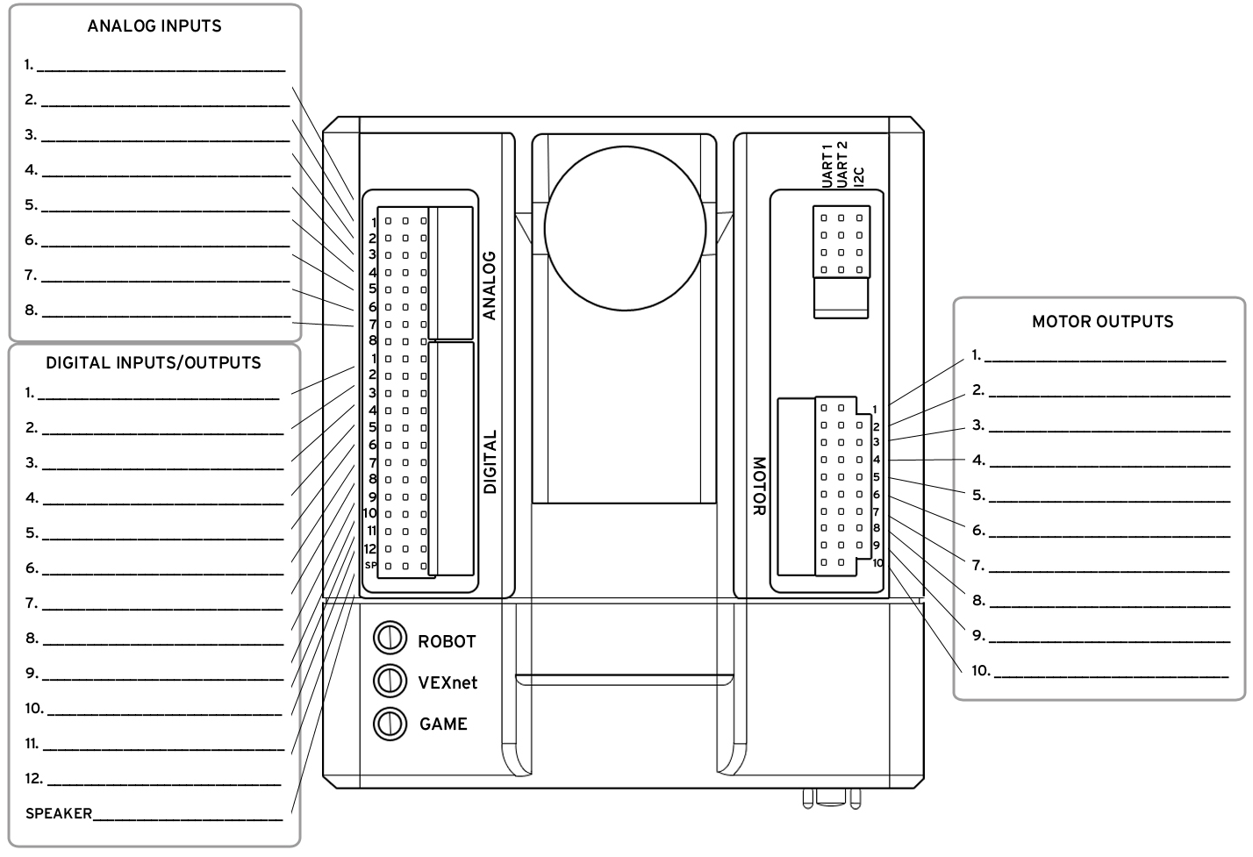
Step 16: Connect Motors and Sensors to Cortex
Encoder (upper)
Encoder (lower)
Bump Switch
Motor
Ultrasonic (in)
Ultrasonic (out)
Encoder (lower)
Encoder (upper)

Slide 22
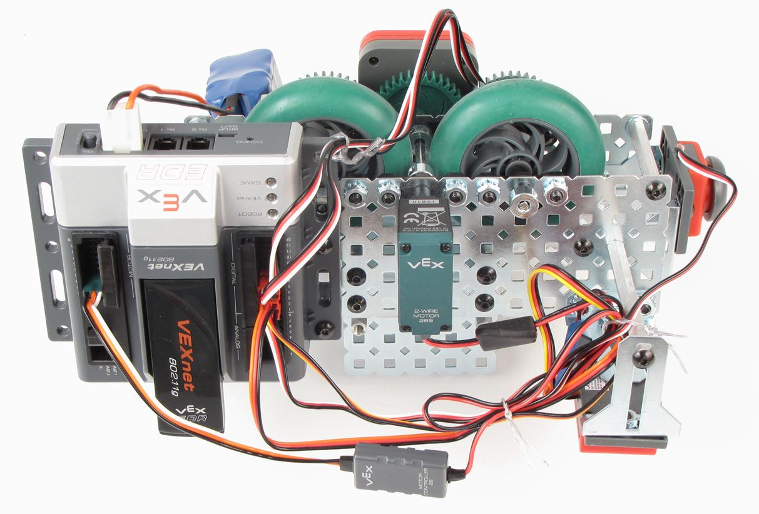
Step 17: Secure Wires
Route wires to avoid gear teeth
Secure wires
Secure wires

Slide 23
Completed Satellite Robot

Slide 24
Stop
Complete
Activity 4.2.8 Satellite Flight

