Slide 1
Introduction to Dimensioning
Introduction to Engineering Design
© 2012 Project Lead The Way, Inc.

Slide 2
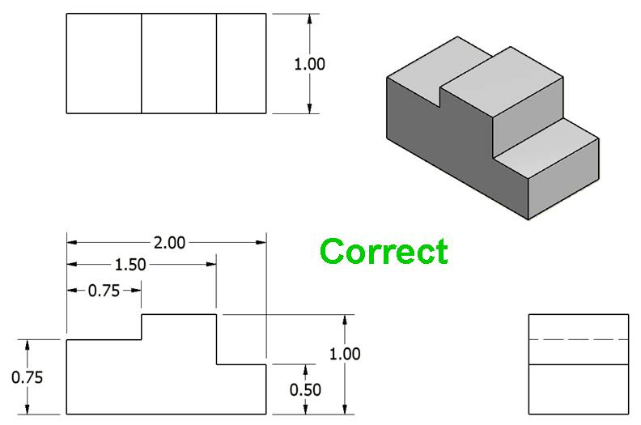
Dimensions should reflect actual size of the object, not the scaled size.
The dimension measured on the drawing is ¾ in., but the actual dimension of the part is 2 in. Therefore, show 2.00 on drawing.
Notes:
Do not used the measurement on a drawing as the true dimension of the part. The part could be shown larger or smaller than actual size. Always show the actual (designed) dimension of a part on the drawing.

Slide 3
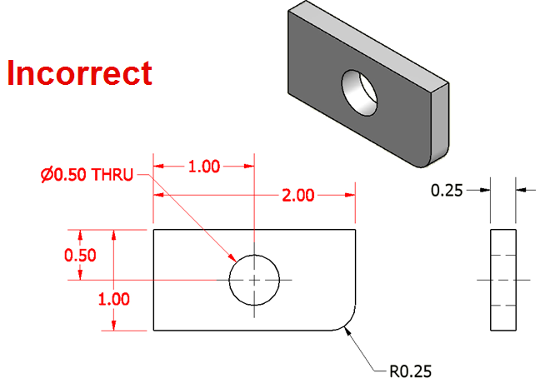
2. Include overall dimension in the three principle directions – width, height, and depth.
Overall dimensions should be placed the greatest distance away from the object so that intermediate dimensions can nest closer to the object.

Slide 4
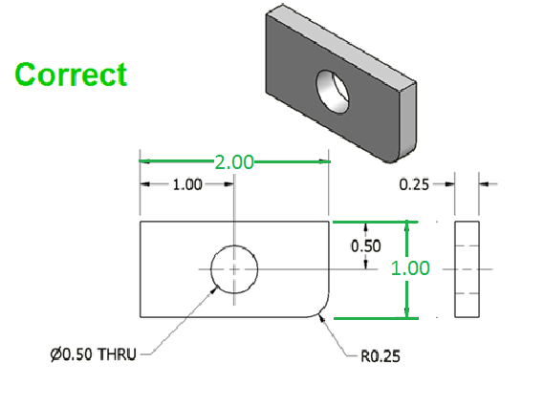
2. Include overall dimension in the three principle directions – width, height, and depth.
Overall dimensions should be placed the greatest distance away from the object so that intermediate dimensions can nest closer to the object.

Slide 5
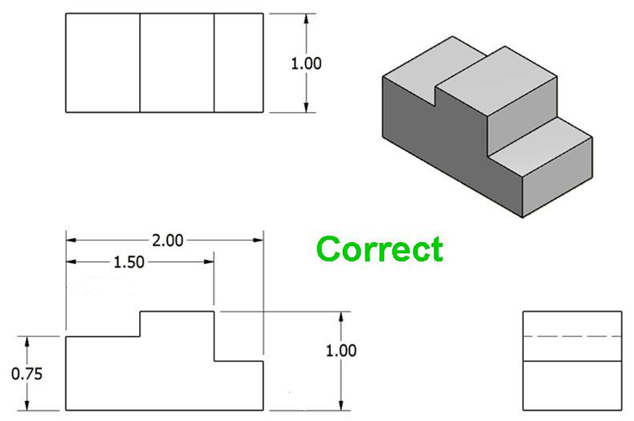
3. Include all dimensions necessary to produce or inspect the part.
Dimensions should be placed so that it is not necessary to calculate or scale a dimension.
Incorrect
?
?
Notes:
What are the measurements of these dimensions? Can this part be built without these dimensions?

Slide 6
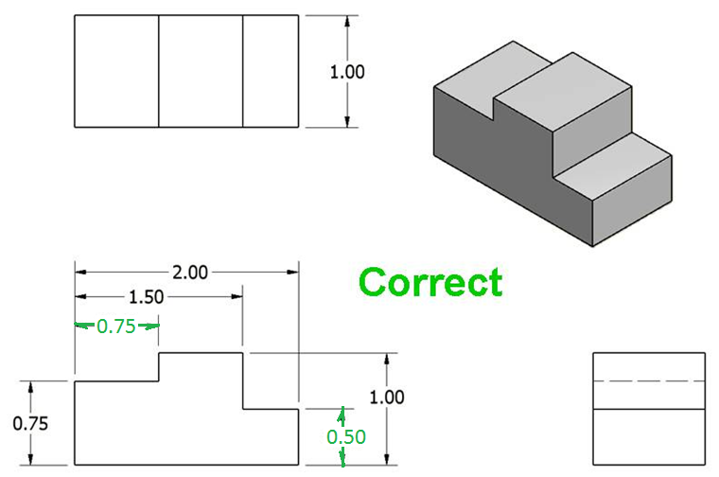
3. Include all dimensions necessary to produce or inspect the part.
Notes:
References:
Pg 337 Engineering Drawing and Design 3rd Edition by David Madsen et. al.
Pg 109 Fundamentals of Modern Drafting by Paul Wallach
Pg 425 Technical Drawing 9th Edition by Frederick Giesecke et. al.
Pg 701 Technical Graphics Communication 3rd Edition by Gary Bertoline & Eric Wiebe

Slide 7
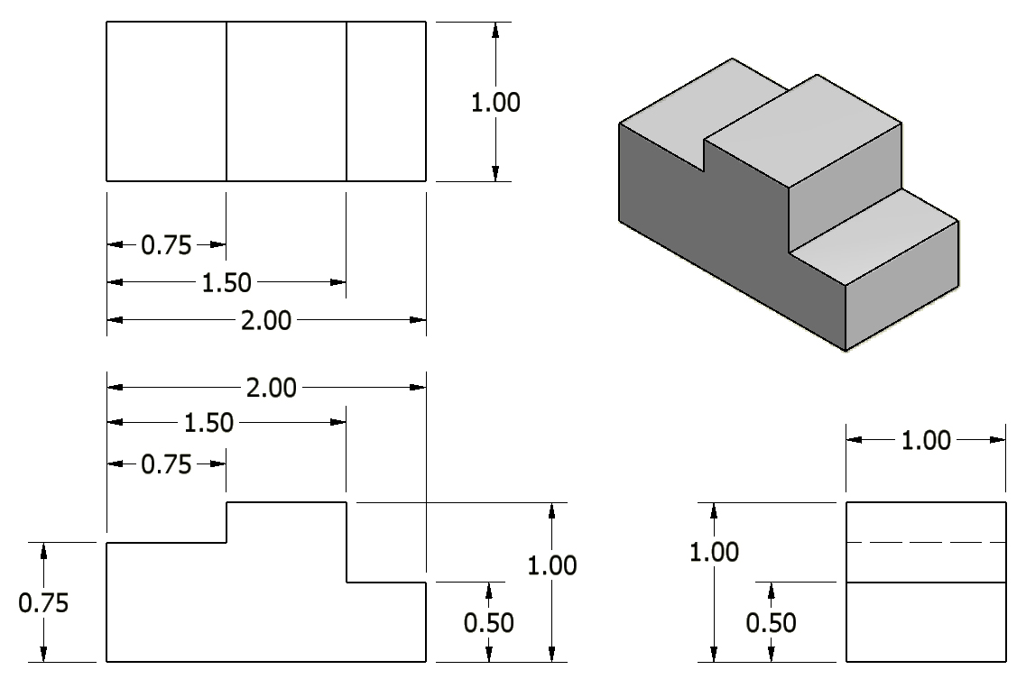
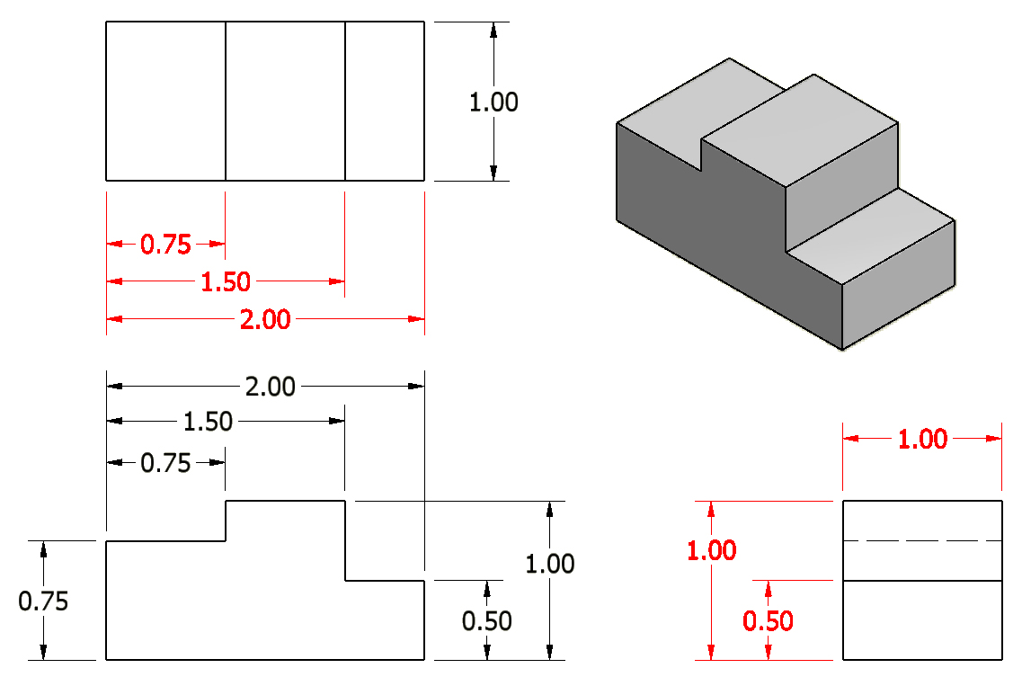
4. Do not include unnecessary dimensions.
Dimensions should NOT be duplicated or the same information given in two different ways.
DUPLICATED
Incorrect
Notes:
All of the red dimensions are duplicated somewhere else. DO NOT DUPLICATE DIMENSIONS!
[Ask student to identify unnecessary dimensions, then click through duplicated dimensions.]

Slide 8
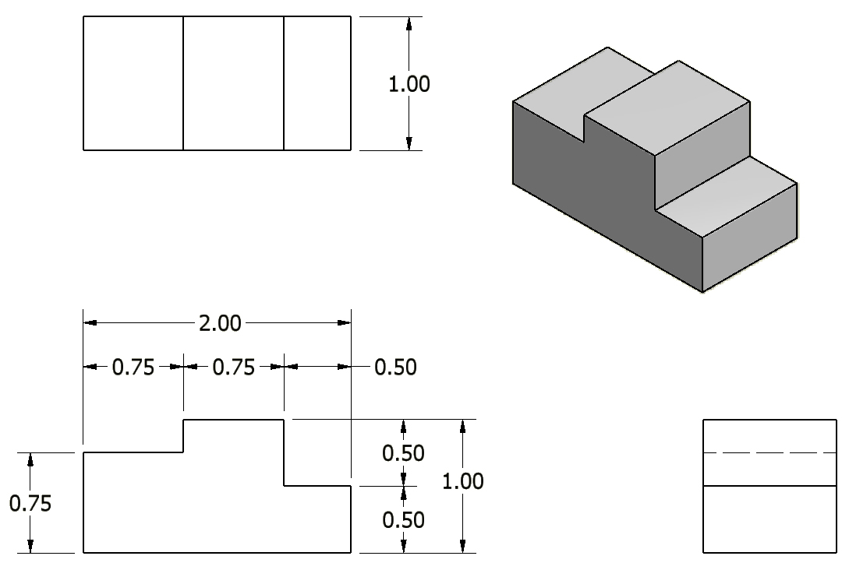
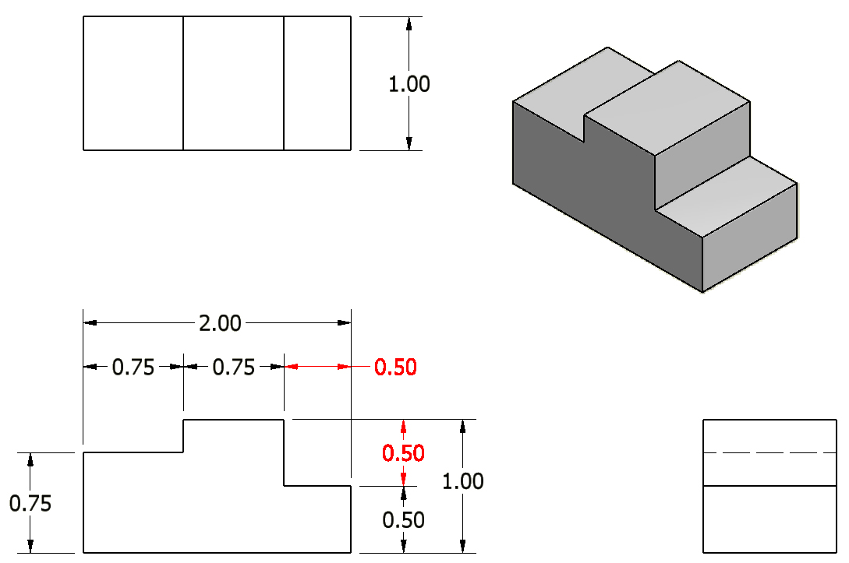
4. Do not include unnecessary dimensions.
Do not include chain dimensions that add up to a given overall dimension.
Provides the same information in two different ways.
Incorrect
Notes:
References:
Pg 109 Fundamentals of Modern Drafting by Paul Wallach
Pg 392 Technical Drawing 9th Edition by Frederick Giesecke et. al.
Note: In a chain of dimensions, as seen with the width and height dimensions in the front view, one of the dimensions is unnecessary in each chain and must be removed. Overall dimensions for width, height, and depth must be present.

Slide 9
4. Do not include unnecessary dimensions.
Notes:
References:
Pg 337 Engineering Drawing and Design 3rd Edition by David Madsen et. al.
Pg 109 Fundamentals of Modern Drafting by Paul Wallach
Pg 425 Technical Drawing 9th Edition by Frederick Giesecke et. al.
Pg 701 Technical Graphics Communication 3rd Edition by Gary Bertoline & Eric Wiebe

Slide 10
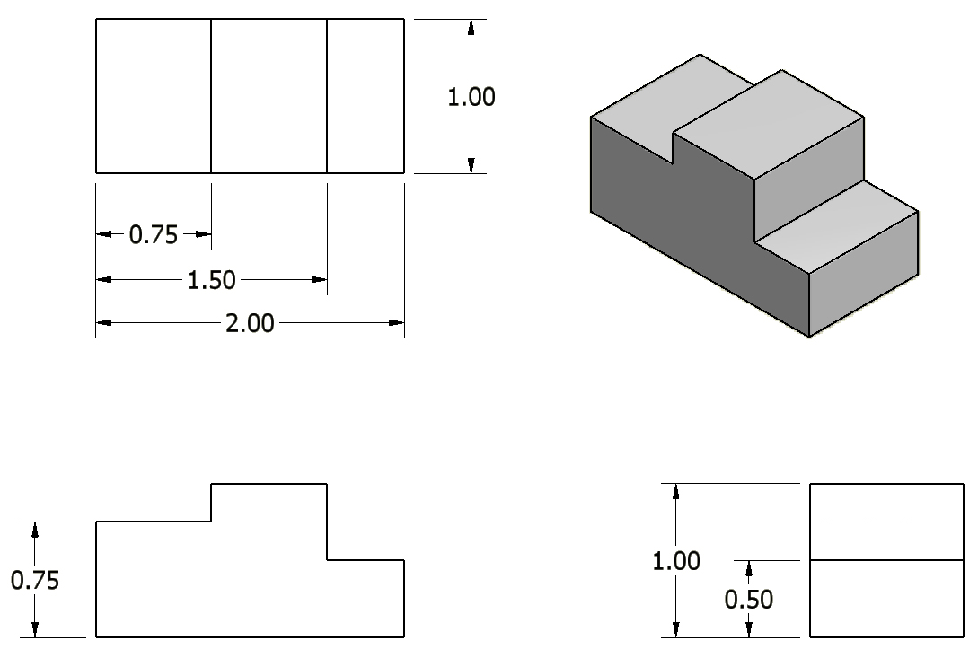
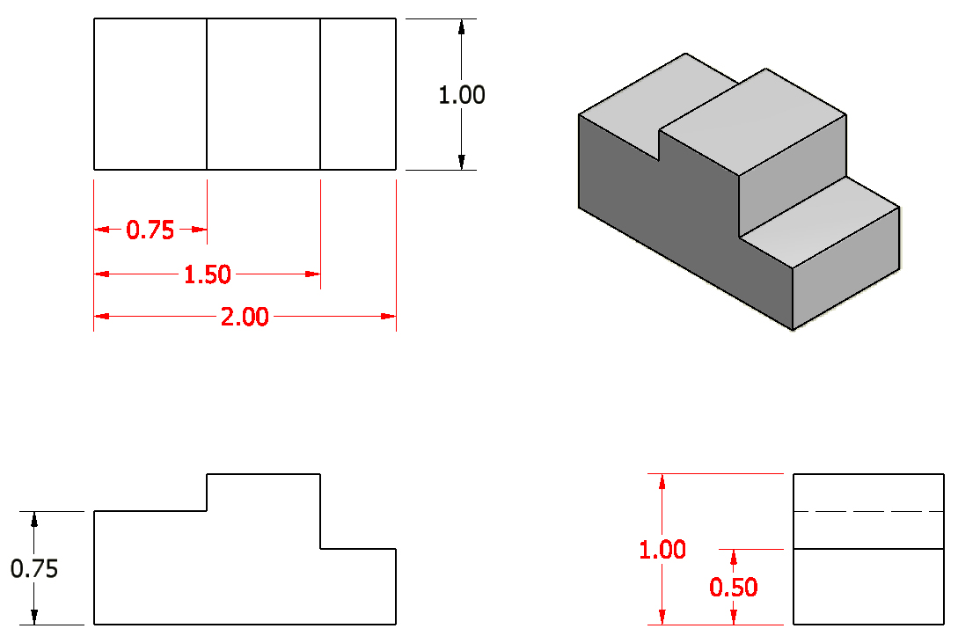
5. Dimensions should be attached to the view that best shows the contour of the feature to be dimensioned.
Incorrect
Notes:
References:
Pg 342 Engineering Drawing and Design 3rd Edition by David Madsen et. al.
Pg 405 & 425 Technical Drawing 9th Edition by Frederick Giesecke et. al.
Pg 698, 700, 701-703 Technical Graphics Communication 3rd Edition by Gary Bertoline & Eric Wiebe
It should be noted that the 2.00 inch dimension would be appropriately located if placed on the top view, but the front view is preferred because it is supposed to provide the most information about an object’s geometry.

Slide 11
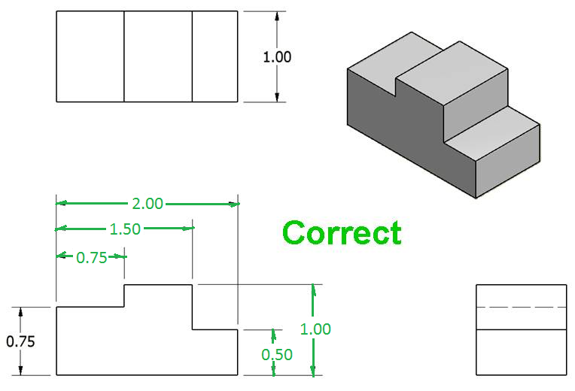
5. Dimensions should be attached to the view that best shows the contour of the feature to be dimensioned.
Notes:
References:
Pg 342 Engineering Drawing and Design 3rd Edition by David Madsen et. al.
Pg 405 & 425 Technical Drawing 9th Edition by Frederick Giesecke et. al.
Pg 698, 700, 701-703 Technical Graphics Communication 3rd Edition by Gary Bertoline & Eric Wiebe
It should be noted that the 2.00 inch dimension would be appropriately located if placed on the top view, but the front view is preferred because it is supposed to provide the most information about an object’s geometry.

Slide 12
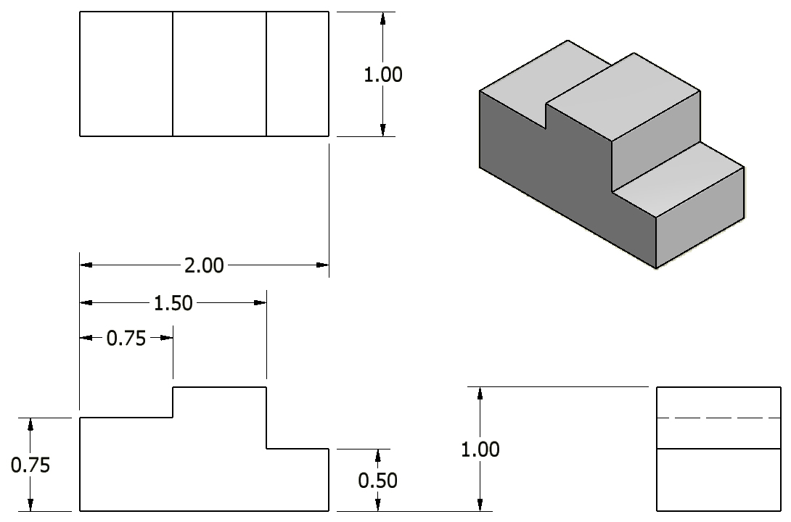
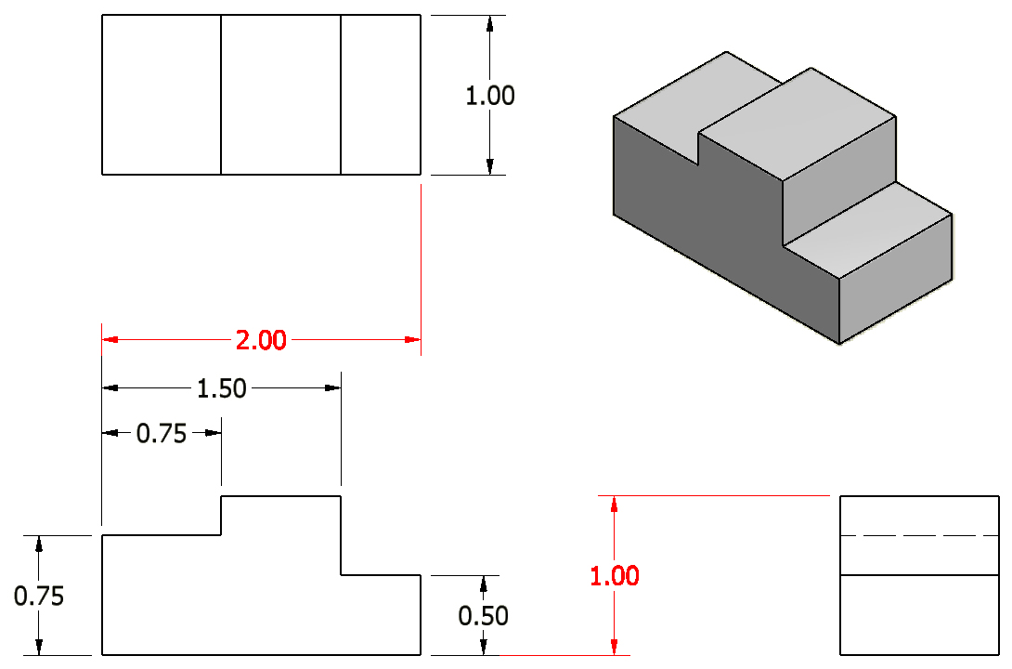
6. A dimension should be attached to only one view; for example, extension lines should not connect two views.
Incorrect
Notes:
Reference:
Pg 426 Technical Drawing 9th Edition by Frederick Giesecke et. al.

Slide 13
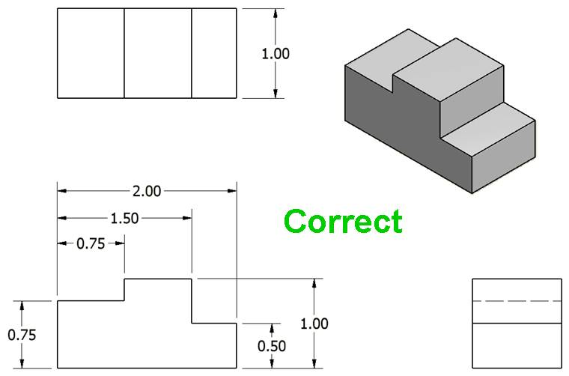
6. A dimension should be attached to only one view; for example, extension lines should not connect two views.
Notes:
Reference:
Pg 426 Technical Drawing 9th Edition by Frederick Giesecke et. al.

Slide 14
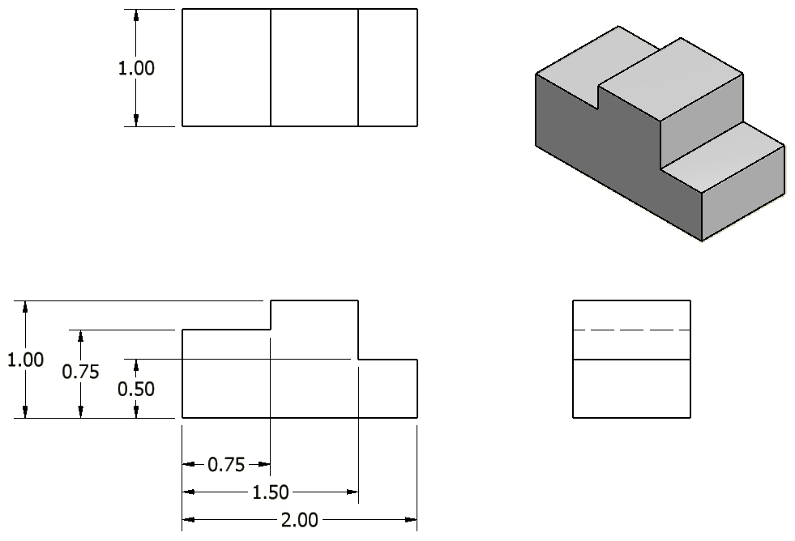
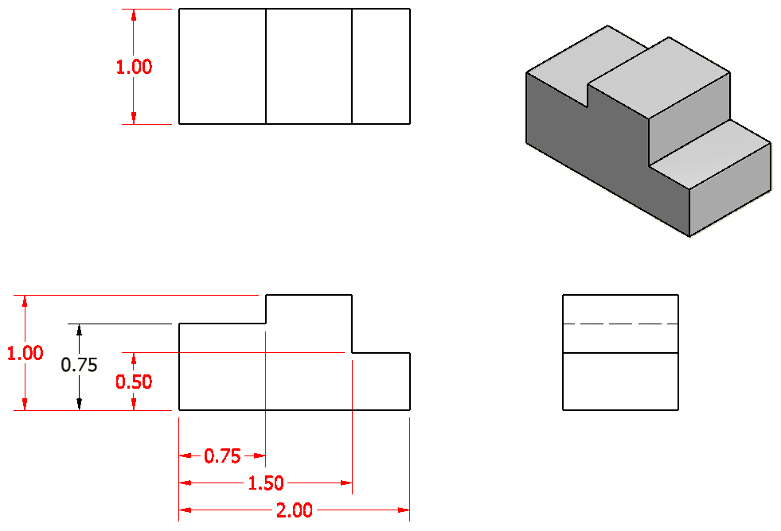
7. Whenever possible, locate dimensions between adjacent views.
Incorrect
Notes:
References:
Pg 342 Engineering Drawing and Design 3rd Edition by David Madsen et. al.
Pg 108 Fundamentals of Modern Drafting by Paul Wallach
Pg 426 Technical Drawing 9th Edition by Frederick Giesecke et. al.

Slide 15
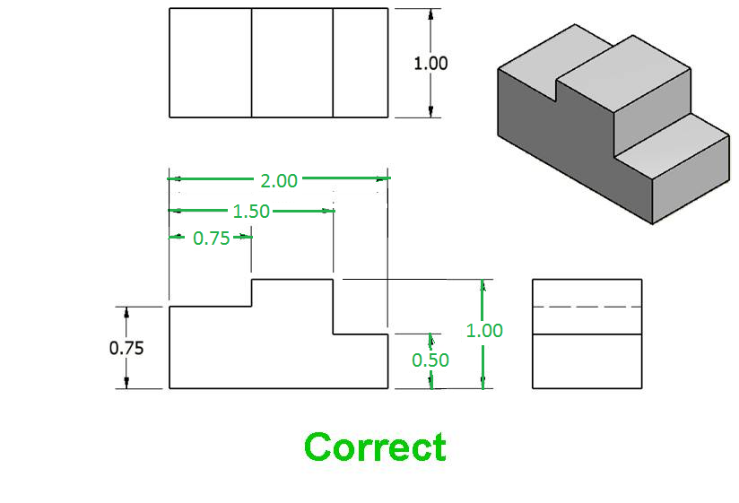
7. Whenever possible, locate dimensions between adjacent views.
Notes:
References:
Pg 342 Engineering Drawing and Design 3rd Edition by David Madsen et. al.
Pg 108 Fundamentals of Modern Drafting by Paul Wallach
Pg 426 Technical Drawing 9th Edition by Frederick Giesecke et. al.

Slide 16
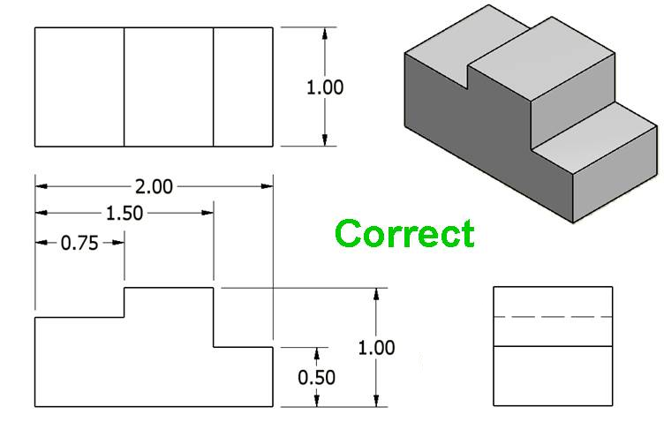
8. Avoid dimensioning to hidden lines.
Incorrect
0.75
0.75
Notes:
Reference:
Pg 342-343 Engineering Drawing and Design 3rd Edition by David Madsen et. al.

Slide 17
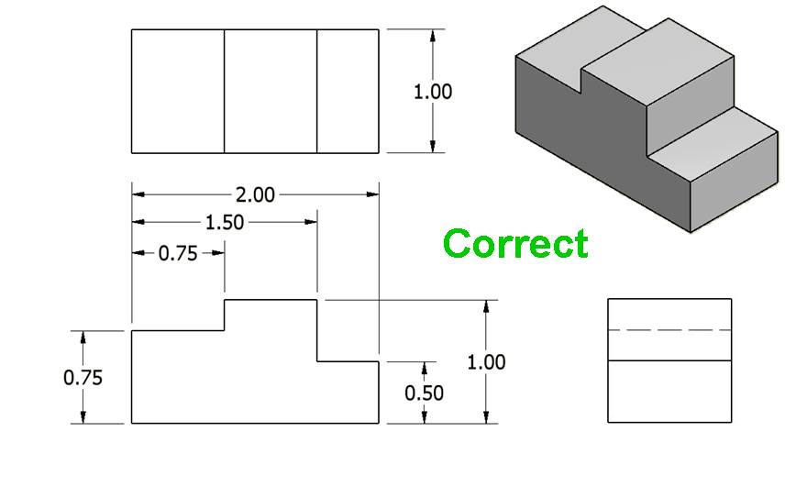
8. Avoid dimensioning to hidden lines.
0.75
Notes:
Reference:
Pg 342-343 Engineering Drawing and Design 3rd Edition by David Madsen et. al.

Slide 18
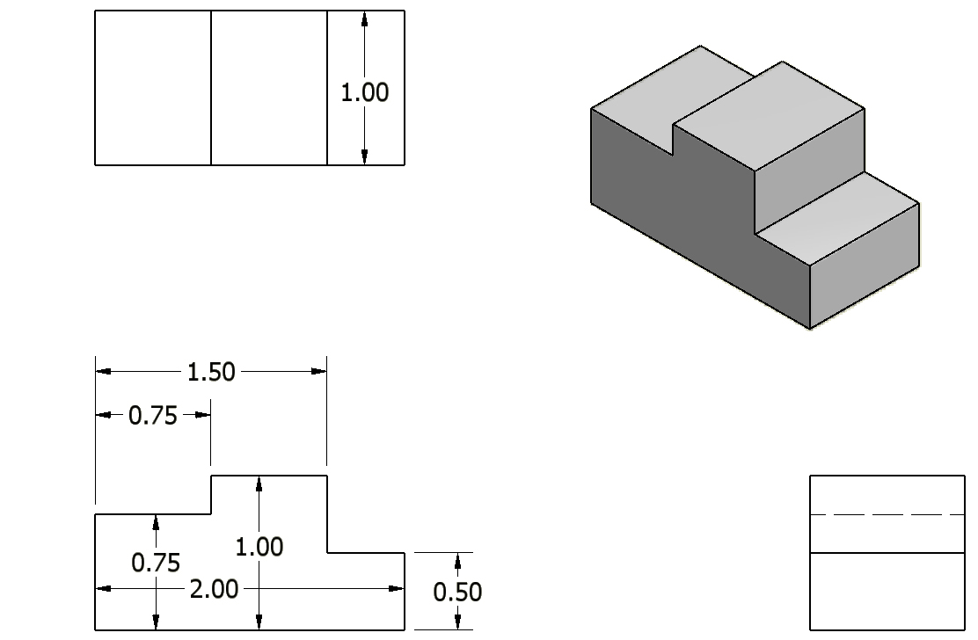
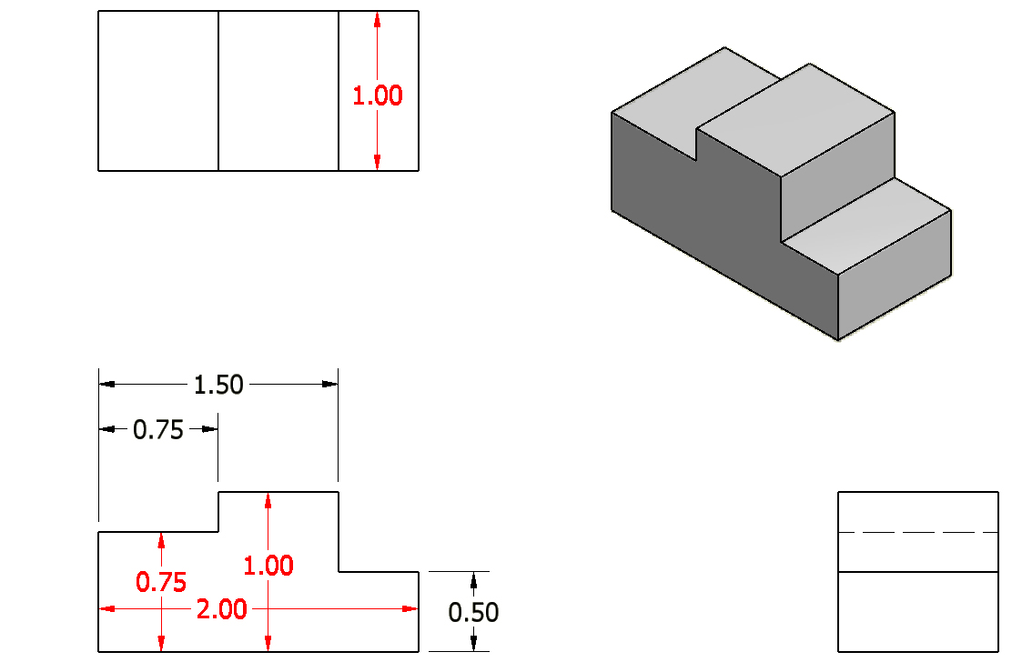
9. Do not place dimensions on the object unless it is absolutely necessary.
Incorrect
Notes:
References:
Pg 342 Engineering Drawing and Design 3rd Edition by David Madsen et. al.
Pg 394, 404, 426 Technical Drawing 9th Edition by Frederick Giesecke et. al.
Pg 692 Technical Graphics Communication 3rd Edition by Gary Bertoline & Eric Wiebe

Slide 19
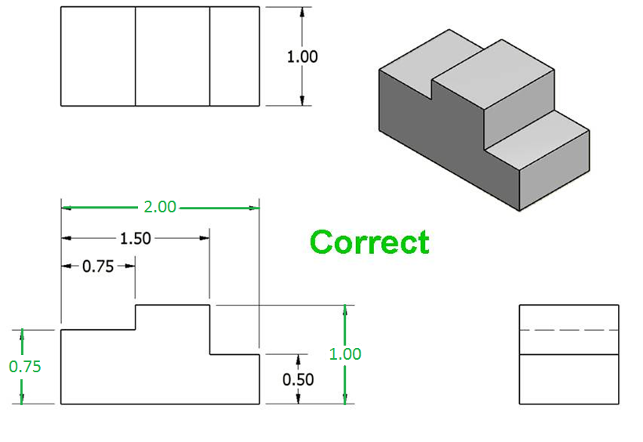
9. Do not place dimensions on the object unless it is absolutely necessary.
Notes:
References:
Pg 342 Engineering Drawing and Design 3rd Edition by David Madsen et. al.
Pg 394, 404, 426 Technical Drawing 9th Edition by Frederick Giesecke et. al.
Pg 692 Technical Graphics Communication 3rd Edition by Gary Bertoline & Eric Wiebe

Slide 20
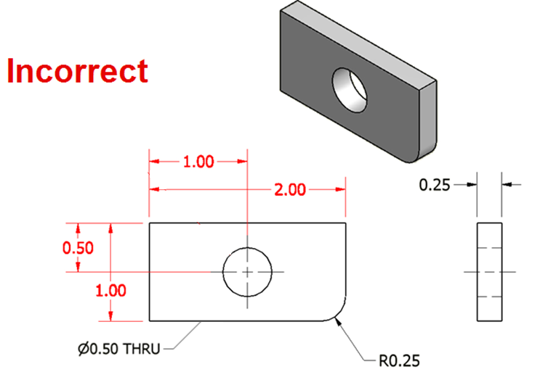
10. Do not cross a dimension line with another dimension line or with an extension line.
Notes:
References:
Pg 342 Engineering Drawing and Design 3rd Edition by David Madsen et. al.
Pg 394, 426 Technical Drawing 9th Edition by Frederick Giesecke et. al.

Slide 21
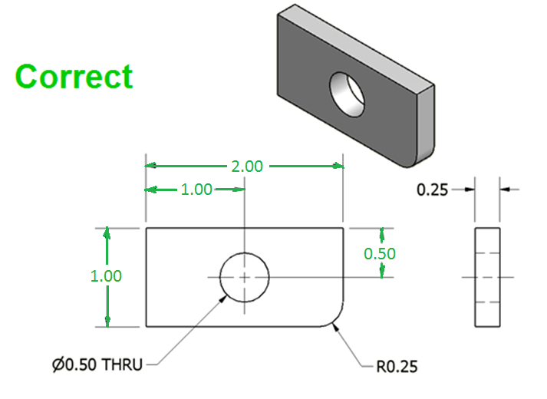
10. Do not cross a dimension line with another dimension line or with an extension line.
Notes:
References:
Pg 342 Engineering Drawing and Design 3rd Edition by David Madsen et. al.
Pg 394, 426 Technical Drawing 9th Edition by Frederick Giesecke et. al.

Slide 22
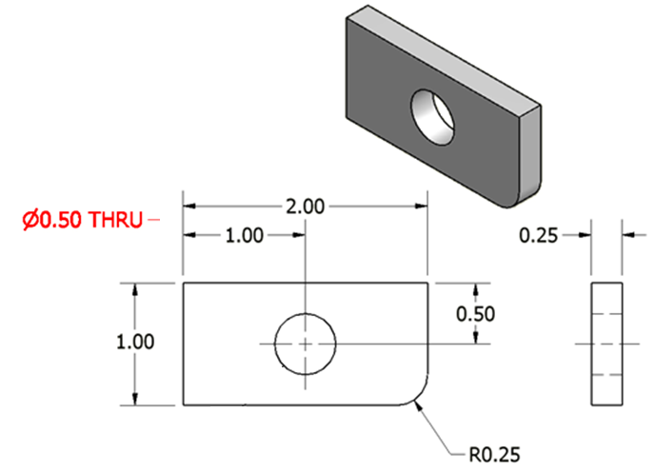
11. Avoid crossing dimension or extension lines with leader lines.
Incorrect
Notes:
References:
Pg 342 Engineering Drawing and Design 3rd Edition by David Madsen et. al.
Pg 394, 426 Technical Drawing 9th Edition by Frederick Giesecke et. al.

Slide 23
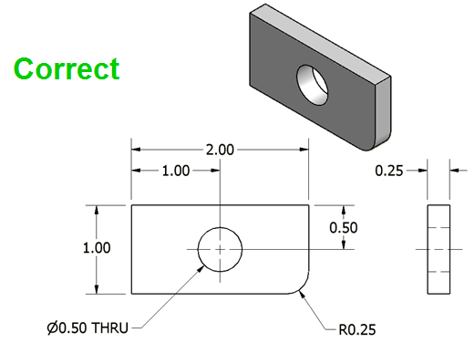
11. Avoid crossing dimension or extension lines with leader lines.
Ø 0.50 THRU
Notes:
References:
Pg 342 Engineering Drawing and Design 3rd Edition by David Madsen et. al.
Pg 394, 426 Technical Drawing 9th Edition by Frederick Giesecke et. al.

Slide 24
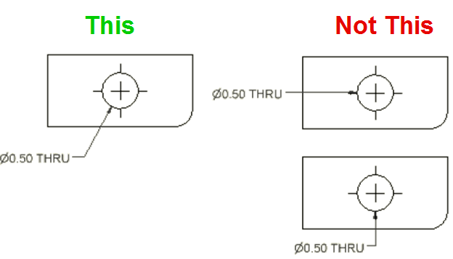
12. Leader lines point toward the center of the feature and should not occur horizontally or vertically.
Notes:
References:
Pg 45, 344 Engineering Drawing and Design 3rd Edition by David Madsen et. al.
Pg 395-396, 402-403, 426 Technical Drawing 9th Edition by Frederick Giesecke et. al.
Pg 686-687, 703 Technical Graphics Communication 3rd Edition by Gary Bertoline & Eric Wiebe
Note: Slopes greater than 75° and less than 15° from horizontal should be avoided. A leader has a .25 in shoulder at one end that begins at the center of the vertical height of the lettering and an arrowhead at the other end point.

Slide 25
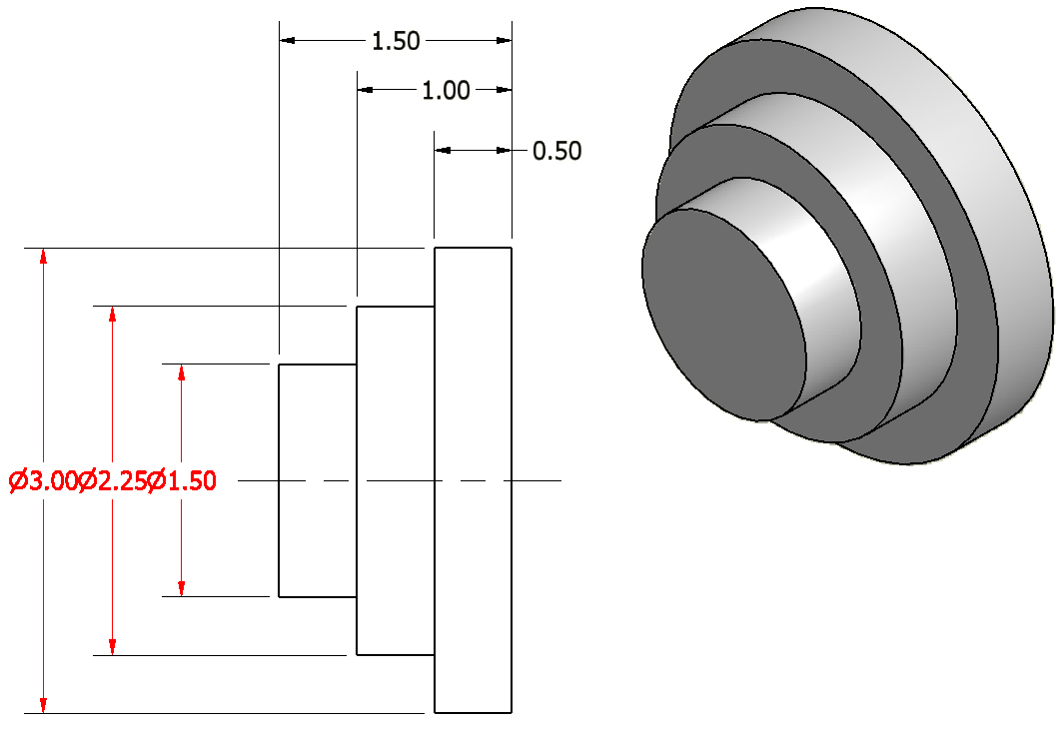
13. Dimension numbers should be centered between arrowheads, except when using stacked dimensions, and then the numbers should be staggered.
Incorrect
Notes:
References:
Pg 341-342 Engineering Drawing and Design 3rd Edition by David Madsen et. al.
Pg 137 Fundamentals of Modern Drafting by Paul Wallach
Pg 400, 426 Technical Drawing 9th Edition by Frederick Giesecke et. al.
Pg 690-691 Technical Graphics Communication 3rd Edition by Gary Bertoline & Eric Wiebe
Note: The 0.50 dimension cannot fit between its extension lines, so it is placed to the outside of the common extension line to avoid confusion.

Slide 26
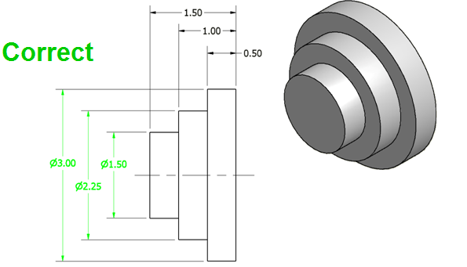
13. Dimension numbers should be centered between arrowheads, except when using stacked dimensions, and then the numbers should be staggered.
Notes:
References:
Pg 341-342 Engineering Drawing and Design 3rd Edition by David Madsen et. al.
Pg 137 Fundamentals of Modern Drafting by Paul Wallach
Pg 400, 426 Technical Drawing 9th Edition by Frederick Giesecke et. al.
Pg 690-691 Technical Graphics Communication 3rd Edition by Gary Bertoline & Eric Wiebe

Slide 27
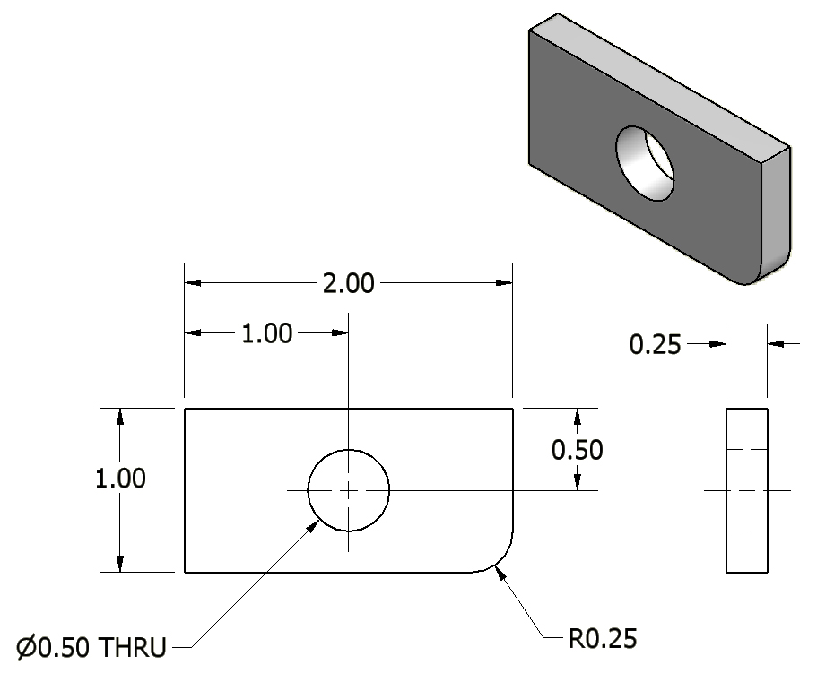
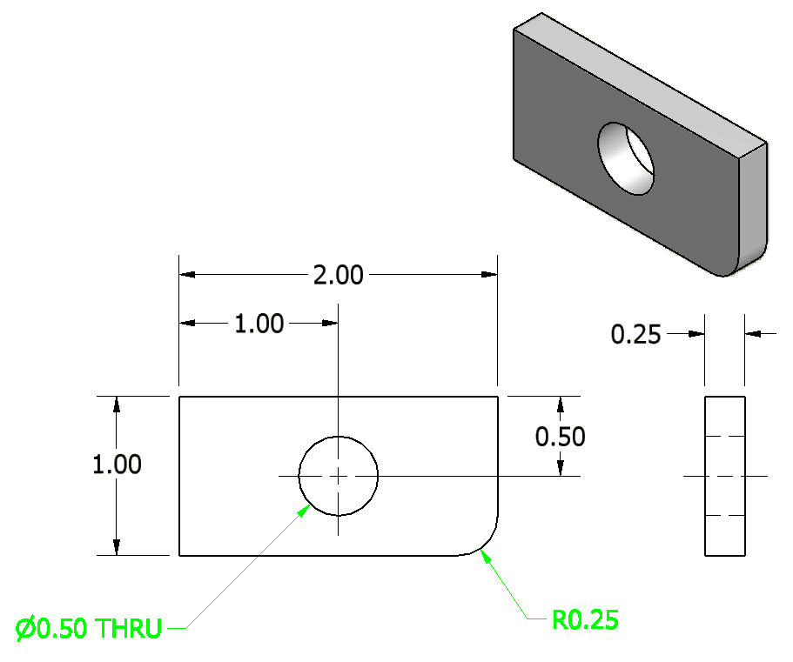
14. In general, a circle is dimensioned by its diameter and an arc by its radius.
Notes:
References:
Pg 344-345, 347-349 Engineering Drawing and Design 3rd Edition by David Madsen et. al.
Pg 131, 138-139 Fundamentals of Modern Drafting by Paul Wallach
Pg 402-403, 410-411, 427 Technical Drawing 9th Edition by Frederick Giesecke et. al.
Pg 687-688, 695-696 Technical Graphics Communication 3rd Edition by Gary Bertoline & Eric Wiebe

Slide 28
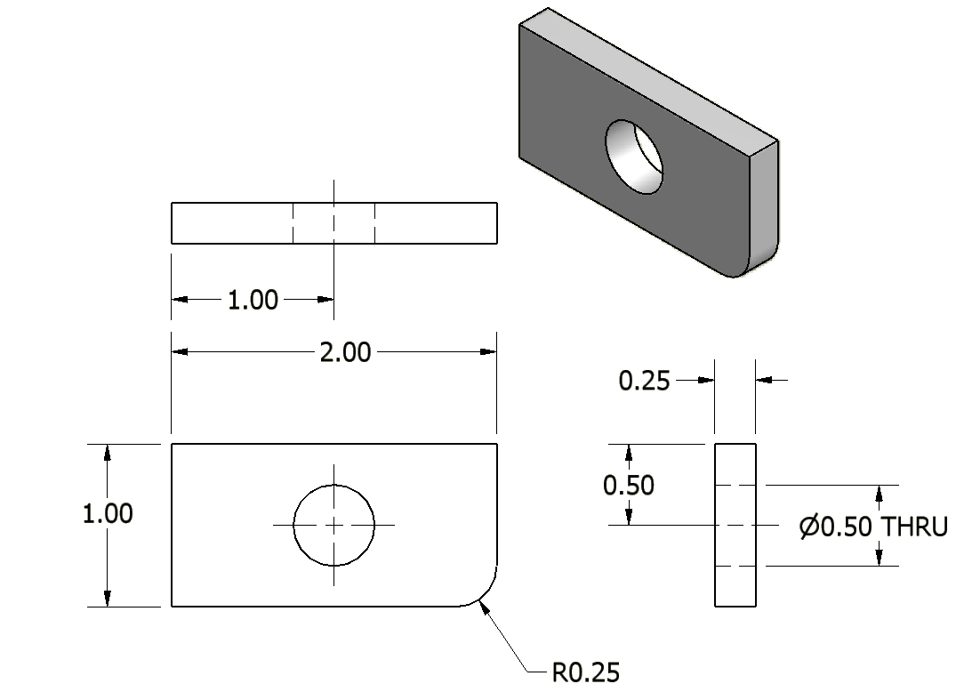
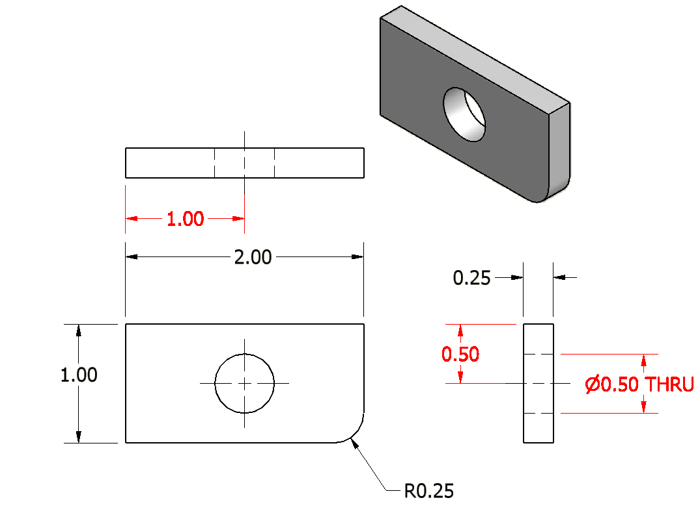
15. Holes should be located and sized in the view that shows the feature as a circle.
Incorrect
Notes:
References:
Pg 351 Engineering Drawing and Design 3rd Edition by David Madsen et. al.
Pg 109 Fundamentals of Modern Drafting by Paul Wallach
Pg 411, 427 Technical Drawing 9th Edition by Frederick Giesecke et. al.
Pg 693 Technical Graphics Communication 3rd Edition by Gary Bertoline & Eric Wiebe

Slide 29
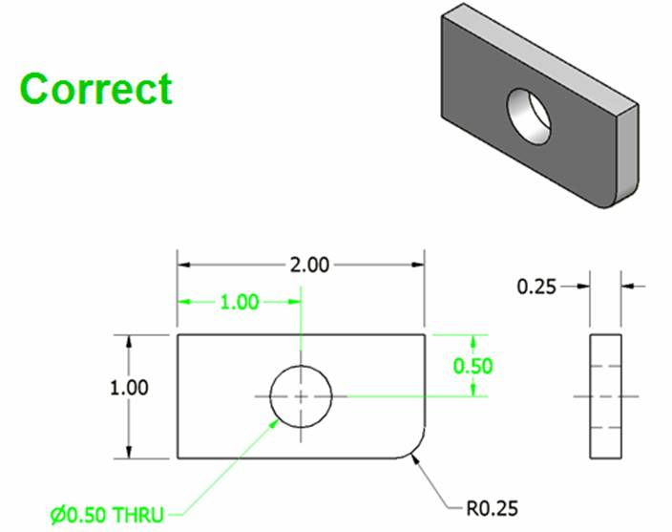
15. Holes should be located and sized in the view that shows the feature as a circle.
Notes:
References:
Pg 351 Engineering Drawing and Design 3rd Edition by David Madsen et. al.
Pg 109 Fundamentals of Modern Drafting by Paul Wallach
Pg 411, 427 Technical Drawing 9th Edition by Frederick Giesecke et. al.
Pg 693 Technical Graphics Communication 3rd Edition by Gary Bertoline & Eric Wiebe
Note: The top view was removed because it is not needed to completely communicate the object’s geometry.

Slide 30
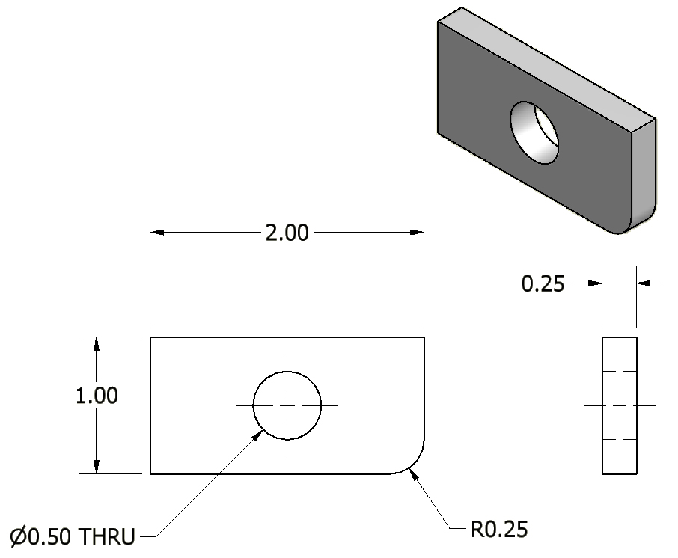
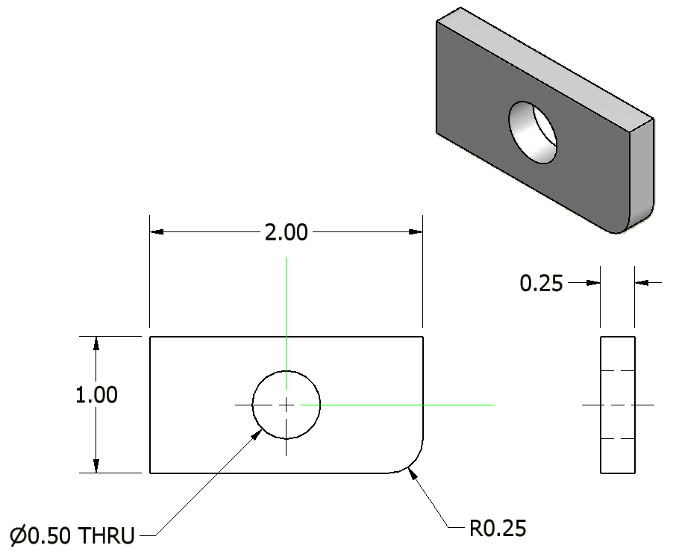
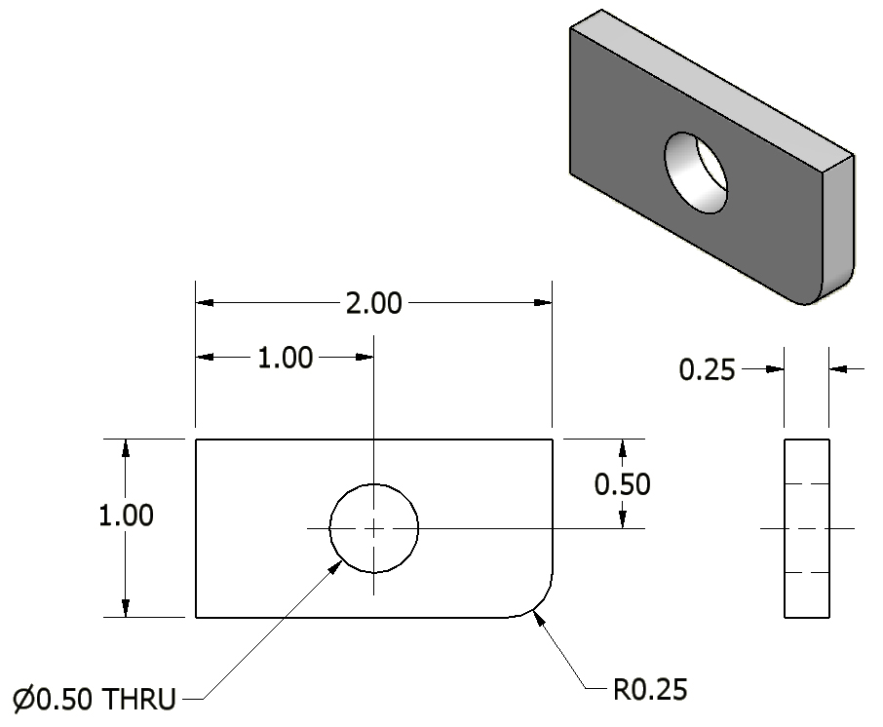
16. Holes are located by their centerlines, which may be extended and used as extension lines.
Notes:
References:
Pg 44, 340 Engineering Drawing and Design 3rd Edition by David Madsen et. al.
Pg 393-394, 426 Technical Drawing 9th Edition by Frederick Giesecke et. al.
Pg 690-691 Technical Graphics Communication 3rd Edition by Gary Bertoline & Eric Wiebe

Slide 31
References
Bertoline, G. (2003). Technical graphics communication. (3 ed.). Boston, MA: McGraw-Hill.
Giesecke, F. [et al.] (1991). Technical drawing. (9 ed.). New York, NY: Macmillan Pub. Co.
Madsen, D., Folkestad, J., Schertz, K., Shumaker, T., Stark, C., & Turpin, J. (2002). Engineering drawing and design. (3 ed.). Albany, NY: Delmar Thomas Learning.

