Slide 1
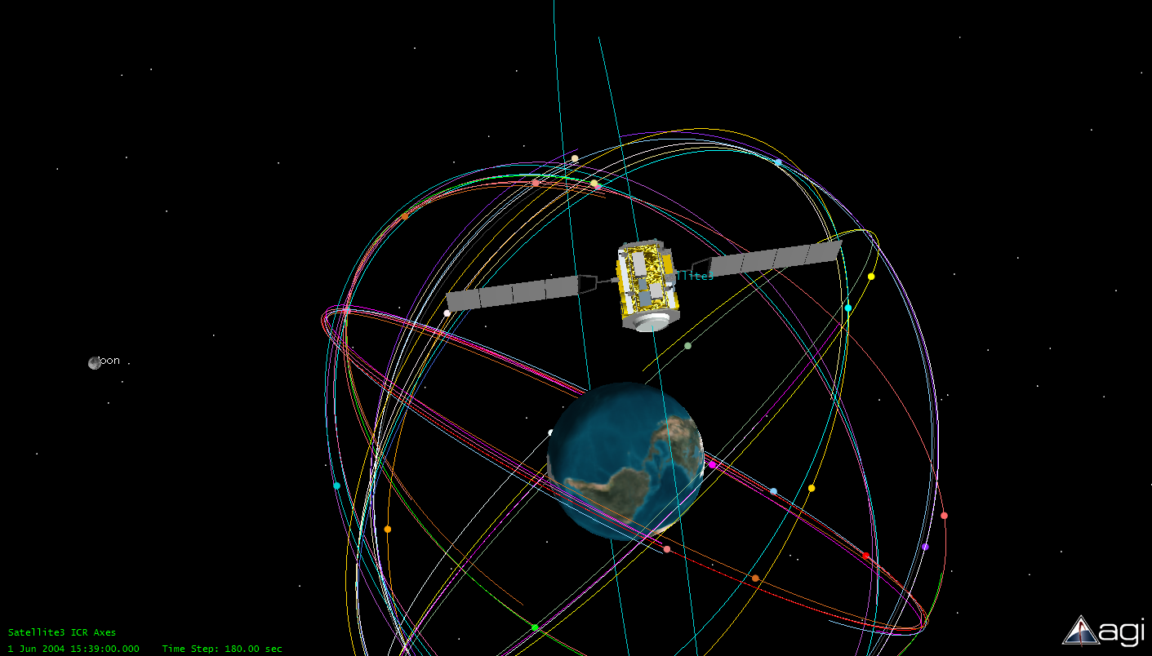
Introduction to Orbital Mechanics
Notes:
This presentation introduces students to some basic orbital mechanics concepts. Use the slide notes for additional information.
This presentation requires the STK Viewer to display .vdf files or watch the video files. Refer to the teacher notes for more information. STK software by AGI may also be used as an optional add-on tool so that students can practice adjusting orbital parameters. Refer to the teacher notes for display instructions. If the macro will not display the simulation, then stop the presentation, play the simulation, and restart the presentation.

Slide 2
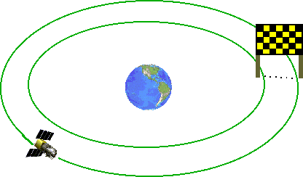
What Is an Orbit?
A closed path around which a planet or satellite travels.
Graphic obtained from
Astronautics Primer by Jerry Sellers.
Johannes Kepler discovered in 1600s that planet orbits form ellipses, not circles.
Satellites (natural or human-made) orbit Earth as an ellipse.
Elliptical orbits remain fixed in space, and Earth spins under a fixed satellite orbit.
Notes:
A Comparison
Comparing an orbit to a racetrack is an analogy that many students can understand. The car drives around a fixed racetrack, much like a satellite travels around a fixed orbit. Make sure that students understand what natural satellites are. Ask students to identify a natural satellite of the earth (the moon). What are natural satellites of the sun (the planets)? Kepler’s observations were based on the movements of the planets, but all that he discovered also applies to human-made satellites in their orbits.
History
An entire course can be taught on the history of humankind’s knowledge of space. This lesson is not intended to cover history in detail, but it is certainly worth addressing briefly at this point.
Perhaps the most amazing facet of Kepler’s work to discuss with students is that Kepler made all of his observations and calculations without the use of any kind of technology that we rely on today – no calculators, no computers. Students rely so heavily on technology today that they often must be reminded that many of the greatest minds in the past made incredible discoveries without the aid of any technology. Kepler observed the planets’ orbits with the naked eye over years and years and derived his laws (and the equations related to them) from these observations. His accomplishments were truly mind boggling.
Kepler relied on earlier theories and observations made by Nicolaus Copernicus. An excellent, recent (2007) book on Copernicus’ life and work is Copernicus’ Secret: How the Scientific Revolution Began by Jack Repcheck.

Slide 3
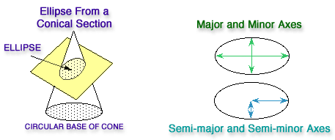
What Is an Ellipse?
An ellipse is the two-dimensional shape that is produced by a plane fully intersecting a cone.
Note that a plane intersecting the cone at a angle perpendicular to the cone’s center line will form a special ellipse called a circle.

Slide 4
What Is an Ellipse?
A
Circle is a set of points fixed (constant distance) from a center point (focus)
A = constant
Ellipse has two focii instead of a center
Sum of distances from focii is constant
A+B = constant
A
B
Circle is simply an ellipse with both focii located at the same spot.
Satellites orbit Earth with one focus at Earth’s center.
The other focus is an empty point, which may or may not be within Earth’s boundaries.
Notes:
Hands-On Ellipse Makers
At this point teachers may elect to have students build “ellipse makers” in order to gain a better understanding of ellipses.
Supplies needed (per student or pair of students):
Piece of cardboard measuring roughly 1.5 feet x 1.5 feet. Medium to large pizza boxes work great (one per ellipse maker)
Thin string or dental floss, cut into pieces roughly 18 inches long (one piece per ellipse maker)
Push pins (two per ellipse maker)
Pen or marker (one per ellipse maker)
1. Push two push pins into cardboard to serve as focii. Tie a loop of string and place it around pins. Take tip of pen, “hook” it on the string, and extend it as far as it can go (in slide, imagine the tip of the pen being at the intersection of line segments A and B).
2. Point out to students that the length of the string remains fixed, and the distance between the push pins remains fixed. Therefore, the sum of A + B must be a constant. Slide the pen around in a clockwise motion, always keeping the string taut. The pen will trace the shape of an ellipse. When B gets larger, A gets smaller, but their sum is always the same.
3. Have students change the distance between the pins and observe the resulting ellipse. The farther apart the focii, the more elliptical the resulting shape. The closer the focii, the more circular the shape. If the push pins are placed in the same spot, the result is a circle.

Slide 5
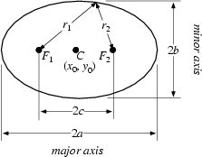
What Is an Ellipse?
a defines ½ the major axis length
b defines ½ the minor axis length
c is the distance from the center of the ellipse to either focal point
For a circle, a and b are equal to the radius, and both focal points are co-located at the center of the ellipse

Slide 6
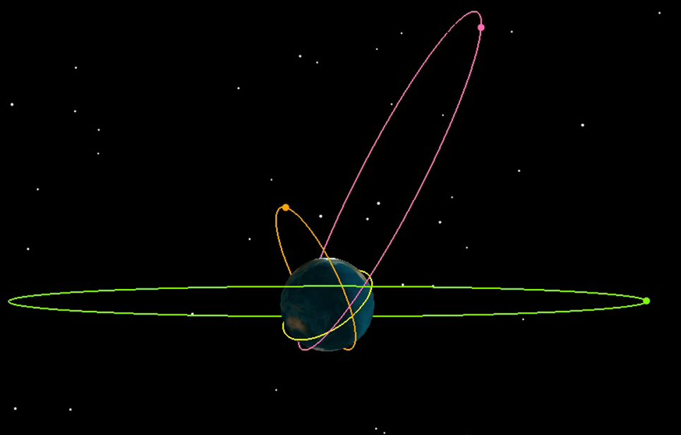
Diverse Orbits
Notes:
This slide displays the Diverse file to demonstrate this content. A longer animation with more detailed explanation can be displayed on the next slide.
An Introduction to Orbits
This is perhaps the first time many students have ever viewed satellite orbits in 3D. Be sure to both rotate and animate this .vdf file so that students obtain a true appreciation for the wide variety of sizes and shapes of the orbits. Point out that each of these orbits serves an actual real-world purpose. There are sound reasons why different missions require such wildly different orbits. Ensure students that after completing this full unit, they will understand why each of these orbits is well-suited for its particular mission.

Slide 7
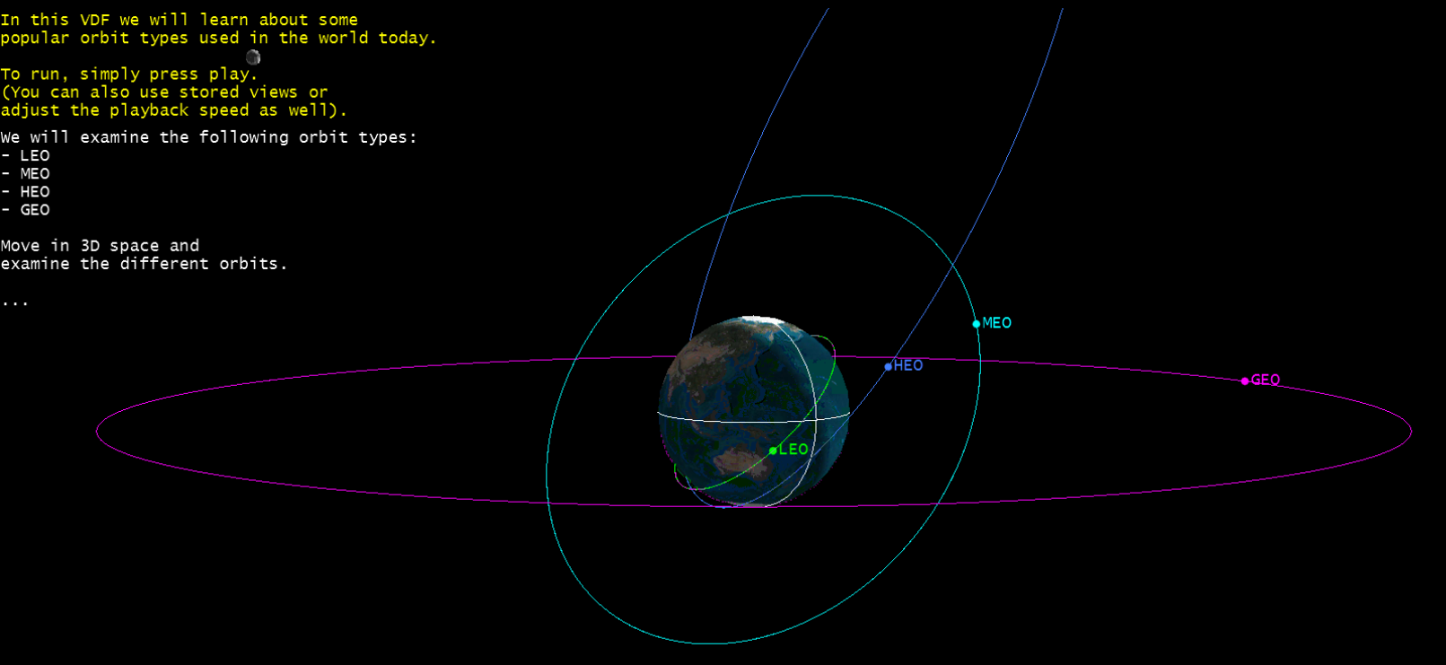
Basic Orbits
Notes:
This slide displays the optional BasicOrbits file.
An Introduction to Orbits
This is perhaps the first time many students have ever viewed satellite orbits in 3D. If a .vdf file is displayed then rotate and animate this to obtain a true appreciation for the wide variety of sizes and shapes of the orbits. Point out that each of these orbits serves an actual real-world purpose. There are sound reasons why different missions require such wildly different orbits. Ensure students that after completing this full unit, they will understand why each of these orbits is well-suited for its particular mission.

Slide 8
How Are Orbits Described?
Orbits are described by a set of parameters called orbital elements (i.e., Keplerian elements).
The Keplerian element set consists of 6 parameters (plus a time stamp):
Two of these describe the size and shape of an orbit
Three of these describe the orientation of the orbit in space
One of these describes the location of the satellite within the orbit
Notes:
Overview of Upcoming Lessons
This slide provides the background for the upcoming slides which address the Keplerian element set.
A good hands-on visualization tool for teachers to include in this lesson is a simple hula hoop and ball (e.g., basketball or beach ball). If different sizes of hula hoops are available, all the better.
A hula hoop may be oriented around a ball in many different ways. It may be slid down around the ball parallel to the ground, much like an “equator.” This equator could be tilted around the ball anywhere from no tilt (parallel to the ground, a true “equator”) up to being perpendicular to the ground (now encircling the imaginary “poles” of the ball). This simple illustration can be used throughout the lesson to illustrate various orbital parameters.

Slide 9
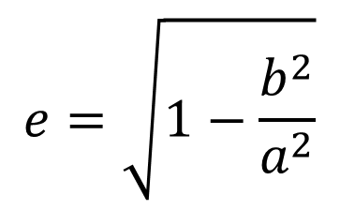
Eccentricity (e)
Eccentricity describes the roundness of an orbit. It describes the shape of the ellipse in terms of how wide it is.
Calculate the eccentricity of a circle.
Eccentricity can vary from
Semi-minor axis, b
$$e=\sqrt{1−\frac{b^{2}}{a^{2}}}$$
Semi-major axis, a
Notes:
Further Explanation
Whereas a circle has only one diameter, an ellipse has many, all with different sizes. The largest diameter is called the major axis; the smallest diameter is called the minor axis. Instead of radii, we call half of these axes the semi-major axis and the semi-minor axis.
Math Activity
A circle has only one major/minor axis, called the diameter.
Therefore, in a circle a = b.
Therefore, b²/a² would be 1.
Therefore, the formula would solve for the square root of 1 minus 1, or 0.
The square root of 0 is 0.
Therefore, the eccentricity of a circular orbit is 0.

Slide 10
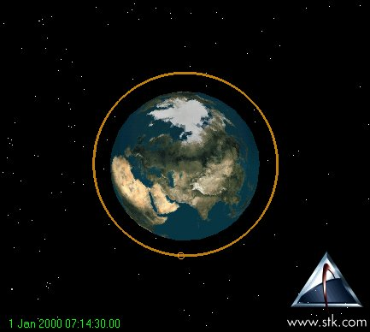
Eccentricity
This value is between 0 and 1 (for “closed” orbits).
Eccentricity of 0 means the orbit is circular.
An eccentricity of 1 or greater means the orbit is not closed. Such would be used for interplanetary missions. Satellites in these types of orbits do not come back to their starting point.
Notes:
This slide contains an image not an animation.
Further Explanation
The “open orbits” mentioned would be parabolic (eccentricity = 1) or hyperbolic (eccentricity > 1).

Slide 11
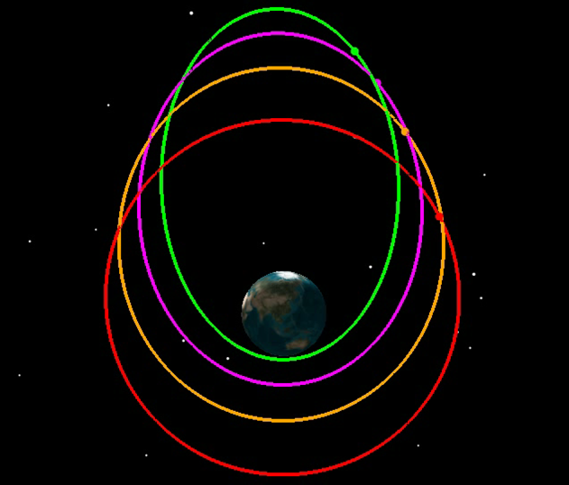
Eccentricity
Values between 0 and 1 mean the orbit is elliptical.
e = .74
e = .60
e = .4
e = 0
Notes:
This slide displays the Eccentricity file to demonstrate this content.
Illustration
The orbits in this slide are identical in every parameter except eccentricity. Since the students have not been introduced to these other parameters yet, simply rotate the .vdf to show students that all the orbits have the same “tilt” relative to the Earth. Ensure them that the only difference between the orbits is eccentricity.
While this slide shows a wide range of eccentricities, it can be difficult for the human eye to detect eccentricities which are mathematically obvious. The orbit with a .4 eccentricity looks rather circular, but it is not. The eccentricities of the pink and green orbits will be more obvious to the human eye.
Animate until all satellites are in the “12 o’clock” position. Pause the animation and ask students which satellite they think will complete an orbit first. You will receive a range of answers. Animate through one complete orbit, and students will see that all satellites completed one orbit in the same amount of time. Some satellites showed dramatic speed changes while others didn’t. This phenomenon will be discussed later in the lesson.

Slide 12
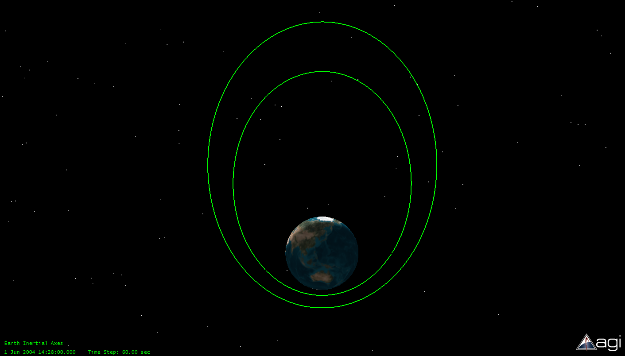
Beyond Eccentricity
Orbits may have the same eccentricity (e) but may be different sizes. There must be a Keplerian element which describes the size of an orbit.
Notes:
This slide contains an image not an animation.
Optional Illustration
To illustrate this concept, a teacher can simply show two different sizes of hula hoops. Both have the same eccentricity (0, because they are circular), but they are different sizes. There must be a way to describe the size of an orbit.

Slide 13

Semi-Major Axis
Major axis, 2a
Semi-major axis a describes the size of the ellipse. It is half of the largest diameter (the major axis) of the orbit.
Semi-major axis, a
Center of ellipse
The semi-major axis originates from the center of the orbit, but we are located on Earth. This makes semi-major axes difficult for us to visualize from our reference point.
Notes:
Explanation
An ellipse has multiple diameters and/or radii, all of different lengths. The largest diameter is called the major axis. In orbital mechanics, it is the radius rather than the diameter that is used. Since this is half of the major axis, it is referred to as the semi-major axis.
Point out that we are located on the Earth rather than at the center of the ellipse. This can make it difficult for us to visualize the actual size of a semi-major axis.

Slide 14
Important Points on the Orbit
“gee” suffix means Earth
e.g. apoapsis and periapsis.
Apogee
Perigee
altitude
Apogee altitude
Perigee
Apogee defines the point in an orbit that is farthest from Earth.
Perigee describes the point in an orbit that is closest to Earth.
Apogee altitude is the distance between the surface of the Earth and apogee.
Perigee altitude is the distance between the surface of the Earth and perigee.
Notes:
Going Deeper
Since we are located on the Earth, using altitudes rather than semi-major axes can make it easier for us to visualize the size of the orbit.
While apogee and perigee are actually reserved for use with objects in Earth’s orbit, people often refer to the apogee and/or perigee of the Earth’s orbit around the Sun. Technically, this is incorrect. In this case the generic terms of apoapsis and periapsis should be used, or the terms specific for a sun-centered orbit, apohelion and perihelion, should be used.

Slide 15
Apogee, Perigee, and Circular Orbits
For circular orbit
Apogee Altitude = Perigee Altitude
Apogee
Apogee
altitude
Perigee
altitude
Perigee
In circular orbit, apogee altitude and perigee altitude are the same.
Perfectly circular orbit has neither an apogee nor perigee and is undefined.
Perfectly circular orbits cannot be achieved.
Generally circular orbits are described by their altitude.
Semi-major axis rarely used to describe circular orbits.
Notes:
Optional Additional Activity
Teachers may have students use an Internet search engine and search on the terms “typical space shuttle orbit” or “typical space station orbit.” Some of the resulting websites will list a typical orbit in terms of the altitude. This is customary for circular orbits.
Prior to searching, have students guess a typical altitude for such an orbit. Do they know the radius of the Earth? It is 6,378 km or 3,963 miles. A large altitude (as shown in the slide) is often used for depicting orbits simply to make the illustrations readable. However, a typical space shuttle orbit is roughly 300 - 350 km above the Earth. If a drawing of such an orbit were to be made to scale, the circle representing the orbit would barely be larger than the image representing the Earth.

Slide 16

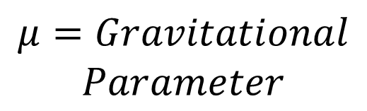


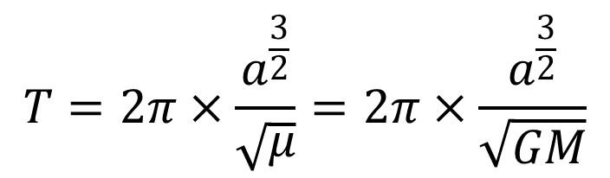
Semi-Major Axis
(Altitude for circular orbits)
$$T=2π×\frac{a^{\frac{3}{2}}}{\sqrt{μ}}=2π×\frac{a^{\frac{3}{2}}}{\sqrt{GM}}$$
$$T=Orbital Period$$
Semi-major axis is the only orbital parameter that determines the orbital period.
$$a=SemiMajor Axis$$
$$μ=Gravitational$$
$$Parameter$$
G = Universal Gravitation Constant
(6.67x10⁻¹¹ m³/kg*s²)
$$M = Mass of central body$$
Translated as Kepler’s 3rd Law: The square of the period of a planet is proportional to the cube of its mean distance from the Sun.

Slide 17
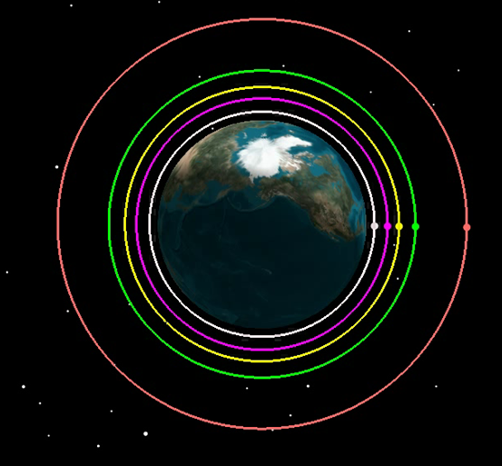
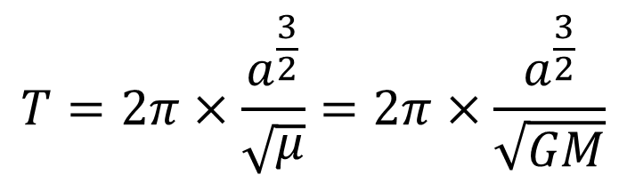
Semi-Major Axis
Let’s Have a Race
$$T=2π×\frac{a^{\frac{3}{2}}}{\sqrt{μ}}=2π×\frac{a^{\frac{3}{2}}}{\sqrt{GM}}$$
Notes:
This slide displays the Altitude file to demonstrate this content.
Let’s Have a Race
From this animation, the parallel of satellites being like race cars on a track can easily be drawn. The satellites are “all lined up at the starting line.” Ask students which satellite they think will complete a “lap,” or orbit, first. Depending on the students’ math background, walk them through the proof that the larger the semi-major axis (a), the greater the period.
The ONLY variable in the equation is a. It is to the 3/2 power, so the larger a is, the larger this term is. Therefore, the larger a is, the greater the period.
Start the animation and pause it after the first satellite completes an orbit. The students will see that the satellite with the smallest orbit has the smallest period.
A good question to pose to students at this point is “What is the approximate orbital period of the International Space Station?” The students will likely provide a wide range of answers. The correct answer is approximately 90 minutes!

Slide 18
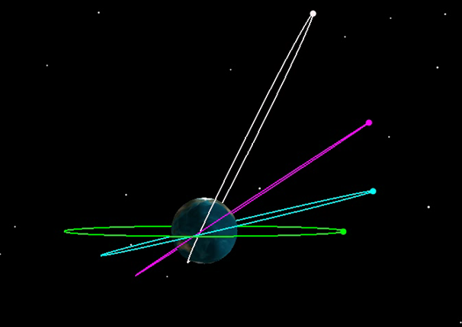
Semi-Major Axis
These orbits all have the same semi-major axis (a), but their eccentricities (e) and their orientations around Earth are different.
Observe the orbital periods.
Notes:
This slide displays the SemiMajorAxis file to demonstrate this content.
Illustration
It is important to rotate the .vdf file here so that students can clearly see the differences in the orbits. They may argue that these orbits are not the same size, but they are. Because their eccentricities vary so widely, the appearance of size can be a bit distorted. Ask students when a satellite will “win” the race for one orbit. Hopefully, they will answer that all orbits will have the same period, because this slide tells us that all of the orbits are the same size!
Prior to animating, it is suggested to rotate the Earth such that the view is essentially looking down on the North Pole, such that the white orbit is at the very top of the animation and all of the satellites appear to be lined up in the “12 o’clock position.” This orientation provides a clear starting and ending point. Animate and observe that all satellites complete one orbit in the same amount of time.
As was seen previously, at different times in the orbit, different satellites will take the lead. Be sure to point out to students that some of these satellites show dramatic changes in speed (the highly elliptical orbits), while others travel at a constant speed (the circular orbits). This phenomenon will be discussed later in the lesson.

Slide 19
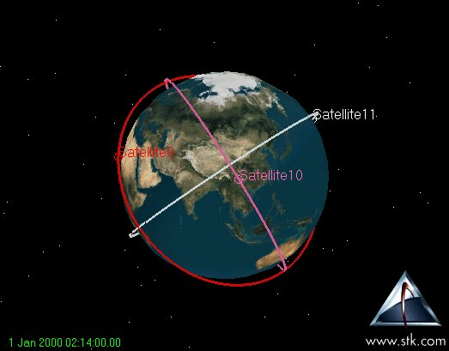
Describing the Orientation of the Orbit in Space
Orbits may have identical sizes and shapes (a and e), yet they can vary in their orientation in space.
Three additional Keplerian elements define this orientation:
Inclination
Right ascension of the ascending node
Argument of perigee
Notes:
This slide displays the Raan2 file to demonstrate this content.
Illustration
The hula hoop and basketball can again be used to reinforce the contents of this slide. There are numerous orientations in which a given hula hoop can be oriented around the ball. While the size and shape of the hula hoop don’t change, the orientation can. There must be parameters to describe the orientation of the orbit once its size and shape are known.

Slide 20
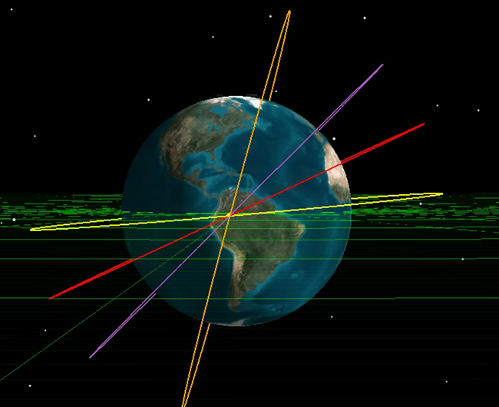
Inclination (i)
Inclination is the angle between the Earth’s equatorial plane and the plane of the orbit. It describes the tilt of the orbit.
i = 5^{ο}
i = 25^{ο}
i = 45^{ο}
i = 75^{ο}
???
Which satellite will complete one orbit first?
Notes:
This slide displays Inclination file to demonstrate this content.
Illustration
These satellites all have the same size and shape, but their tilts relative to the equator all differ. This tilt is called inclination. Rotate the .vdf to show students that only the inclination is different between the various orbits.
Once again, you can have the satellites race. In this case, the best starting point for the race is to have all of the satellites cross the equatorial plane. All of the satellites will complete one orbit in the same amount of time. Hopefully by now, students understand that period is dependent only upon the semi-major axis!
Students will most likely ask, “Won’t they crash into each other?” Stress that the size of the dots is greatly exaggerated in order to show the satellites. While in-space collision IS a topic which satellite operators must not neglect, the likelihood of collisions is very, very small.

Slide 21

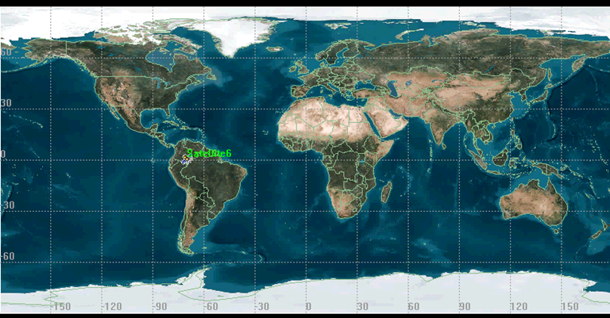
We interrupt our regularly scheduled presentation on inclination to bring you important information regarding ground traces!
If a long string with a magic marker tied to the end of it were hung from a satellite, the path which the magic marker would trace over the ground is the ground trace. A ground trace is a projection of the satellite’s orbit onto the Earth.
The satellite appears to move westward on (most) conventional orbits because the Earth is rotating eastward.
(More on this later!)
Notes:
This presentation displays the GroundTrace file.
Switching gears to 2D
This is the first time in this lesson that students will consider what an orbit looks like when projected in 2D rather than 3D. This projection is called a ground trace. A fair amount of information about the satellite’s orbit can be obtained simply from the ground trace. This information will be addressed in later slides.

Slide 22
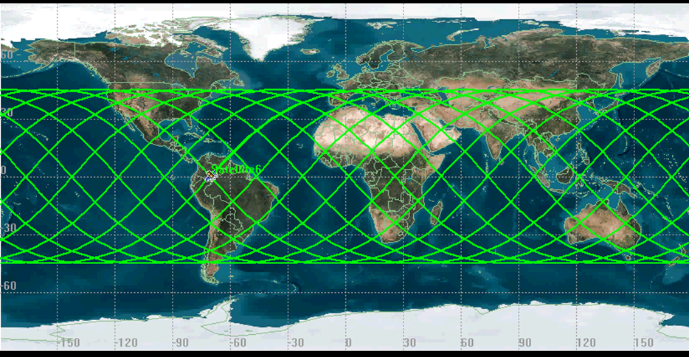
Ground Traces
After a full day, the ground trace of a satellite with an approximate 90 minute orbital period would look like this. Because the Earth is continually rotating below the orbit of the satellite, the ground trace eventually spans all longitudes.
Notes:
This presentation displays the GroundTrace_AlternateView file.
Further Explanation
If presented with a ground trace like this without having watched the previous slide’s movie, the ground trace can be extremely confusing to students. However, hopefully after watching the movie, students realize that, because the Earth continually rotates under the satellite, the ground trace appears to “move” itself across the Earth over the course of a day.
At this point it is good to ask students why the ground trace doesn’t cover the far north and far southern regions of the Earth (the next few slides will address this). If the satellite depicted in this slide had a mission of obtaining satellite imagery of an oil tanker spill just off the coast of Alaska, would this be a good orbit for that satellite? No! The satellite never orbits directly over Alaska. How could this problem be resolved? The next couple of slides will provide the students with the information they need to answer this question.

Slide 23
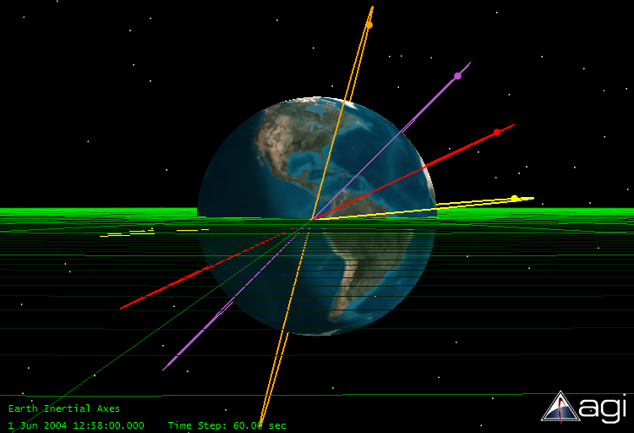
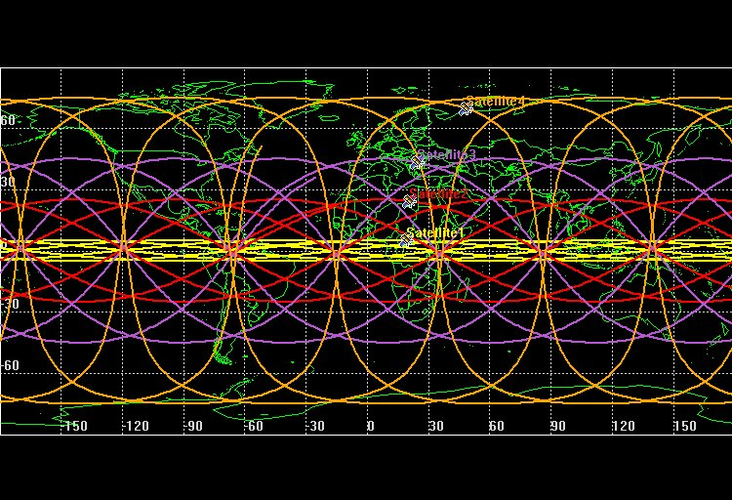
Back to Inclination
Inclination determines the northern and southern latitude limits over which the satellite orbits. For example, a satellite with a 45^{ο} inclination will have a ground trace ranging from 45º north to 45º south.
You can determine the inclination of an orbit simply by examining its ground trace.
Notes:
This slide contains two images not animations.
Tying it Together
The inclination of the satellite in degrees is equal to the northern and southern limits of the ground trace in degrees latitude. To answer the question from the previous slide, a satellite wishing to obtain imagery of an oil spill near Alaska should have an inclination close to the latitude of the oil spill.
The inclination of an orbit can be obtained simply by looking at the ground trace. Have students provide approximate inclinations for the orbits provided on this slide by looking at their ground traces. Do these inclinations seem to correspond to the degrees of “tilt” relative to the equatorial plane which they can see in the 3D picture? Yes, they do.
Which of the orbits pictured would be most suitable for a weather satellite? The answer is the orange satellite (or the one with the highest inclination), because it is important for weather satellites to be able to observe weather across the entire globe. Weather satellites are in highly inclined orbits.

Slide 24
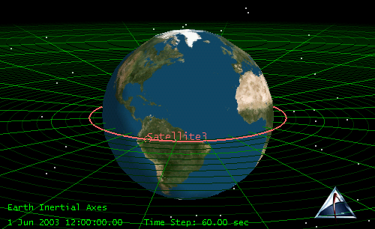
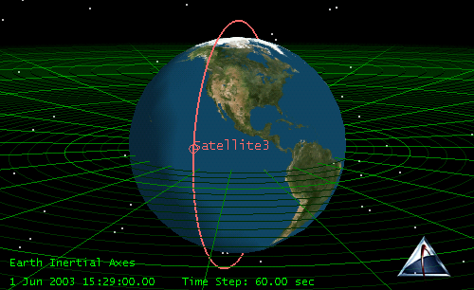
Inclination
An orbit with an inclination of 0 degrees is called an equatorial orbit.
An orbit with an inclination of 90 degrees is called a polar orbit.
Notes:
This slide contains two images not animations.
Special Terms
The terms “equatorial” and “polar” are used to describe orbits with zero and approximately 90 degree inclinations, respectively. Equatorial orbits are very important in the world of communications and are discussed later in the lesson. However, it should be noted that rarely (if ever) do satellites in equatorial orbits have altitudes as low as shown in this slide. This low altitude is used simply for the sake of illustrating a concept.

Slide 25
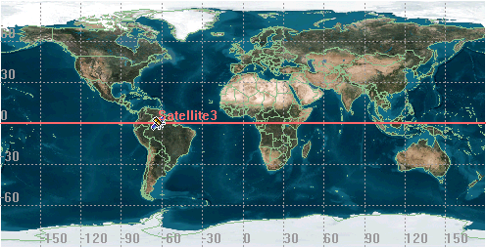
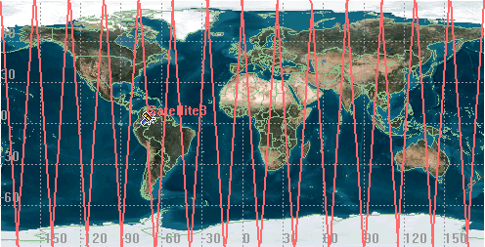
Inclination
A satellite in an equatorial orbit will pass directly over the equator.
A satellite in polar orbit will pass over the entire Earth.
Notes:
This slide contains two images not animations.
Further Explanation
Students should realize that in a polar orbit, the satellite would appear to pass off the southern limit of the map and then reappear from the northern limit, moving in a southerly direction. This is caused by the problem of representing a 3D globe in a 2D map.

Slide 26
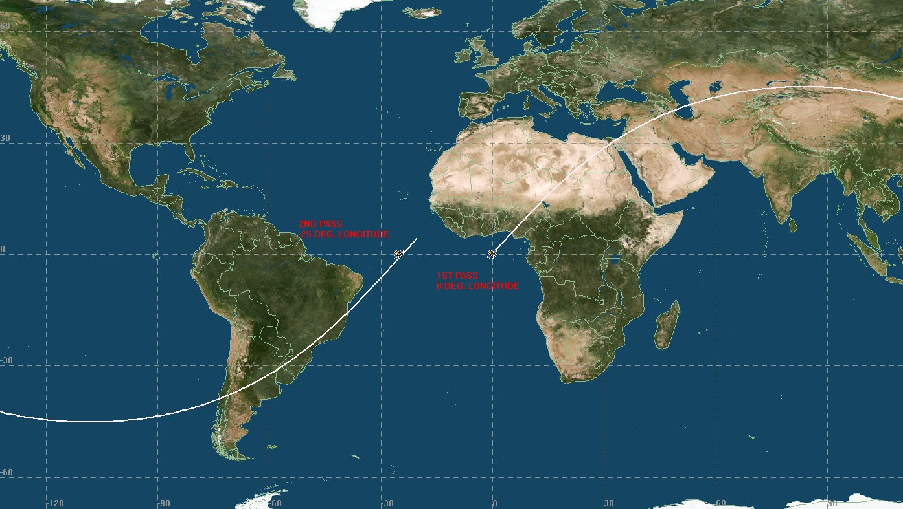
What Do Ground Traces Reveal?
2nd pass, 25 degrees west longitude
1st pass, 0 degrees longitude
Based on what we have already learned about orbital parameters, we can determine both inclination and orbital period from a ground trace.
  Inclination is determined simply by noting the northern and southern latitude limits of the ground trace.
  Orbital period can be determined using a simple calculation.
Notes:
This slide contains an image not an animation.
Further Explanation
Inclination has been discussed in detail in previous slides. However, the orbital period of a satellite can also be obtained from a ground trace. The next slide will walk through the process of computing inclination. However, in preparation for that computation, students should note the longitudes of the 1st and 2nd passes of the satellite from this ground trace.
The most common reference point used for such a calculation is the point where the satellite crosses the equator, or 0 degrees latitude. In this example, this occurs at 0 degrees longitude for this satellite’s first pass and 25 degrees west longitude for the 2nd equatorial crossing. We will use this information in the next slide.

Slide 27
Determining a Satellite’s Orbital Period from its Ground Trace
Recall that the orbit of a satellite remains fixed in space, and the Earth rotates underneath it.
The westward regression of the ground trace is due to the rotation of the Earth.
Determine how many minutes it takes for the Earth to rotate one degree:
1440 minutes/360 degrees = 4min/degree
Determine how many degrees per pass the satellite’s orbit regresses on consecutive orbits (equatorial crossing is a common reference point). We’ll use 25 degrees as an example.
How long did it take the Earth to rotate this many degrees? That’s the period of the satellite.
25degrees * 4min/degree = 100 minutes
Notes:
Mathematical Exercise
This slide walks students step by step through the process of determining orbital period from a ground trace.
Step 3 refers to 1440 minutes, which represents one day (24 hours X 60 minutes). Students should realize that the earth spins completely on its axis in one day.
NOTE: The exercise assumes a perfect 24 hour day. In actuality, the Earth completes a rotation on its axis in 23 hours, 56 minutes. For this lesson, we will simply use 24 hours.

Slide 28
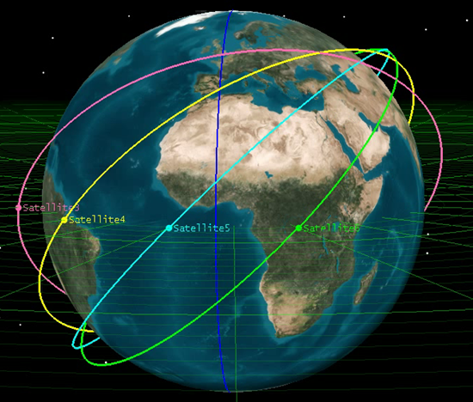
Right Ascension of the Ascending Node (RAAN, Ω )
Satellites may have identical eccentricities, semi-major axes, and inclinations (e, a, and i) yet may still be oriented differently in space – they can be “rotated” or “twisted” about the Earth in various ways.
Each satellite here starts out above a different longitude on the Earth. However, longitude can’t be used as a reference point because the Earth will rotate underneath the orbits, changing the reference longitude on each satellite pass.
Notes:
This slide displays the Raan file to demonstrate this content.
Further Explanation
RAAN is probably the most difficult orbital parameter for students to grasp. Return to the hula hoop and basketball illustration. Once the hula hoop is placed around the ball at a specified inclination, that hoop may still be “twisted” around the ball. RAAN describes this “twist.”
Before animating, note that in addition to the equatorial plane, another reference on the globe is provided. The blue line represents the Greenwich Meridian, or the line of 0 degrees longitude. Also stress to students that all of the orbits in this slide have the same eccentricities, semi-major axes, and inclinations. Students may argue that they have different inclinations, but this is an optical illusion. Look at each orbit individually and not the maximum latitude over which it passes. All have the same inclination.
Upon animating, note that the Greenwich Meridian could not be used as a reference for identifying where each orbit crosses the equatorial plane because the Earth is constantly rotating. The next few slides examine RAAN in greater detail.

Slide 29
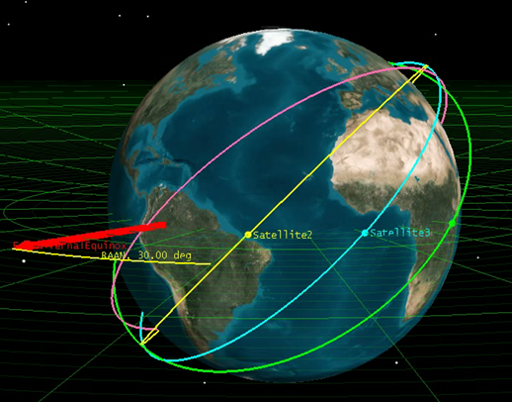
RAAN
Right ascension of the ascending node is the angle measured along the equatorial plane between a vector pointing to a fixed reference point in space (the first point of Aries, also known as the vernal equinox) and the point on the orbit where the orbital motion is from south to north across the equator (this point is called the ascending node).
= 0^{ο}
= 30^{ο}
= 60^{ο}
= 90^{ο}
Notes:
This slide displays the Raan2 file to demonstrate this content.
Further Explanation
It helps to break RAAN up into two parts, right ascension and ascending node. Explain ascending node first. This is the point on the orbit where the satellite crosses the equatorial plane in an ASCENDING direction, that is, traveling from the southern hemisphere into the northern hemisphere. 180 degrees after the ascending node, the satellite has a descending node. That is, it once again crosses the equator, this time traveling from the northern to southern hemisphere. It is this ascending node which must be located using a non-moving reference point.
This reference point is the right ascension portion of RAAN. Since we can’t use an earth-based reference point, we use a celestial reference point known as the vernal equinox or the first point of Aries. The angular measurement of the right ascension is 0 at the vernal equinox. If the ascending node of the orbit is aligned with the vernal equinox, the RAAN is 0.
RAAN references the vernal equinox which is determined by the orientations of the earth’s rotation axis and orbit around the sun. These orientations vary over time. In actuality our “fixed” celestial reference is not really fixed. Therefore, several different coordinate systems may be used which “point” to the place in space where the vernal equinox was at a given date. For example, the B1950 coordinate system points toward the location where the vernal equinox was at the onset of year 1950, and the J2000 to the point where it was at the onset of the year 2000.

Slide 30
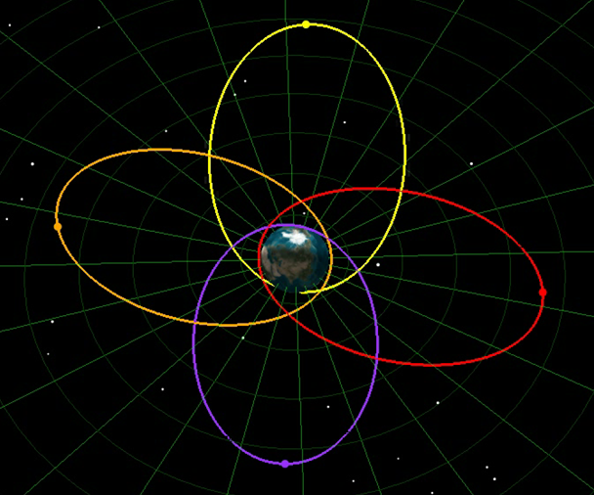
Argument of Perigee (ω)
Orbits may have the same e, a, I, and Ω, yet may still have different orientations around the Earth. The location of their perigee point can vary within the orbital plane.
Argument of perigee describes the orientation of the orbit within the orbital plane (where is apogee and where is perigee?).
It is measured as the angle from the ascending node to the perigee point in the direction of the satellite’s motion.
= 0^{ο}
= 90º
= 180^{ο}
= 270^{ο}
Notes:
This slide displays the ArgPerigee file to demonstrate this content.
Limitations
As the name implies, argument of perigee is only mathematically defined if a perigee point exists in the orbit. Up to this point in the lesson, circular orbits have been used heavily for examples, but a circular orbit has no perigee. Therefore, on this slide highly elliptical orbits are used so that the perigee point is obvious.
The orbits in this slide are identical in all parameters except for argument of perigee. Rotate the .vdf to illustrate this.
Observe the ascending nodes one orbit at a time. The red and orange orbits are the easiest to observe. With the orange orbit, the ascending node occurs AT perigee, hence the argument that perigee is 0 degrees. However, the red satellite experiences its ascending node at apogee, or 180 degrees from perigee.
While argument of perigee is undefined in circular orbits, a true perfect circular orbit is not possible in reality, so while seemingly circular, most “circular” orbits do have an apogee and perigee, albeit very, very close in distance.

Slide 31
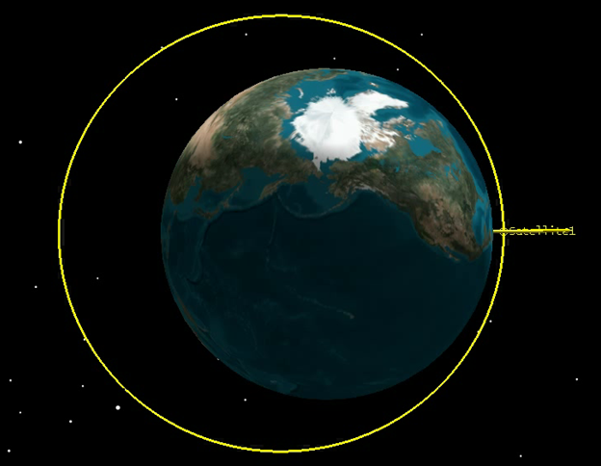
True Anomaly (υ)
After an orbit and its orientation have been thoroughly described, there must be a way to describe the satellite’s position within an orbit at any instant.
True anomaly is the angle between the perigee point and the satellite’s location (measured in the direction of the satellite’s motion). This value is constantly changing as the satellite moves in its orbit.
True anomaly is 0 degrees at perigee, 180 degrees at apogee.
Notes:
This slide displays the TrueAnomoly file to demonstrate this content.
Further Explanation
It is very important to note that a time stamp must always be associated with true anomaly. For example, if a time is not provided to state when a satellite is at its perigee point, it would be impossible to know when it will be at its apogee point (or any other point along the orbit). Therefore, when a complete Keplerian element set is provided (eccentricity, semi-major axis, inclination, right ascension of the ascending node, argument of perigee, and true anomaly), time must also be included to make this element set meaningful. This time is referred to as the epoch. True anomaly is an ever-changing parameter.
If multiple satellites occupied the exact same orbit but had different true anomalies, they would orbit over different locations of the Earth at any given moment.

Slide 32
Keplerian Elements in Review
The Keplerian element set consists of 6 parameters:
Two of these describe the size and shape of an orbit:
Eccentricity (e)
Semi-major axis (a)
Three of these describe the orientation of the orbit in space:
Inclination (i)
Right ascension of the ascending node (Ω)
Argument of perigee (ω)
One of these describes the location of the satellite within the orbit:
True anomaly (υ)
A time stamp, referred to as an “epoch,” must also be included when providing a Keplerian element set. This is so that it is known WHEN this set of values was accurate for the satellite or when the “snapshot” of the orbit was taken.
Notes:
Review
Prior to displaying the answers to each section, see if students can list the appropriate Keplerian elements.

Slide 33
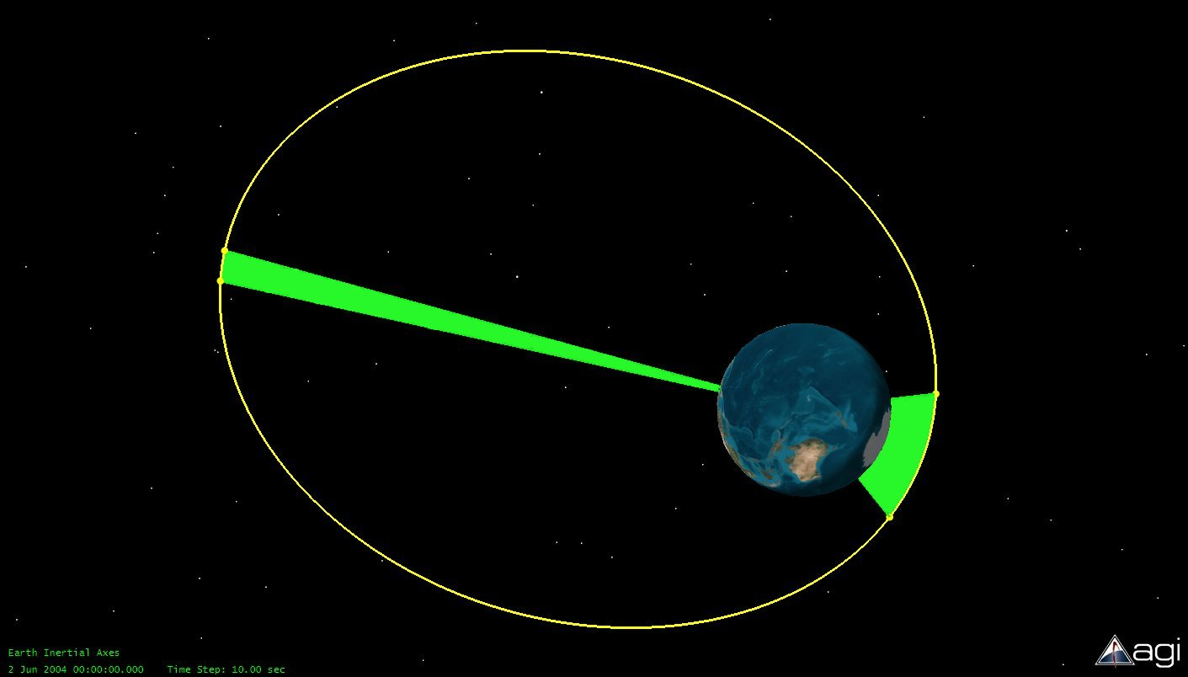
Kepler’s Laws
Kepler’s 1st Law: Satellites will travel around Earth in elliptical paths with the center of Earth at one of the foci.
Kepler’s 2nd Law: A line drawn between Earth and a satellite will sweep out equal areas during equal time periods anywhere along the orbit.
Translated, this means the speed of a satellite changes as the distance between it and Earth changes. At perigee a satellite is moving its fastest; at apogee, it is moving its slowest.
Time₁
Time₁
Kepler’s 3rd Law: The period of an orbit (T) is related to its semi-major axis (a) by:
T² = 4π²
* a³
μ
Notes:
This slide contains an image not an animation.
Kepler’s Laws
In addition to developing the Keplerian element set, Kepler also devised some laws of planetary motion.
Kepler’s First Law was introduced early in the lesson.
Kepler’s Second Law has not been discussed up to this point; however, students have seen the result of it. When viewing highly elliptical orbits, students likely noticed that the satellite travels fastest at perigee and slowest at apogee. This is an alternate way of stating Kepler’s Second Law and will be discussed again when introducing Molniya orbits.
Kepler’s Third Law has already been discussed in this lesson.

Slide 34
Special Orbit Types
The Keplerian element set chosen for any given satellite is highly dependent on its mission. Certain orbits are better suited for certain missions.
Notes:
Applying What You Have Learned
In the following slides, students will be introduced to certain special types of orbits. The reasoning behind the orbital parameters chosen for a given orbit should be discussed.

Slide 35
LEO (Low Earth Orbit)
No specified minimum altitude
Relatively close to the Earth (several hundred km)
  Short orbital periods ~90 minutes
  Many revolutions per day
  Limited swath areas
    What can the satellite view on Earth’s surface?
  All manned space missions (except lunar missions) were LEO
  Many Earth-observing satellites
    Weather and imagery
    Why is this?
Notes:
Further Explanation
Some students might erroneously offer that LEO must be related to the constellation Leo the Lion. There is no connection.
While the amount of Earth that can be seen by LEOs is small, it can be seen in fairly good detail. This is why Earth-observing satellites tend to be in LEO orbits. A good analogy to illustrate this concept to students is the following. If you are at a football game and want to be able to photograph the players’ names that are printed on the back of the jersey, would it be better to be seated on the sidelines or in the nose bleed section? In the nose bleed section, you could likely see the entire field, but the names would be unreadable. Taking pictures from the sidelines would limit the amount of field which could be seen, but the players in any given picture could be seen in much greater detail.

Slide 36
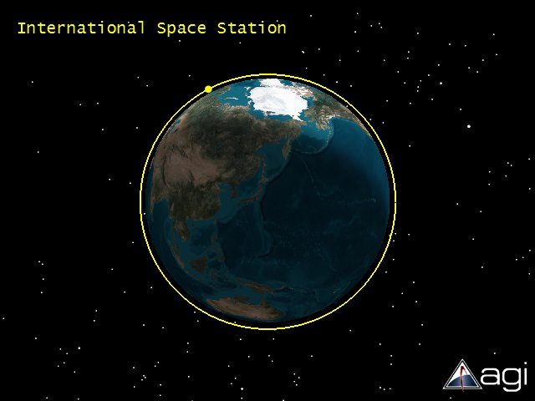
LEO (Low Earth Orbit)
Image is to scale showing International Space Station height of orbit ~ 350 km
Notes:
This slide contains an image not an animation.

Slide 37
GEO (Geostationary)
What’s in a name?
  Geostationary satellite remains over one location on Earth
  Achieved by placing the satellite in a special orbit where period exactly equals one day
    Altitude: roughly 36,000 km (22,200 miles)
    Inclination is exactly zero degrees
Notes:
Going Deeper
Encourage students to understand the two parts that comprise this word. They should be familiar with Geo from terms such as geology, geography, geothermal. Most students are also familiar with a stationary bicycle (as used in exercise), and they know they won’t travel very far when riding this kind of bike! People will often say that geostationary satellites are satellites that don’t move. THIS IS INCORRECT. They do move; they orbit the Earth. What is correct is that they don’t move with respect to a given location on the Earth.
As students have learned, the only orbital parameter which controls orbital period is semi-major axis or (in circular orbits) altitude. This is why geostationary orbits occur only at a single altitude above the Earth.
If a satellite at geostationary altitude has a non-zero inclination, it will not be stationary. It will drift north and south of the equator in an amount equal to its inclination. The ground trace will look like a figure 8.
Geostationary satellites are so well suited for communications because they are always in the same spot with respect to a given location on the Earth. Once an antenna (think of a DirectTV dish) is pointed toward the satellite, it is in constant contact with the satellite. This is in contrast to a LEO satellite which experiences brief periods of contact each day with any given location on the Earth. Additionally, if a LEO satellite were used for communication, the satellite dish on the ground would have to continually move to track the satellite.

Slide 38
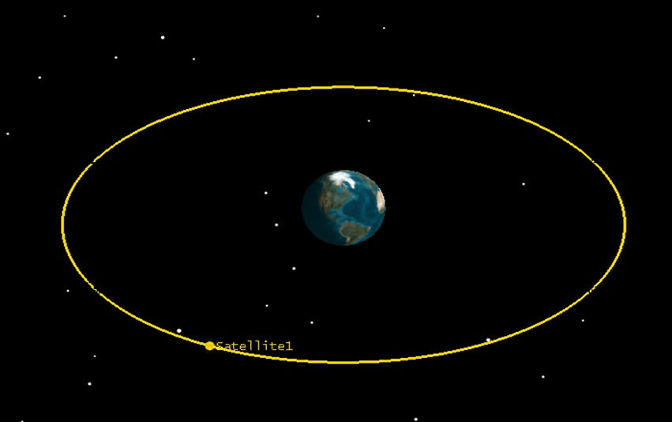
GEO (Geostationary)
Notes:
This slide displays the Geostationary file to demonstrate content within the previous slide.

Slide 39
GEO (Geostationary)
GEO satellite ONLY exists directly above equator AKA sub-satellite longitude
Geostationary satellite can see ~70 degrees north and south of the equator
Geostationary satellites mainly used for communications or “permanent relay station” in space

Slide 40
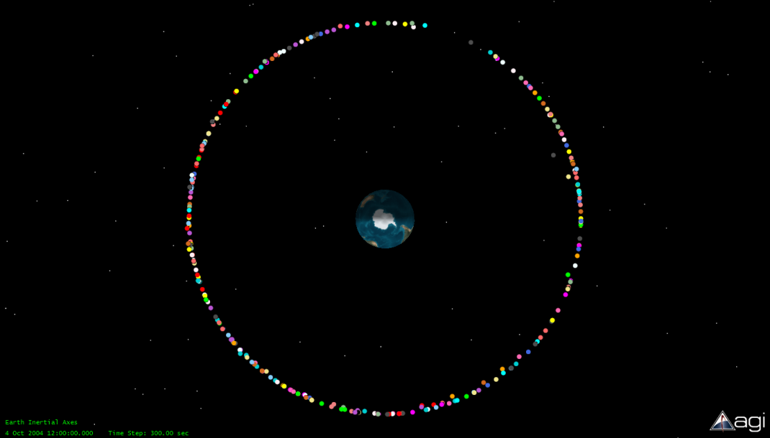
GEO
Only one altitude with a period of 24 hours
All geostationary orbits are in a “ring” around the Earth
The ring is called the geostationary belt
Geostationary belt is a limited resource
When a “Geobird” dies, it
Must be removed from its slot in the geobelt
Must make room for another satellite
Is usually boosted to a slightly higher orbit
Notes:
This slide contains an image not an animation.
Further Explanation
This is an actual representation of the satellites in the geostationary belt. While they appear to be right on top of each other, remember that the size of the dots indicating satellites are GROSSLY enlarged in order to be visible.
A good analogy for the limited “slots” in the geobelt is a parking lot. Once the lot is filled, no more cars (satellites) can be added. Think of a mall parking lot at Christmas Eve; any open spot is valuable! If a broken down, dilapidated car that no one was actually using were occupying a perfectly good spot, drivers of other cars would demand that the car be towed in order to free up the spot. The same applies to mission-dead geostationary satellites. These dead satellites must leave their slots so that new, functional satellites can use them. It requires far less fuel to boost such satellites to a higher, supersynchronous orbit than it requires to deorbit them. In essence, a “satellite graveyard” exists a few hundred km beyond the geostationary belt.

Slide 41
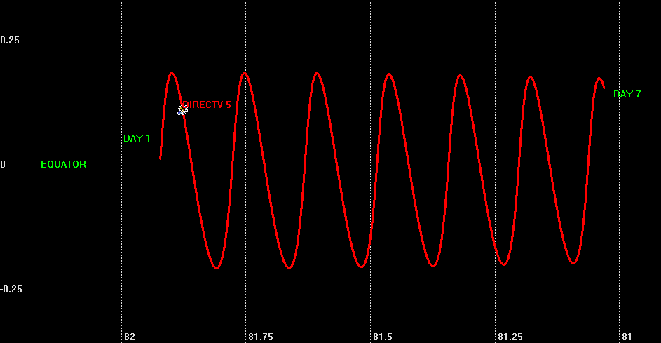
GEO
  Difficult to orbit exactly 24-hour period and zero inclination
  Orbits typically have slight inclination
    Satellites drift slightly north and south of equator
    Slight east or west drift due to imperfect period
  Small orbit-adjustment burns performed (called station-keeps)
  Satellites with 24 hour period and non-zero inclination are called geosynchronous
  Geostationary and geosynchronous often interchanged
Notes:
This slide contains an image not an animation.
Further Explanation
Be sure to point out the scale on this figure. The inclination and orbital drift may look significant, but the inclination is less than ¼ of a degree, and the satellite drifts less than a full degree of longitude in a week. Still, over time such adjustments become too great and must be corrected.
On a Somewhat Related Note
A very interesting topic to research is the history of the tiny island nation of Tonga and its impact on regulations in filing for geostationary “slots.” A good starting point on this topic is found in the New York Times issue dated August 28, 1990 in the business section. (http://query.nytimes.com/gst/fullpage.html?res=9C0CE0DB1539F93BA1575BC0A966958260&sec=&spon=&pagewanted=all)
This is an interdisciplinary research topic for students. It provides a clear example of science, politics, money, geography, and law intersecting in the real world.

Slide 42
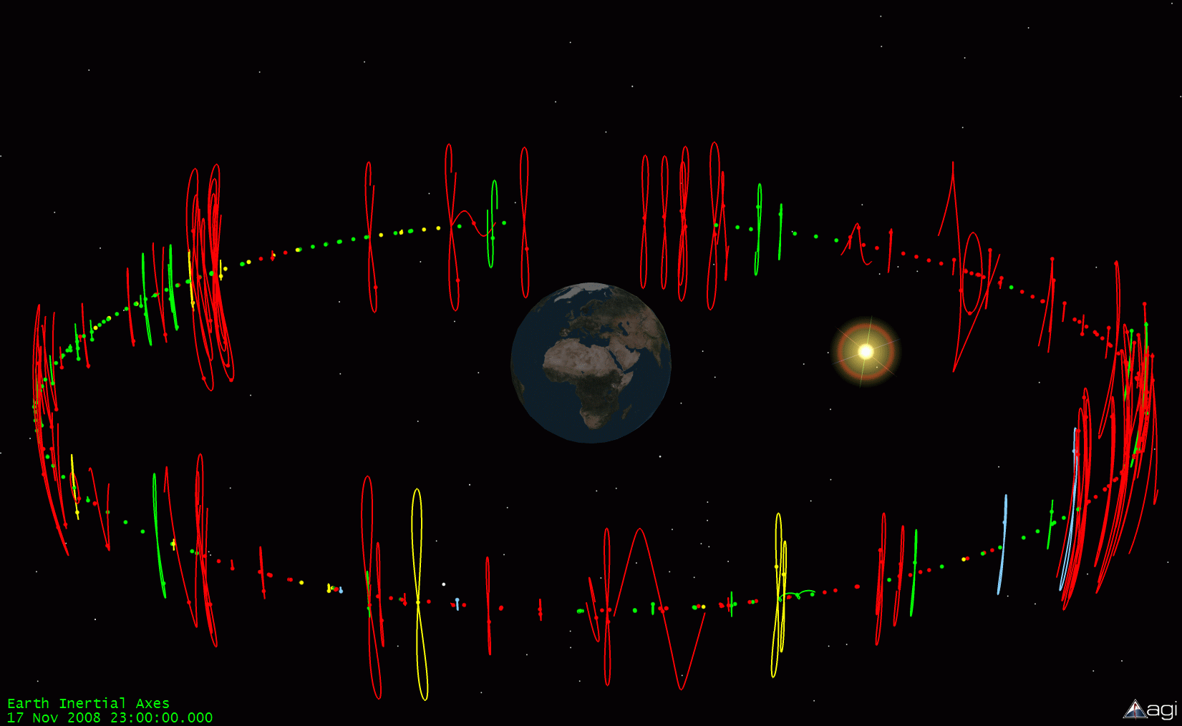
Real Geobelt
Ground traces projected out to geostationary altitude
Large inclinations (figure 8) run out of station-keeping fuel
Sine wave orbits are being drifted to new location
Orbit color participation in data sharing program
Notes:
This slide contains an image not an animation.
Explanation of Image
Ground traces of all operational geostationary satellites projected out to geostationary altitude
Large inclinations (figure 8 type orbits) ran out of station-keeping fuel
Sine wave orbits are being drifted to new location
Orbit color corresponds to participation in specific data sharing program not orbit-related data
Further Explanation
This slide may be a bit difficult for students to interpret. It is important that they understand that they are NOT seeing orbits here. An orbit, are they have already learned, is a closed path (circular, in the case of geostationary satellites). This slide is showing the ground traces projected out to space, whereas ground traces are normally shown against a 2D map of the earth. However, this representation allows for easy visualization of the “true” geostationary satellites versus those with significant inclinations.
A satellite may be fully functional long after it has run out of station-keeping fuel. In that case it would not be financially prudent to discontinue use of the satellite. Instead, the satellite is still used, although it begins to acquire an inclination which increases over time. Depending on the location of the ground station and the inclination of the satellite, continuous 24 hour contact with the satellite may become impossible.

Slide 43
GEO
A Short Lesson in Urban Navigation
Q.
How can you tell what direction is south if you’re lost in the middle of an urban area in the United States with no compass or GPS receiver? It is too cloudy to see the sun, and there is no moss growing anywhere! Think about what you have learned about orbits.
A.
Just look for a building/house with a TV satellite dish. Since geostationary satellites can only “hover” above the equator, all dishes in the northern hemisphere that are communicating with geostationary satellites must
be pointing toward the south.
Notes:
Thinking it Through
Be prepared for all sorts of answers to this question.
Students will likely offer up all kinds of answers based on nature solutions such as “If it is winter, look for the directions birds are flying, because they fly south in winter.” Remind the students you are looking for an answer based on satellites and their orbits.
After revealing the answer, discuss which direction TV satellite dishes would point in the southern hemisphere. Since they would all be located south of the equator, they would point north.
Keep in mind the dishes would necessarily point due north or south. If the satellite with which the dish is communicating is east or west of the dish, it would point southwest or southeast (or northwest or northeast), but the general north/south direction can be observed from satellite dishes.

Slide 44
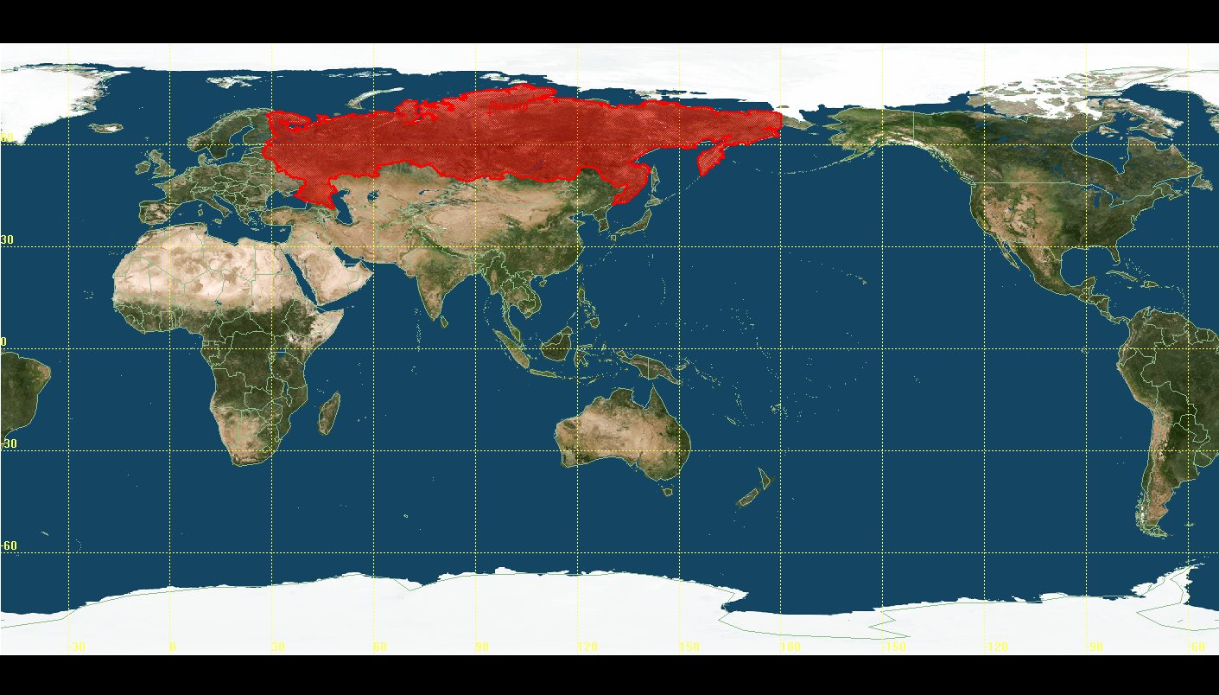
Molniya (Moly)
Using geostationary satellites for communications posed severe problems for Russia since so much of their land mass is near or north of 70 degrees in latitude.
To overcome this problem, they created a type of orbit, a Molniya orbit, to allow for long-term communications over their northern land mass.
Notes:
This slide contains an image not an animation.
Further Explanation
Students might point out that southern Russia falls not only below 70 degrees latitude, but even below 60 degrees latitude. Why couldn’t these parts of Russia utilize geostationary satellites? Even though geometric line-of-sight between a ground location and geostationary satellite can exist here, the satellite would be very low on the horizon relative to the ground site. This would require any signal passed to/from the satellite to pass through an exceptionally large amount of atmosphere, thereby resulting in significant signal loss. Also, when pointing a dish very low on the horizon, the horizon must be clear of obstructions such as buildings or trees. This is usually not possible.

Slide 45
Molniya
Highly inclined and highly elliptical orbit
High inclination covers northern Russia
High eccentricity
-- Large apogee altitude
-- Very slow velocity at apogee
If apogee is over Russia, then satellite hangs over Russia (Kepler’s 2nd Law)
Notes:
Further Explanation
Encourage students to watch the animation clock on the next animation so that they see that the satellite actually hangs over Russia for hours, not just minutes or seconds.

Slide 46
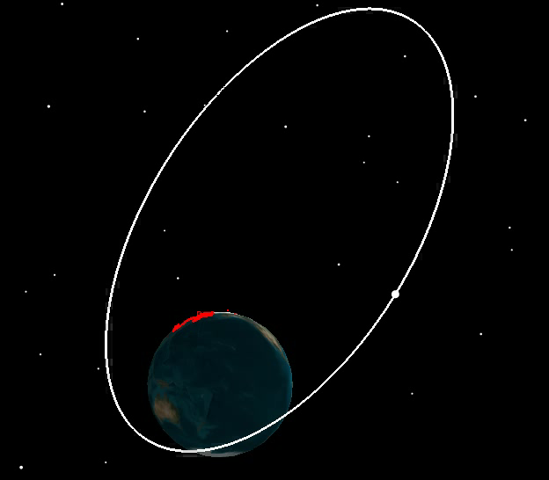
Molniya
Notes:
This slide displays the Molniya file to demonstrate this concept within the previous slide.

Slide 47
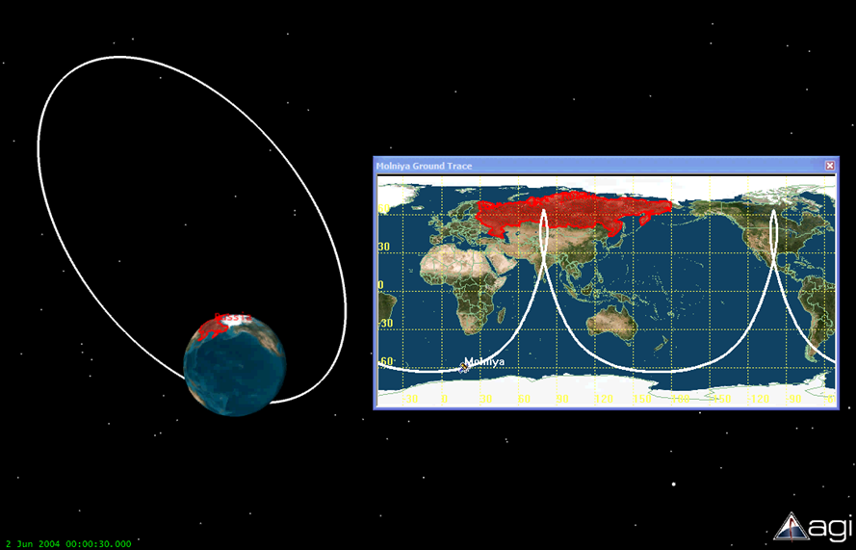
Molniya
The Molniya ground trace looks quite different from most conventional ground traces. It clearly illustrates the “hang time” of the satellite over the Russian Federation.
Notes:
This slide displays the Moly2and3D file to demonstrate this content.
Further Explanation
Point out that, due to the earth’s rotation, the satellite will hang over Russia and then hang over North America during two consecutive orbits. This made these orbits doubly useful to Russia (formerly the Soviet Union) during the Cold War. Not only could these satellites be used as communications satellites for Russia, they could also be used to spy on the United States! It should be noted that this type of intelligence collection was not photo imagery. The altitude was too high for that. These satellites were commonly used for signals collection and launch detection.

Slide 48
Polar
Because the inclination of a polar orbit is 90 degrees, a satellite in polar orbit will eventually pass over every part of the world. This makes polar orbits well-suited for satellites gathering information about the Earth, such as weather satellites.
A special type of polar orbit called a Sun-synchronous orbit passes over the same part of the Earth at roughly the same local time every day. Why might this be useful?
Notes:
This slide contains an image not an animation.
Further Explanation
This topic was briefly touched upon in the slides addressing inclination. In general, satellites with Earth-observing missions will have high inclinations. It should be noted that the inclination is not always exactly 90 degrees.
A sun-synchronous orbit is useful when data collection is desired at the same local time each day. For example, if measuring air quality or temperature of a certain area, the variations in these values which would naturally occur due to time of day can be eliminated with a sun-synchronous orbit.

Slide 49
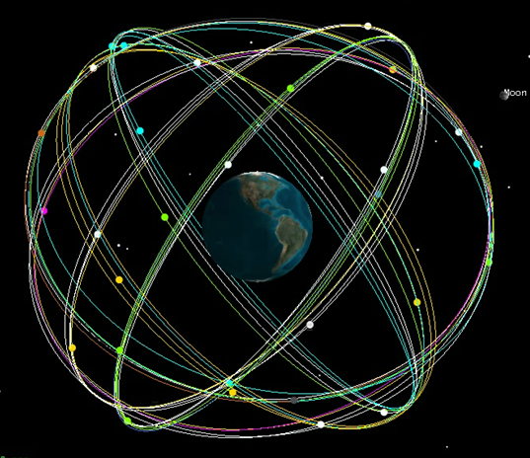
Constellations
A single satellite is often insufficient to perform a particular mission. Groups of satellites in various orbits will work together to accomplish the mission. Such groupings of satellites are called constellations. GPS (Global Positioning System) is one such example.
Notes:
This slide displays the Constellation file to demonstrate this content.
Further Explanation
This unit, for the sake of instruction and simplicity, has focused on individual orbits. However, constellations are extremely common in reality. Most students have heard of GPS, but there are many other satellite constellations.
As an optional activity, have students research different satellite constellations and their missions. Not all constellations look like the GPS constellation. The numbers of satellites and their orbital parameters will vary greatly.

Slide 50
Now That You Know the Basics
Use your new understanding of orbital mechanics to answer the following questions.
If Norway wanted to obtain satellite imagery of all of its major urban areas, what type of orbit would be appropriate?
Could researchers at McMurdo Station in Antarctica use geostationary satellites for communications?
Notes:
If opting to use STK software in addition to this presentation, students can create orbits which would be appropriate for these and other missions.

Slide 51
Now That You Know the Basics
If Norway wanted to obtain satellite imagery of all of its major urban areas, what type of orbit would be appropriate?
For the Norwegian satellites, the satellite should have a high inclination (since Norway is in the northern latitude region) and low altitude, circular orbit. The inclination is approximately 70-80 degrees with an altitude of several hundred km.

Slide 52
Now That You Know the Basics
Could researchers at McMurdo Station in Antarctica use geostationary satellites for communications?
No, because the latitude of Antarctica is too far south. However, options do exist.

Slide 53
Now That You Know the Basics
2. Could researchers at McMurdo Station in Antarctica use geostationary satellites for communications?
Option #1
Old geostationary satellites that have acquired significant inclination (i.e., >10 degrees) can often provide continuous communications for >6 hours a day when they are in the southern portion of their figure 8 ground trace.
Notes:
These old geostationary satellites have acquired significant inclination due to lack of station-keeping.

Slide 54
Now That You Know the Basics
2. Could researchers at McMurdo Station in Antarctica use geostationary satellites for communications?
Option #2
Researchers in Antarctica can also communicate using low Earth orbiting communication constellations such as Iridium.

Slide 55
Optional Analysis Tool
STK software can be used to explore, create, and analyze orbits in greater detail.
Notes:
STK
STK is a fully interactive software package that allows students to create and modify orbit and report out numerous data associated with these orbits. It requires an installation separate from AGI Viewer. Details regarding STK can be found in the teacher notes.

Slide 56
References
Analytical Graphics, Inc. (AGI). (2010). Educational resources. Retrieved from http://www.stk.com/resources/academic-resources/for-students/access-resources.aspx
National Aeronautics and Space Administration (NASA). (2009). Basics of flight. Retrieved from http://www2.jpl.nasa.gov/basics/bsf3-1.php

