Slide 1
Rocket Launch
Aerospace Engineering
© 2011 Project Lead The Way, Inc.

Slide 2
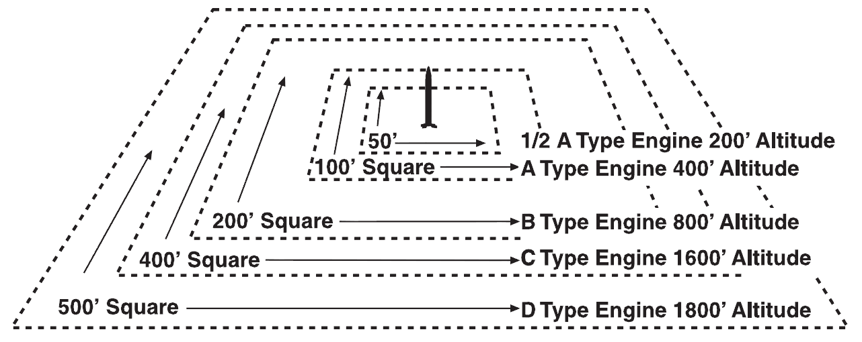
Launch Area
Minimum launch areas

Slide 3
Launch Configuration
Place launcher upwind of landing zone
Place spotters at right angles
Spotters will measure the angle of ground to rocket at maximum height
Spotter 2
>150ft
Spotter 1
Launcher
>150ft
Video
Camera
Safe Down range
Wind

Slide 4
Model Rocket Safety
General
Only use pre-packaged solid model rocket engines.
Check engine before use to make sure casing and nozzle are sound and have no defects or cracks.
Never re-use or re-pack a spent solid rocket engine.
Don't brew your own fuel.
Don't modify the nozzle or casing.

Slide 5
Model Rocket Safety
General
Use only cardboard tubes and balsa or plastic fins and nose cones for the rocket construction. Don't use any metal parts.
Preflight
Check for loose fins, launch lugs, and shock cords.
Check the condition of your recovery system.
Check the stability of your rocket with the engine installed.

Slide 6
Model Rocket Safety
Preflight
Be sure that your nose cone does not fit too tightly in the body tube. A nose cone that is too tight can cause the engine to be expelled by the ejection charge with subsequent loss of the rocket.
Use electrical launching devices that come with your launch rail and launch pad. Don't use fuses and matches.
Remove safety key when connecting the clips to the wires of the igniters.

Slide 7
Model Rocket Safety
Preflight
Make sure that no one is "playing with" the launcher while you are at the pad.
Make sure that the pad is securely anchored so that it doesn't tilt or fall over with a large rocket.
Place cup over the top of the launch rail when you are at the pad so that you don't accidentally get poked in the eye.
Don't fly in high winds or in threatening weather.

Slide 8
Model Rocket Safety
Preflight
Fly your rocket in an open field where there are no obstacles.
Never fly near trees, a highway, houses, or high tension wires.
Launch
Clear the pad area before launching.
Call a countdown so that others in the area are aware that a rocket is being launched.

Slide 9
Rocket Engine Preparation

Slide 10
References
Reproduction Masters for Model Rocketry, Estes (2010). Retrieved from http://www.estesrockets.com/index.php/site/estes-educator/
National Aeronautics and Space Administration (2010). Retrieved from http://www.grc.nasa.gov/WWW/K-12/rocket/rktsafe.html

