Slide 1
Air Traffic Control
How Air Traffic Is Coordinated
Aerospace Engineering
© 20161 Project Lead The Way, Inc.

Slide 2
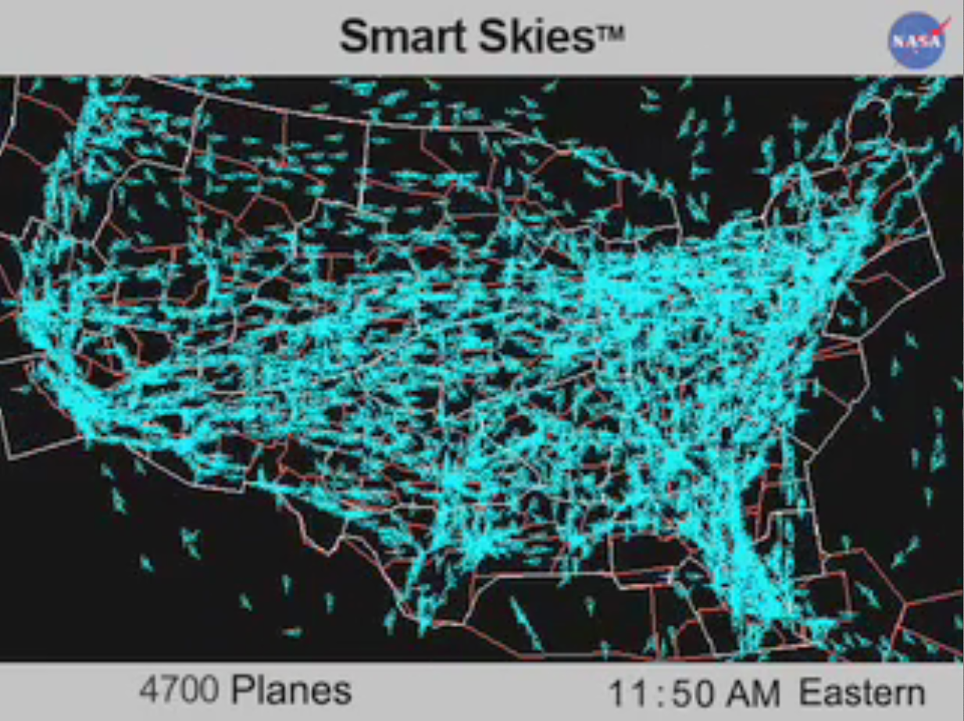
Air Traffic Across the U.S.
Aerospace Engineering
© 2016 Project Lead The Way, Inc.
Notes:
View the 24 Hours of Flight video

Slide 3
National Airspace System (NAS)
Complex system composed of
Airspace
Airports
Aircraft
Pilots
Air navigation facilities
Air Traffic Control (ATC) facilities
Many more components
Aerospace Engineering
© 2016 Project Lead The Way, Inc.
Notes:
Source: Safety Management System (SMS) Manual

Slide 4
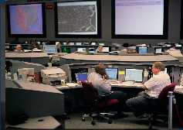
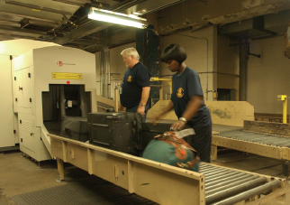
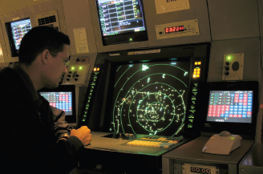
Air Traffic Control (ATC) System
Part of the Federal Aviation Administration (FAA)
ATC system purpose is to coordinate the movement of air traffic to ensure that aircraft stay safe distances apart.
Notes:
More information about FAA and ATC available at
http://www.faa.gov/air_traffic/
http://www.faa.gov/about/history/historical_perspective/

Slide 5
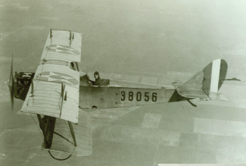
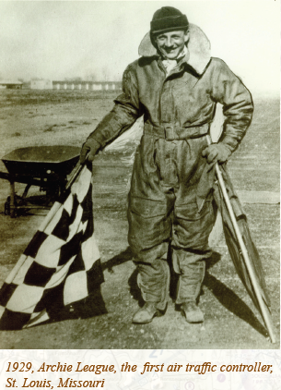
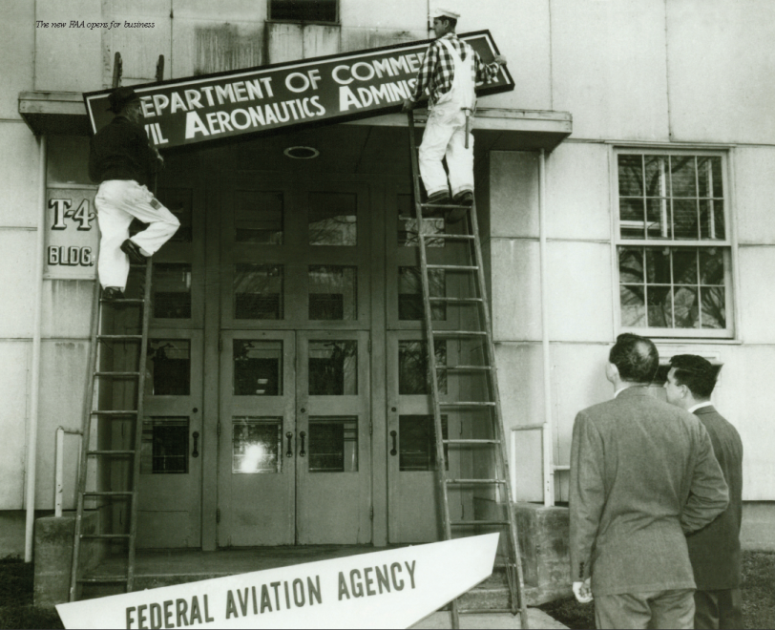
How Did Air Traffic Control Start?
Early aviators depended on visual references
Some airports began using flagmen in ’20s
Air Commerce Act in 1926 established U.S. rules
Air Traffic Control began in 1958 after series of mid-air collisions
Notes:
http://www.faa.gov/air_traffic/publications/atpubs/ATC/atc0201.html

Slide 6
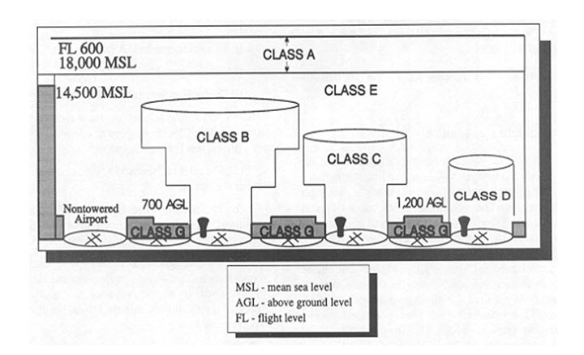
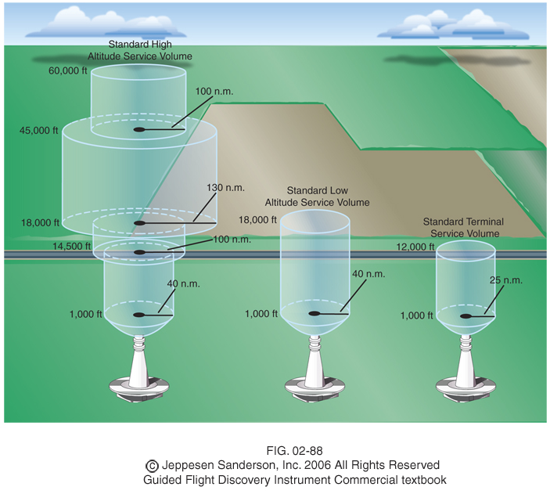
Air Traffic Control System
Air space is divided into three-dimensional areas called classes (A through G)
Airspace close to an airport looks like upside-down wedding cake
Airports connected by Federal airways are called “Victor airways” and “jet routes”
Notes:
Each airspace class has different rules about use and control. Federal airways are like three dimensional highways in the sky. Victor airways exist at low altitudes of 1200 ft AGL to 18,000 ft. Jet routes exist above 18,000 ft.

Slide 7
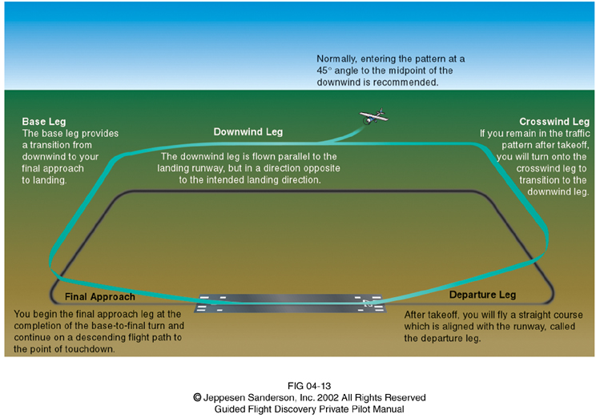
Typical Airport Traffic Pattern
Pattern defines routes to approach and depart from each airport
To provide consistency, patterns are based on five main legs
Downwind
Base
Final
Departure
Crosswind
Notes:
The primary airport runways are aligned parallel to the prevailing winds to allow aircraft to land at and depart from the airport while facing the wind. This provides a slower ground speed for all speeds of air flow over the wings. This improves safety by allowing a shorter distance for takeoff and landing.

Slide 8
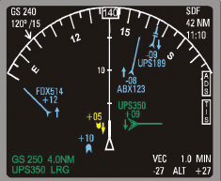
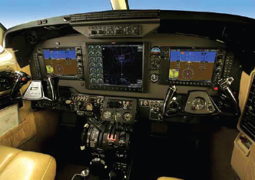
Air Traffic Control System
Pilots and ATCs each use sets of rules
Visual Flight Rules (VFR)
Instrument Flight Rules (IFR)
Standards developed by U.S., used worldwide
Procedures
Equipment
English language
Notes:
Visual Flight Rules are a set of FAA regulations where conditions allow pilots to fly aircraft using visual cues in day or night conditions. This set of regulations is more common in general aviation (GA), which is non-commercial aviation. Instrument Flight Rules are used when conditions prevent use of VFR rules. Instrument Flight Rules are the predominant rules followed in commercial aviation.

Slide 9
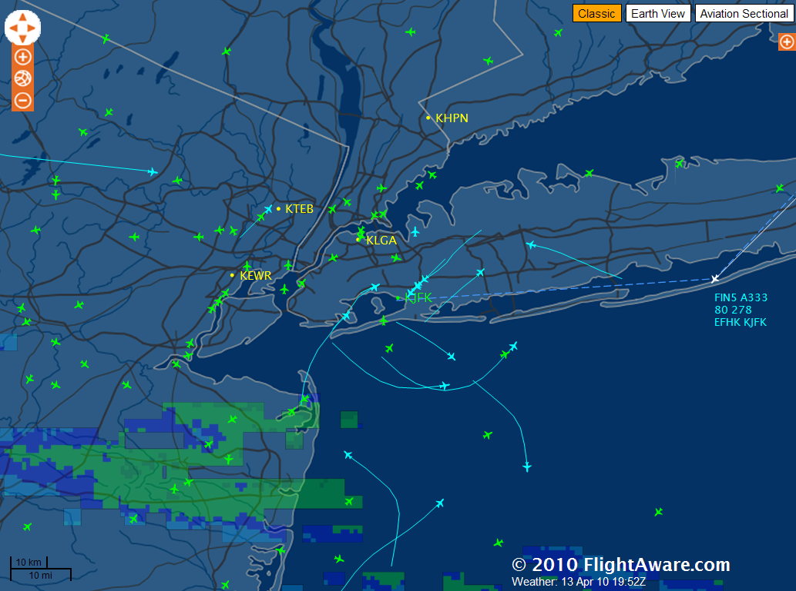
Air Traffic Control System
Air Traffic Controllers often do not actually see airplanes
Air Traffic Control System Command Center
Coordinates air traffic for nation
Aircraft directed to speed up or slow down to balance air traffic
Click the image to see live air traffic at JFK Airport in New York
Notes:
ATCs often do not actually see airplanes. Instead they rely on radar and other instruments. The distances and atmospheric conditions often prevent seeing aircraft directly.
This is an image of JFK airport in New York from the Flight Aware website: http://flightaware.com/live/airport/KJFK. Air traffic is available from http://flightaware.com

Slide 10
Air Traffic Control (ATC)
Long history of development
What’s next?
Aerospace Engineering
© 2016 Project Lead The Way, Inc.
Notes:
More information is available at the following website https://www.faa.gov/nextgen/

Slide 11
References
Federal Aviation Administration (2010). The Federal Aviation Administration: A historical perspective, 1903-2008. Retrieved from http://www.faa.gov/about/history/historical_perspective/
Federal Aviation Administration (2010). Air traffic administration. Retrieved from http://www.faa.gov/air_traffic
Federal Aviation Administration (2016). Safety Management System (SMS) Manual. Retrieved from https://www.faa.gov/air_traffic/publications/
Jeppesen Sanderson, Inc. (2006). Guided flight discovery private pilot images [CD-ROM]. Englewood, CO: Jeppesen Sanderson, Inc.
U.S. Bureau of Labor Statistics (2016). Air Traffic Controllers. Retrieved from http://www.bls.gov/ooh/
Aerospace Engineering
© 2016 Project Lead The Way, Inc.

