Slide 1
Evolution Of Human Flight
Aerospace Engineering
© 2011 Project Lead The Way, Inc.

Slide 2
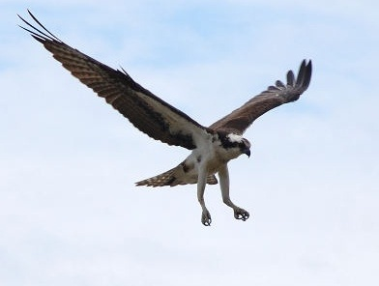
Why Human Flight?
The desire to fly is an idea handed down to us by our ancestors who . . . looked enviously on the birds soaring freely through space . . . on the infinite highway of the air.
~ Wilbur Wright
Notes:
Orville and Wilbur Wright designed and flew the first heavier than air vehicle named the Wright Flyer on December 14, 1903.

Slide 3
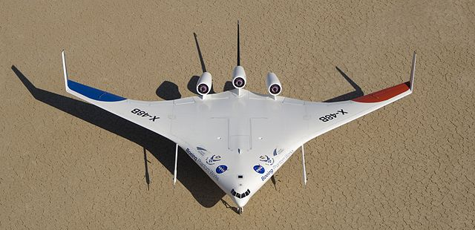
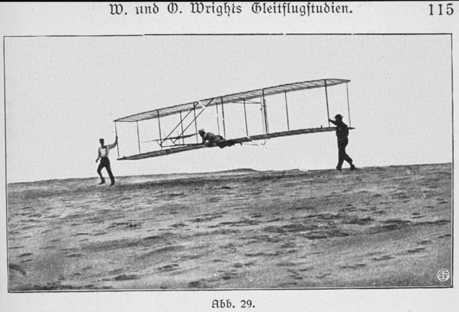
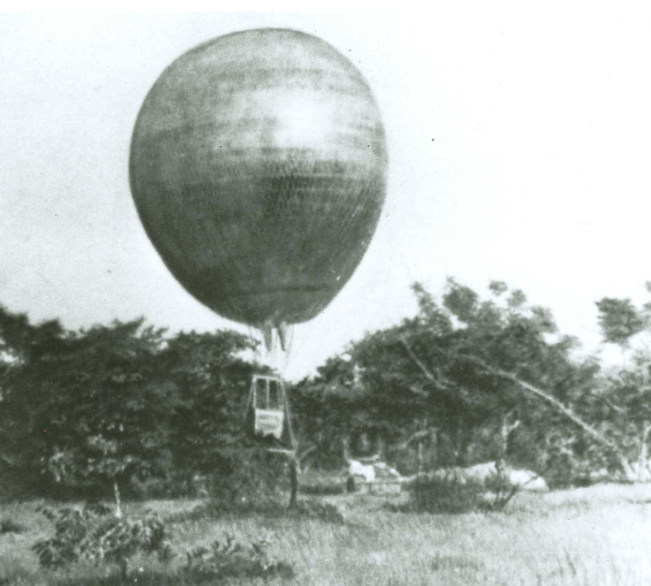
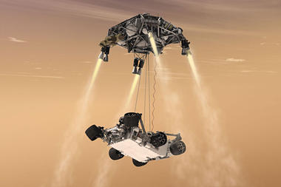
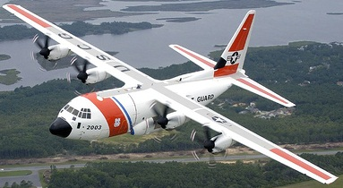
Aerospace Engineering
How did we progress?
Applying science, technology and math through engineering

Slide 4
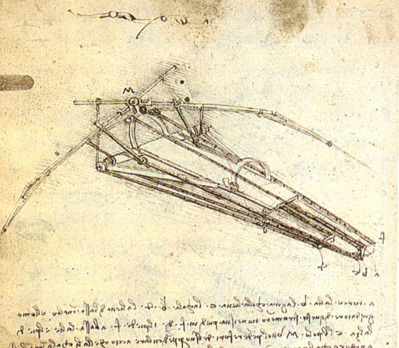
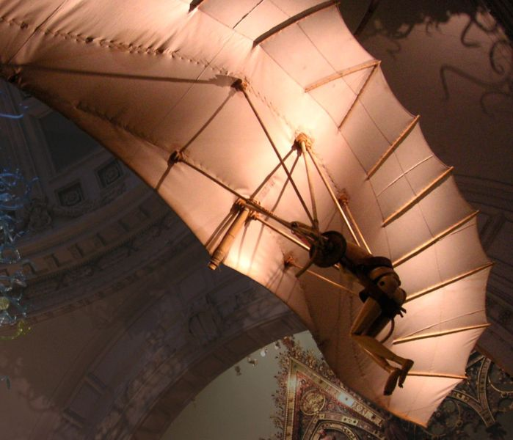
Early Aerospace Engineering
Creative thinking is crucial
Leonardo da Vinci (Lived 1452-1519)
Factors such as technology prevented the idea from becoming reality 600⁺ years ago
Drawing of a Flying Machine
Model of a Flying Machine

Slide 5
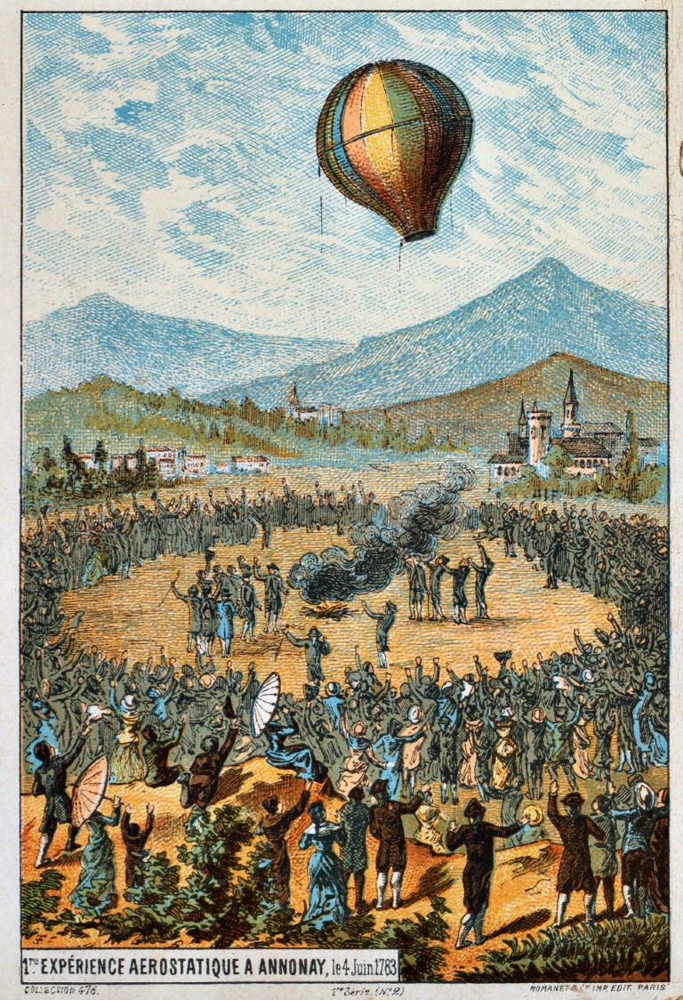
Lighter Than Air
Designing and flying a lighter than air vehicle was an important step
Montgolfier brothers, 1782
What inspired lighter than air flight?
Rising smoke

Slide 6
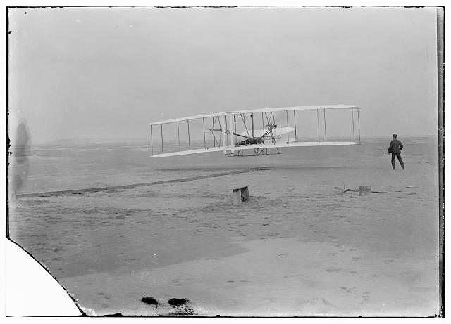
Heavier Than Air Vehicles
Orville and Wilbur Wright flew the Wright Flyer on December 14, 1903
Flew 120 feet in 12 seconds @ 6.8 mph
Built on concepts from others
Horizontal and vertical surfaces
Elements of wing design
Notes:
Orville and Wilbur Wright are best known for their engineering related to the first successful heavier than air vehicle. It is important to understand that to achieve this both had an approach that is common throughout the practice of engineering. Both were very creative and gained significant knowledge and skills through observation and experimenting often using procedures and apparatus that they designed. The brothers learned by doing and were able to build their own knowledge and contribute to the advancement of aviation.

Slide 7
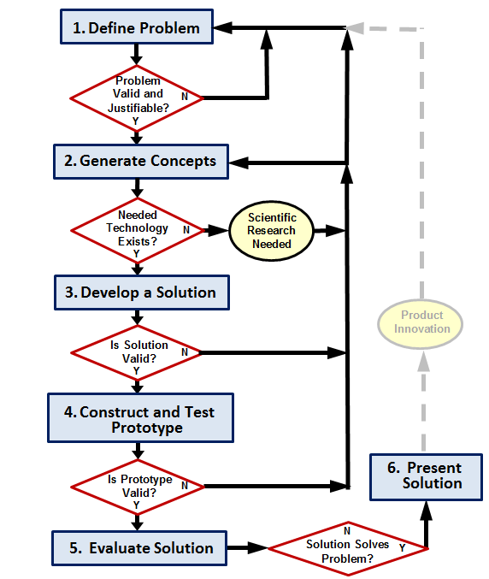
Aerospace Engineering Growth
In one century human flight progressed from a flight of 6.8 mph to thousands of mph for aircraft and tens of thousands mph for spacecraft
How?
STEM
Science
Technology
Engineering
Math
Image, design, test, fail, learn, try again

Slide 8
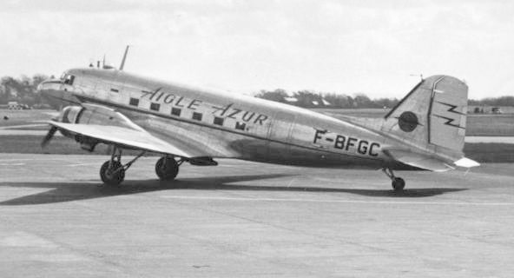
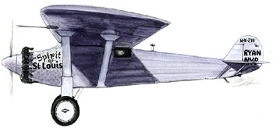
Commercial Aviation
Catalysts for growth
Legislation
Competition and fame
Charles Lindbergh
First non-stop crossing of Atlantic ocean (1927)
Won the Orteig Prize as result
Amelia Earhart
First woman non-stop crossing of Atlantic ocean (1932)
Need for fast transportation
Mail delivery
Paying passengers

Slide 9
Military
Word War I through start WWII
Engineers developed:
More efficient aircraft
Better engines
World War II
Demand for aircraft was extreme
Advances in aerospace engineering and manufacturing capability made this possible
Aircraft performance
Navigation aids
RADAR

Slide 10
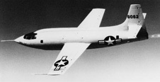
Increasing Performance
Supersonic flight
Aerospace engineers continued to learn
Captain Chuck Yeager flew Mach 1.06 (~700 mph @ 43,000) in 1946
Notes:
More information is available at NASA Dryden Research Center: http://www.nasa.gov/centers/dryden/news/FactSheets/FS-085-DFRC.html#.UuLVDhAo5pg

Slide 11
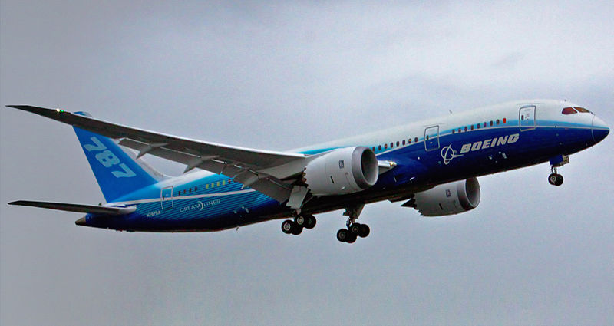
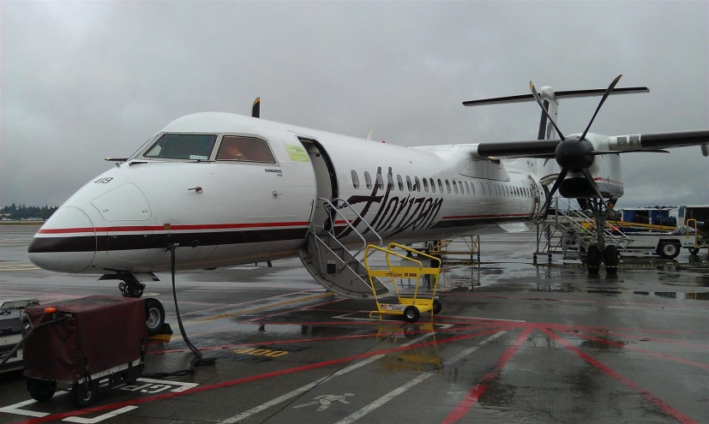
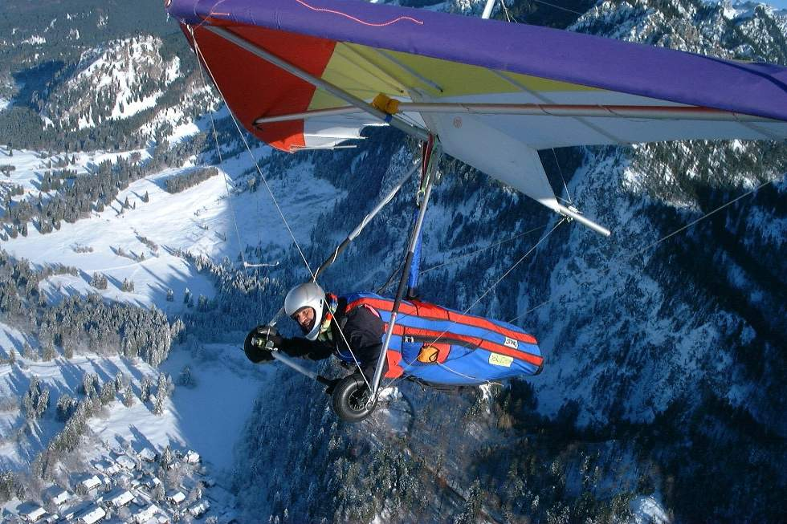
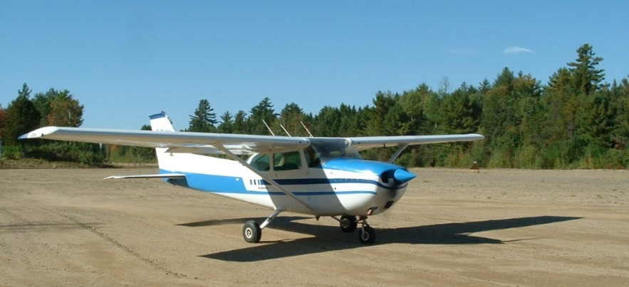
Continued Development
Commercial aircraft
Personal general aviation aircraft
Sport such as hang gliders

Slide 12
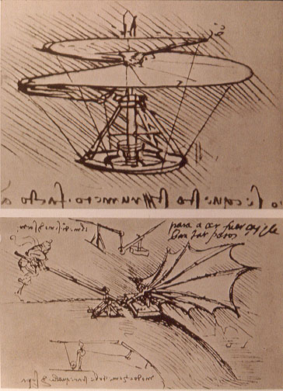
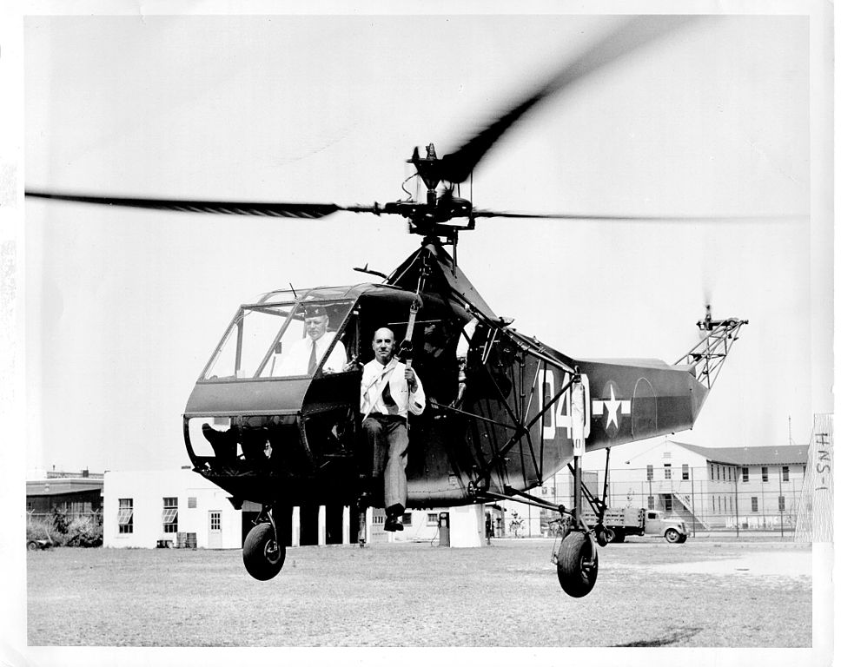
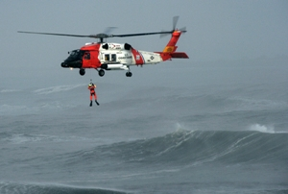
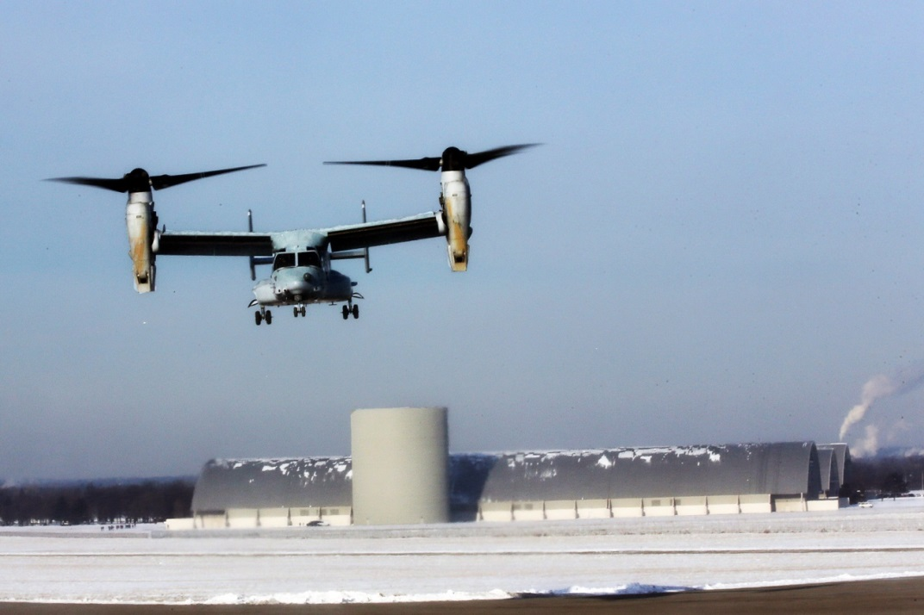
Rotorcraft
Leonardo da Vinci helicopter concept circa 1480
Igor Sikorsky engineers wide scale production of helicopters in 1944
Engineer to design, test, fail, improve

Slide 13
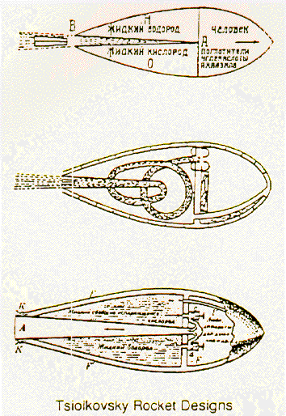
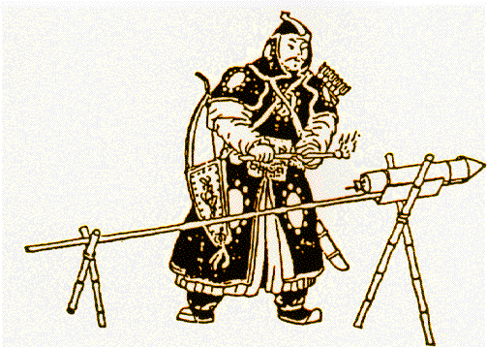
Space Flight
Rocketry
Chinese credited as using in 1,232 AD based on development of black powder.
Russian space scientist Tsiolkovsky developed equations in 1903 to reach space

Slide 14
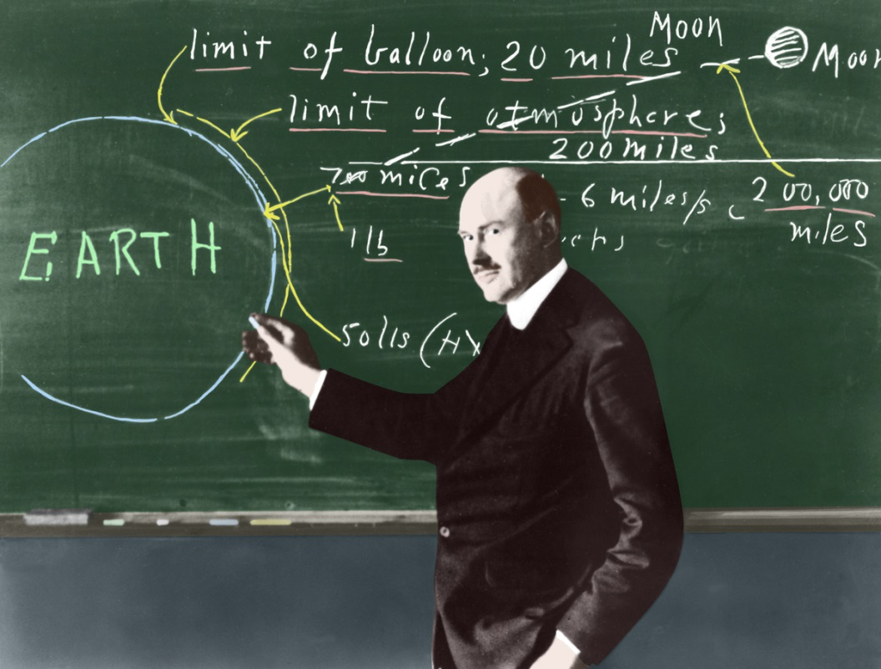
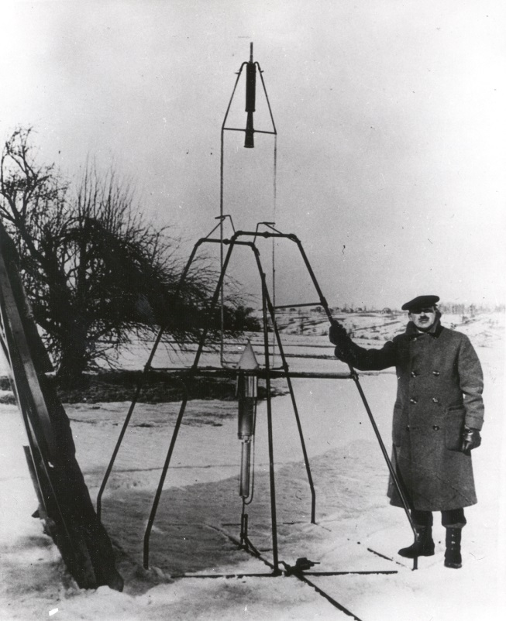
Space Flight
Rocketry
American Robert Goddard
Considered the father of modern rocket propulsion
First liquid fueled rocket launch in 1926

Slide 15
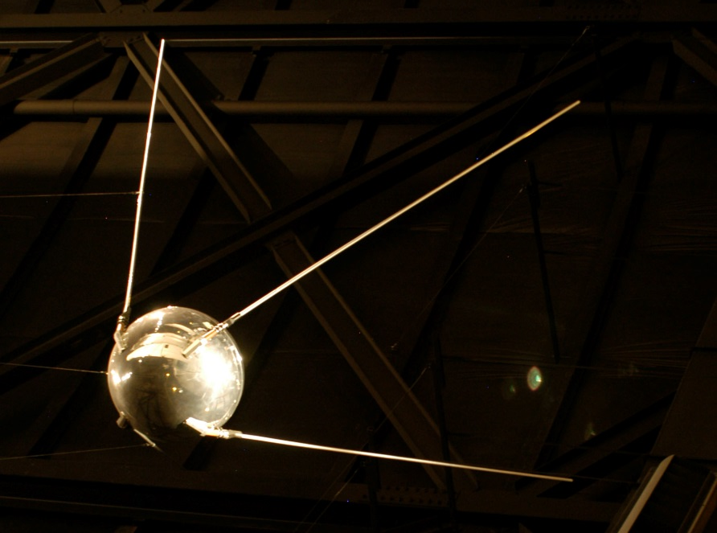
Space Race
Competition Drives Accomplishment
United States and Soviet Union (Russia) space race
Similar to Lindbergh crossing the Atlantic to win a prize in 1927
First Satellite is put in orbit by Soviet Union in Oct, 1957
First animal in space by Soviet Union in Nov, 1957
United States successfully launched its first Satellite (Explorer I) in Jan, 1958
US passes the National Aeronautics and Space Act creating NASA in Oct, 1958
Notes:
Recording of communication emitted by Sputnik can be heard at http://history.nasa.gov/sputnik/sputnik.wav
National Advisory Committee for Aeronautics, NACA, was dissolved when National Aeronautics and Space Administration, NASA, was created.

Slide 16
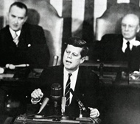
Space Race
Competition Drives Accomplishment
US and Soviet Union race to space
President Kennedy proclaims in 1961 that the US should commit to landing on moon within the decade
How can that be done?
That’s what the US needed to figure out!
Nine years of intense engineering, failure and learning
Notes:
When John F. Kennedy became president in January 1961, Americans had the perception that the United States was losing the "space race" with the Soviets. President Kennedy understood the need and had the vision of not only matching the Soviets, but surpassing them. On May 25, 1961, he stood before Congress and proclaimed that “this nation should commit itself to achieving the goal, before the decade is out, of landing a man on the moon and returning him safely to the earth.”
A transcript and video can be seen at http://www.jfklibrary.org/Asset-Viewer/xzw1gaeeTES6khED14P1Iw.aspx
On September 12, 1962, President Kennedy delivered a speech describing his goals for the nation’s space effort before a crowd of 35,000 people in the football stadium at Rice University in Houston, Texas.
“We choose to go to the moon. We choose to go to the moon in this decade and do the other things, not because they are easy, but because they are hard, because that goal will serve to organize and measure the best of our energies and skills, because that challenge is one that we are willing to accept, one we are unwilling to postpone, and one which we intend to win, and the others, too. ”
A transcript and video can be seen at http://www.jfklibrary.org/Asset-Viewer/MkATdOcdU06X5uNHbmqm1Q.aspx

Slide 17
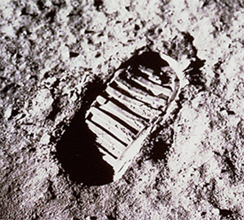
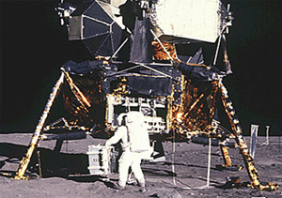
Space Race
America won the race to the moon
Neil Armstrong stepped on the moon July 20, 1969
Success through determination

Slide 18
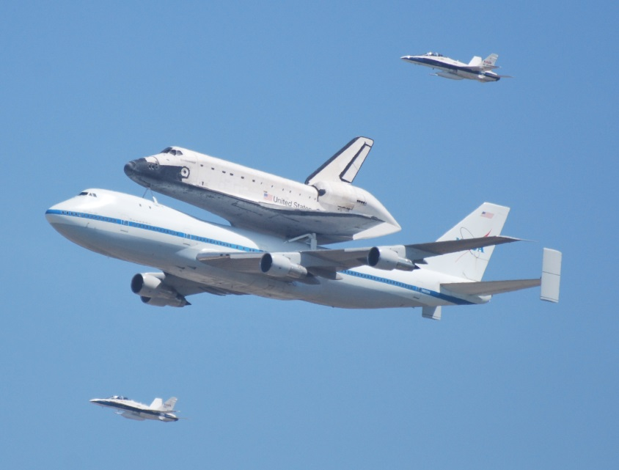
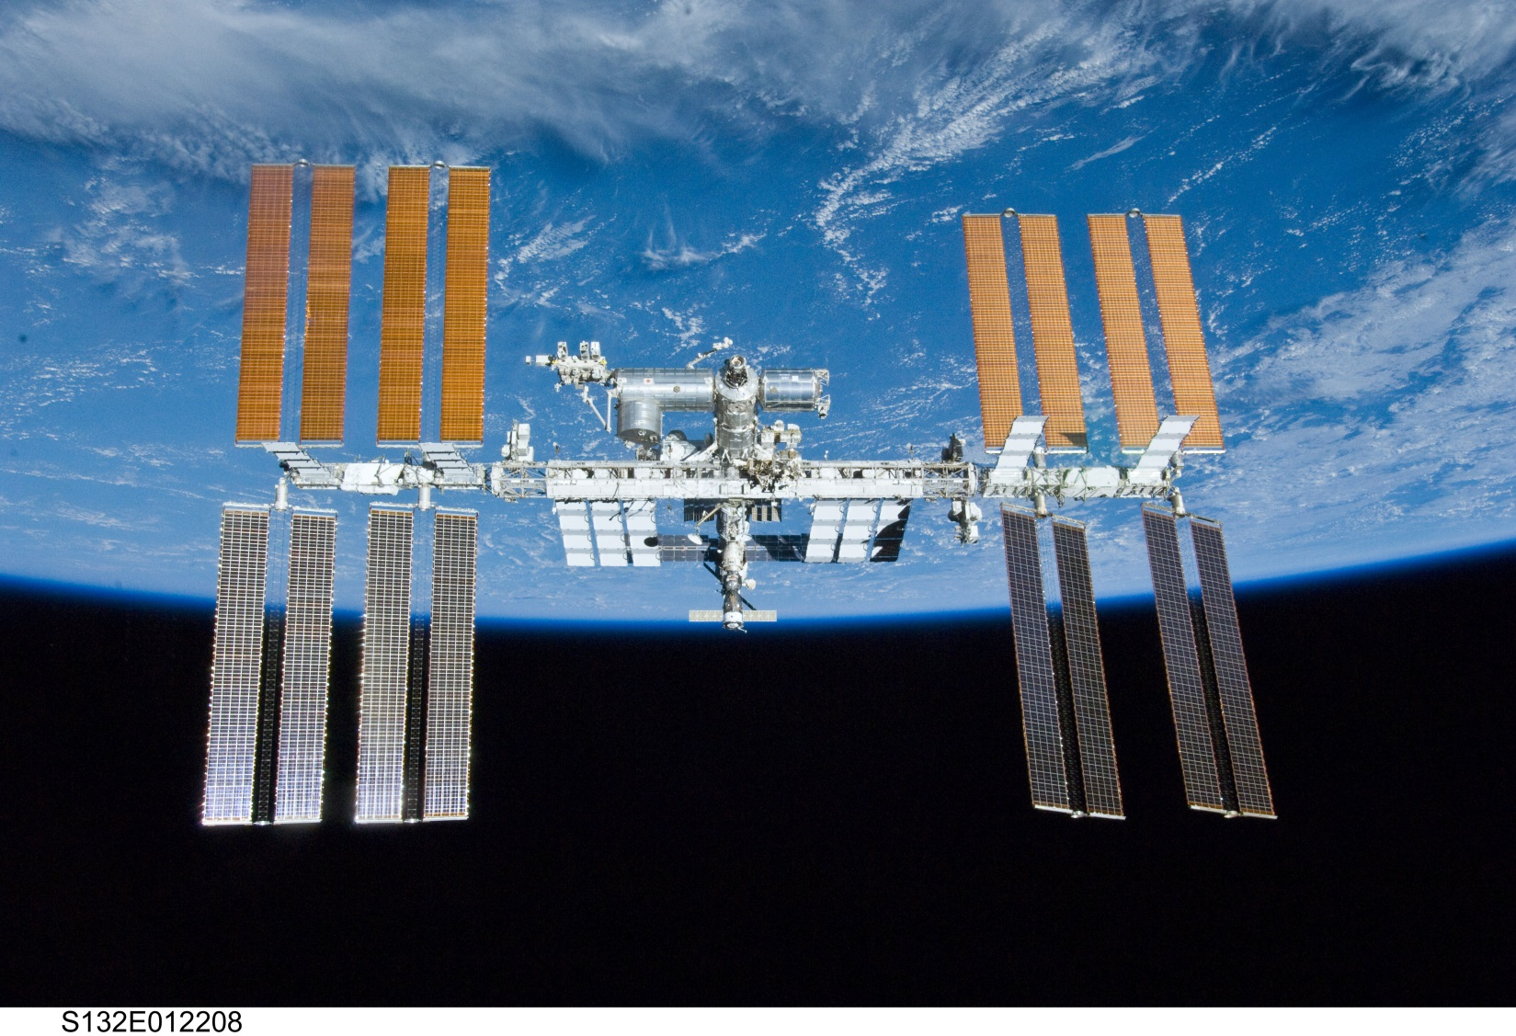
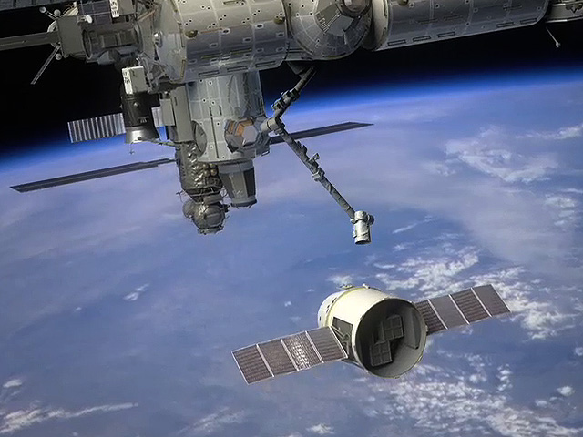
Space
Engineering is foundation for continued exploration

Slide 19
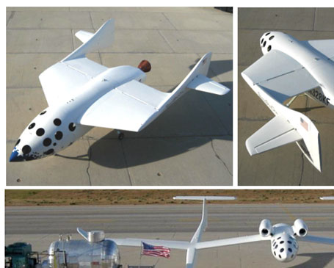
Space Competition
Competition Drives Accomplishment
Inspired by
Lindbergh crossing Atlantic to win a prize in 1927
US and Soviet Union (Russia) space race
X Prize Foundation series of competitions
Ansari XPRIZE
$10M to build and fly a three-passenger vehicle 100 km into space twice within two weeks.
Google Lunar XPRIZE
Northrop Grumman Lunar Lander X CHALLENGE

Slide 20
Aerospace Engineering
What’s next?
Apply science and math through engineering

Slide 21
References
Chapple, G. (Photographer) (2012). Space shuttle endeavour over hawthorne airport
Crouch, T. (2004). Wings. New York: W.W. Norton & Company.
Dalton, S. (1999). The Miracle of flight. Kingston, Ontario: Bookmakers Press Inc..
Garber, S. (2007). Sputnik and the dawn of the space age. Retrieved from http://history.nasa.gov/sputnik/
Grant, R.G. (2007). Flight: The complete history. New York: DK Publishing.
Library of Congress (1903). First flight. Retrieved from http://www.loc.gov/pictures/resource/ppprs.00626/

Slide 22
References
National Museum of the US Airforce (2008). Cv-22B arrival. Retrieved from http://www.nationalmuseum.af.mil/shared/media/photodb/photos/2013/12/131212-F-DW547-004.jpg
NASA (2004). Apollo 11 first footprint on the moon. Retrieved from http://www.nasa.gov/audience/forstudents/k-4/home/F_Apollo_11.html
NASA (1926). First flight of a liquid propellant rocket. Retrieved from http://grin.hq.nasa.gov/ABSTRACTS/GPN-2002-000132.html

Slide 23
References
NASA (2009). First generation x-1. Retrieved from http://www.nasa.gov/centers/dryden/news/FactSheets/FS-085-DFRC.html#.UuLVDhAo5pg
NASA (2014). Ideal rocket equations. Retrieved from http://exploration.grc.nasa.gov/education/rocket/rktpow.html
NASA Human Space Flight (2010). Shuttle sts-132. Retrieved from http://spaceflight.nasa.gov/gallery/images/shuttle/sts-132/hires/s132e012208.jpg
NASA (1974). Skylab and Earth Limb. http://dayton.hq.nasa.gov/IMAGES/LARGE/GPN-2000-001055.jpg

Slide 24
References
NASA. Sputnik and the dawn of the space age. http://history.nasa.gov/sputnik/
NASA Marshall Space Flight Center History Office (2014). Chinese soldier launches fire arrow. Retrieved from http://history.msfc.nasa.gov/rocketry/03.html
NASA Marshall Space Flight Center History Office (2014). Tsiolkovsk rocket designs. Retrieved from http://history.msfc.nasa.gov/rocketry/03.html
National Museum of the US Air Force (2008). Boeing y1b-17 in flight. Retrieved from http://www.nationalmuseum.af.mil/shared/media/photodb/photos/060512-F-1234S-008.jpg

Slide 25
References
National Museum of the US Air Force. Sputnik 1. Retrieved from http://www.nationalmuseum.af.mil/shared/media/photodb/photos/070308-F-1234S-001.jpg
Presidential Library and Museum (2014). Historic speeches. Retrieved from http://www.jfklibrary.org/JFK/Historic-Speeches.aspx
Senson, B. and Ritter, J. (2011). Aerospace engineering: from the ground up. Clifton Park, NY: Delmar, Cengage Learning.
Scaled Composites, LLC (2011). About us. Retrieved from www.scaled.com

Slide 26
References
SpaceX Exploration Technologies (2011). Company. Retrieved from www.spacex.com
Wikimedia (2006). A basic flexible-wing glider flying over the alps. Retrieved from http://en.wikipedia.org/wiki/File:Hg_winter_2006.jpg
Wikimedia (2009). Leonardo da Vinci helicopter and lifting wing. Retrieved from hhttp://commons.wikimedia.org/wiki/File:Leonardo_da_Vinci_helicopter_and_lifting_wing.jpg
Wikipedia (2005). Design for a Flying Machine. Retrieved from http://en.wikipedia.org/wiki/File:Design_for_a_Flying_Machine.jpg

Slide 27
References
Wikipedia (2012). Douglas dc-3 of aigle azur. Retrieved from http://en.wikipedia.org/wiki/File:Douglas_DC-3_Aigle_Azur_Palas_Jet_1953.jpg
Wikipedia (2007). Early flight. Retrieved from http://en.wikipedia.org/wiki/File:Early_flight_02562u_(2).jpg
Wikipedia (2009). Leonardo flying machine. Retrieved from http://en.wikipedia.org/wiki/File:Leonardo_flying_machine.JPG
Wikipedia (2007). R-4 ac hns1 3 300. Retrieved from http://en.wikipedia.org/wiki/File:R-4_AC_HNS1_3_300.jpg

Slide 28
References
Wikipedia (2006). Spirit of st. louis. Retrieved from http://en.wikipedia.org/wiki/File:Spirit_of_St._Louis.jpg
Wikimedia (2012). Boeing 787 first flight. Retrieved from http://en.wikipedia.org/wiki/File:Boeing_787_first_flight.jpg
United States Coast Guard (2013). Advanced helicopter rescue school. Retrieved from http://www.uscg.mil/d13/sectcolrvr/otherAstUnits/advhelorescueschool.asp
X Prize Foundation. (n.d.). Retrieved from http://www.xprize.org/

